Slide 1
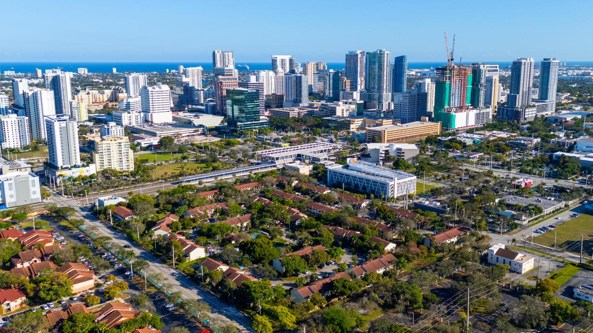
CITY OF
FORT LAUDERDALE
Parks Bond Program Funding Updates
April 22, 2026

Slide 2
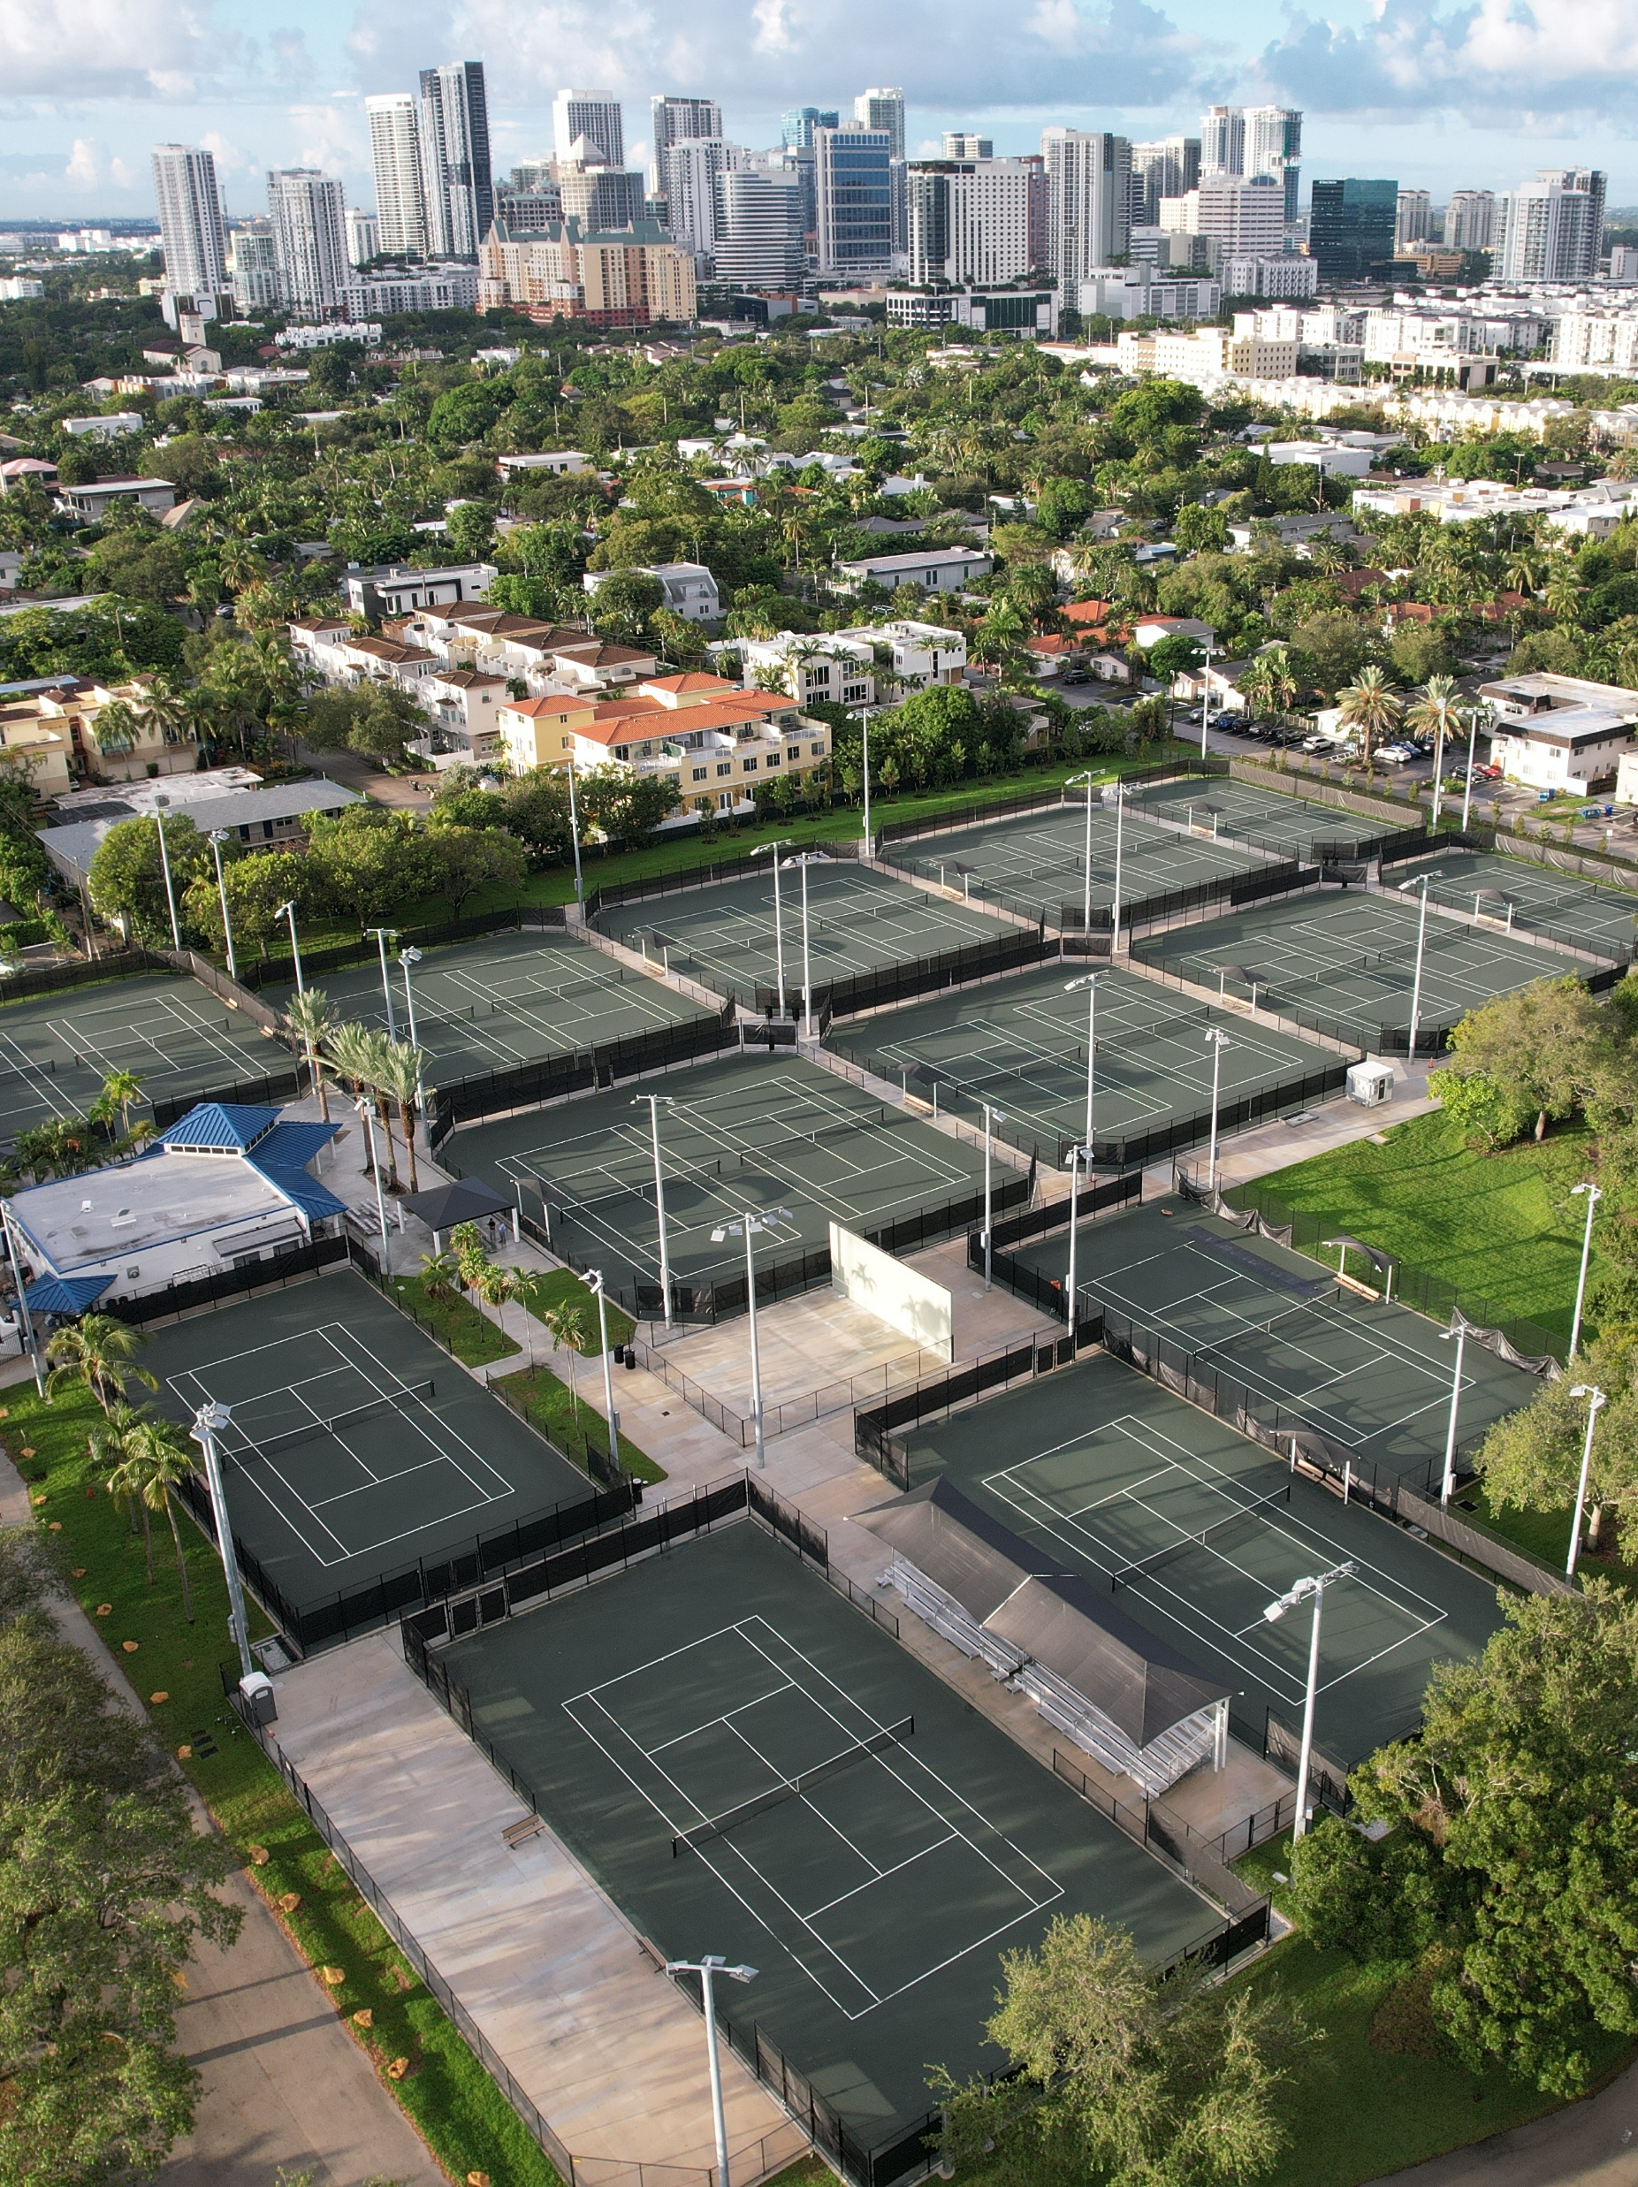
  Parks Bond:
  Project Funding Update
Work on the Parks Bond projects has progressed through the release of One Hundred Twenty-Nine Million Six Hundred Fifty Thousand dollars ($129,650,00.00) across two tranches.
In assessing the status of the Parks Bond Projects, staff have identified execution and funding challenges. Some projects have been phased to expedite scopes of work where possible, while scheduling additional time for scopes requiring additional design, permitting, and/or funding.
The 2016 Parks Master Plan identified funding allocations for each project listed in the Parks Bond.
However, these allocations, in addition to covering hard construction costs, need to cover soft costs. Such as architectural/engineering services, permits, site assessment, testing & program management fees.
Other impacts, such as cost escalations due to inflation, fluctuating market conditions, or stakeholder priorities, significantly reduces the available balance for construction.
A budget amendment is scheduled for consideration at the May 5, 2026, City Commission meeting to address immediate funding shortfalls on four projects, using available Reginal and District Park Impact Funds at Warfield Park, Osswald Park, Snyder Park and Floyd Hull Park.
Further details are provided on subsequent slides, and Staff are continually evaluating potential budget shortfalls which will be shared routinely with the Parks, Recreation and Beaches Advisory Board.

Slide 3
  Parks Bond:
  Project Funding Update
Appropriation from Fund Balance – Park Impact Fee Fund - District 2 - Warfield Park –
$200,000.00
Warfield Park is currently under construction.
The contractor has submitted a series of change order requests to perform additional scopes of work identified during construction and changes requested by permitting agencies after the procurement process for a contractor was initiated. The project contingency has been depleted, and additional funding is required to advance the remaining scopes of work.
If approved by the City Commission, the total project budget for Warfield Park will increase to $1,785,000.
Appropriation from Fund Balance – Regional Park Impact Fee Fund - District 3 - Osswald Park - $1,397,082.00
Design and permitting for Osswald Park have been completed.
The design consultant has submitted an estimated construction cost, which when combined with the Owner’s Contingency and project soft costs, exceeds the project budget by $1,397,082.00.
Staff have identified, Regional Park Impact Fees which can be used to address the shortfall and enable staff to advance the project to the bidding and procurement stage.
If approved by the City Commission, the total project budget for Osswald Park will increase to $4,581,082.

Slide 4
  Parks Bond:
  Project Funding Update
Appropriation from Fund Balance – Park Impact Fee Fund - District 4 - Snyder Park –
$611,230.00
Staff are negotiating with the design consultant to initiate the design and permitting for Snyder Park. The proposal received exceeds the available funds by $611,230.00.
Upon approval of the additional funding, staff shall finalize approval of the contract for design services and initiate the design and permitting phase required to accomplish the scheduled start of construction in FY 2028 as indicated in the Implementation plan.
If approved by the City Commission, the total project budget for Snyder Park will increase to $7,224,230.
Appropriation from Fund Balance – Park Impact Fee Fund - District 4 - Floyd Hull Stadium –
$77,588.00
The design for Floyd Hull Park is in process. During the analysis of the existing site and buildings the consultant identified additional environmental and structural analysis required to advance the project design and provided a proposal for these services.
The proposal received exceeds the available funds by $77,588.00. Upon approval of the additional funding, staff will fund the proposal to the consultant to proceed with the additional evaluations required to complete design and permitting phase required to accomplish the scheduled start of construction in FY 2028 as indicated in the Implementation plan.
If approved by the City Commission, the total project budget for Floyd Hull Stadium will increase to $6,492,338.

Slide 5
CITY OF
FORT LAUDERDALE
QUESTIONS?

