Slide 1
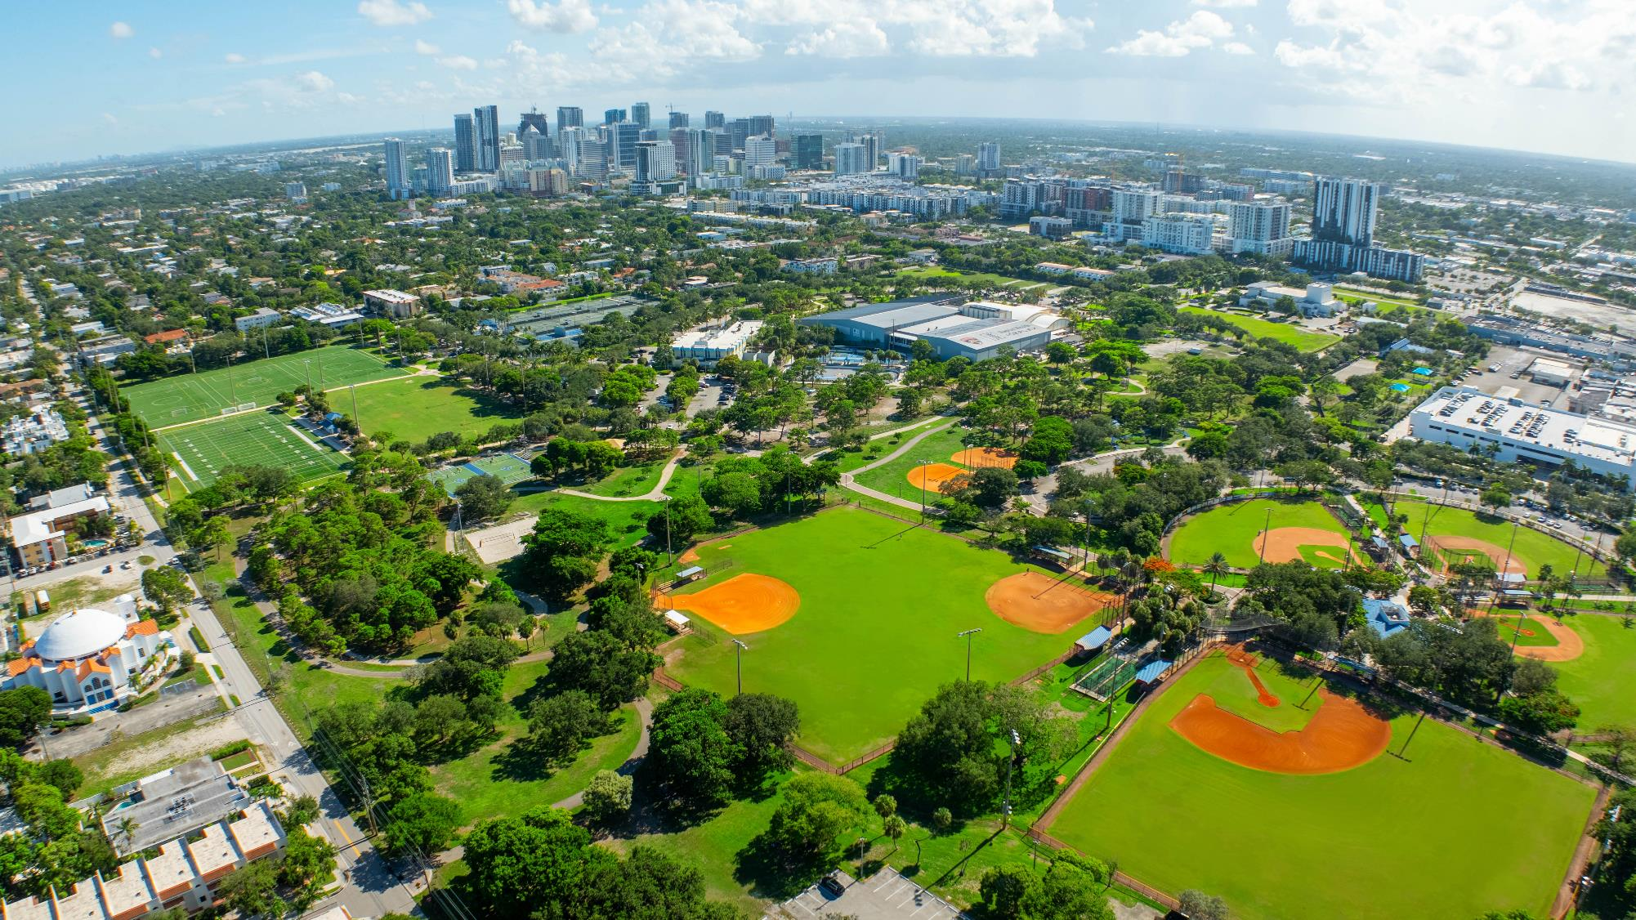
CITY OF
FORT LAUDERDALE
Parks Division

Slide 2
Our Collaborative Team
Mark Almy
Parks Operations Superintendent
Robert Dexter
Parks Manager
Kim Pearson
Parks Manager
Marty Zidtowecki
Urban Landscape Designer
CITY OF
FORT
LAUDERDALE

Slide 3
Parks Division Overview
*120 Fort Lauderdale Parks
*800 total acres
*4 Districts/Managers
*8 District Supervisors
*110 Frontline Staff

Slide 4
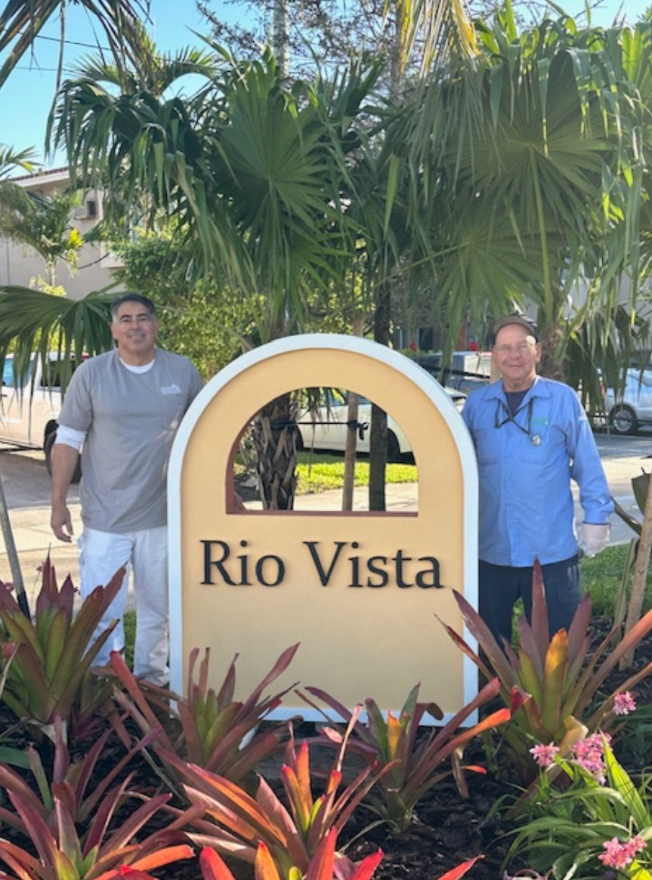
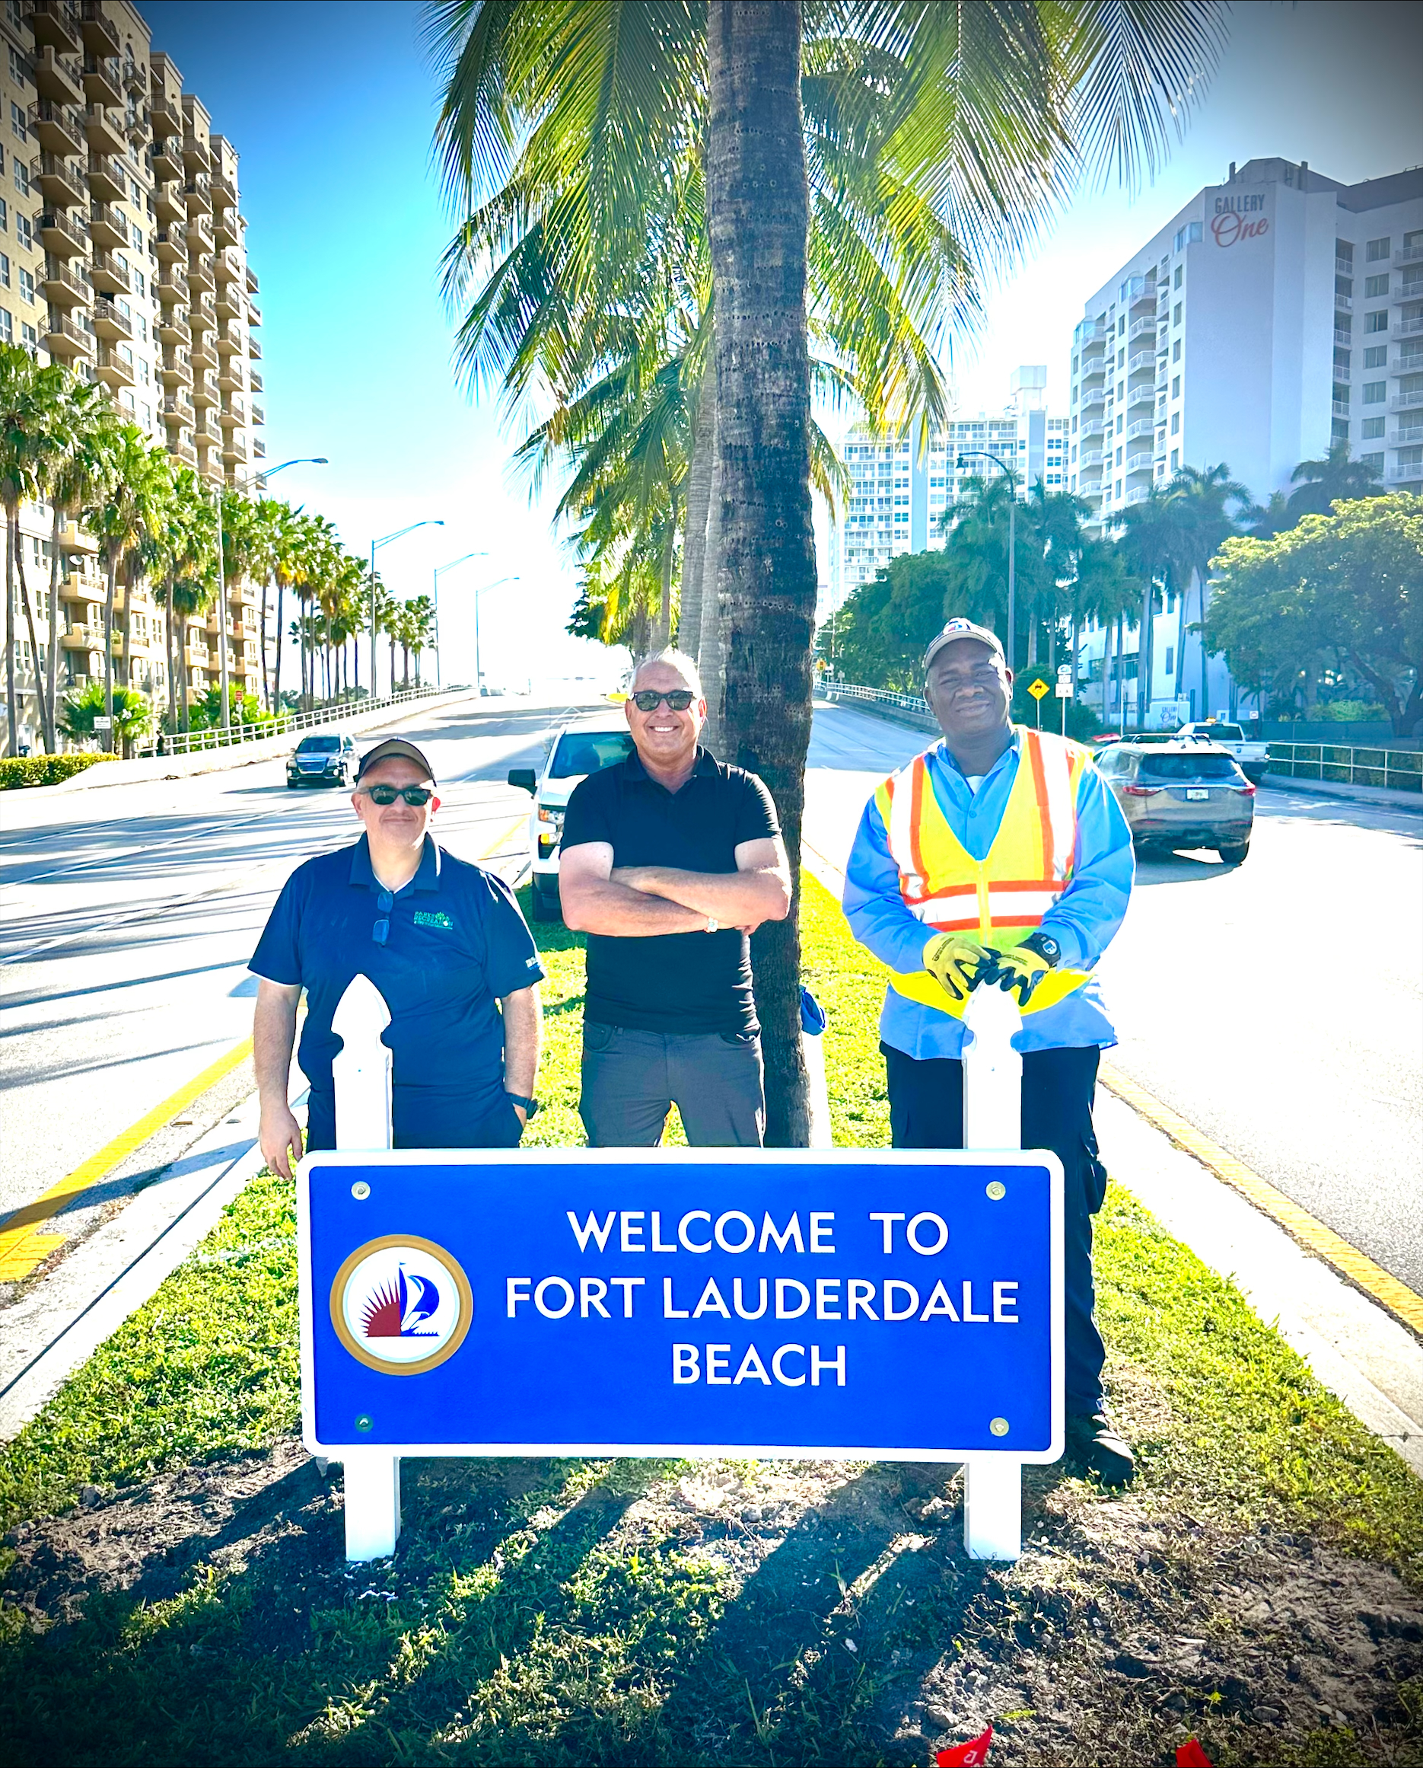
What We Do Every Day
Entryway Maintenance

Slide 5
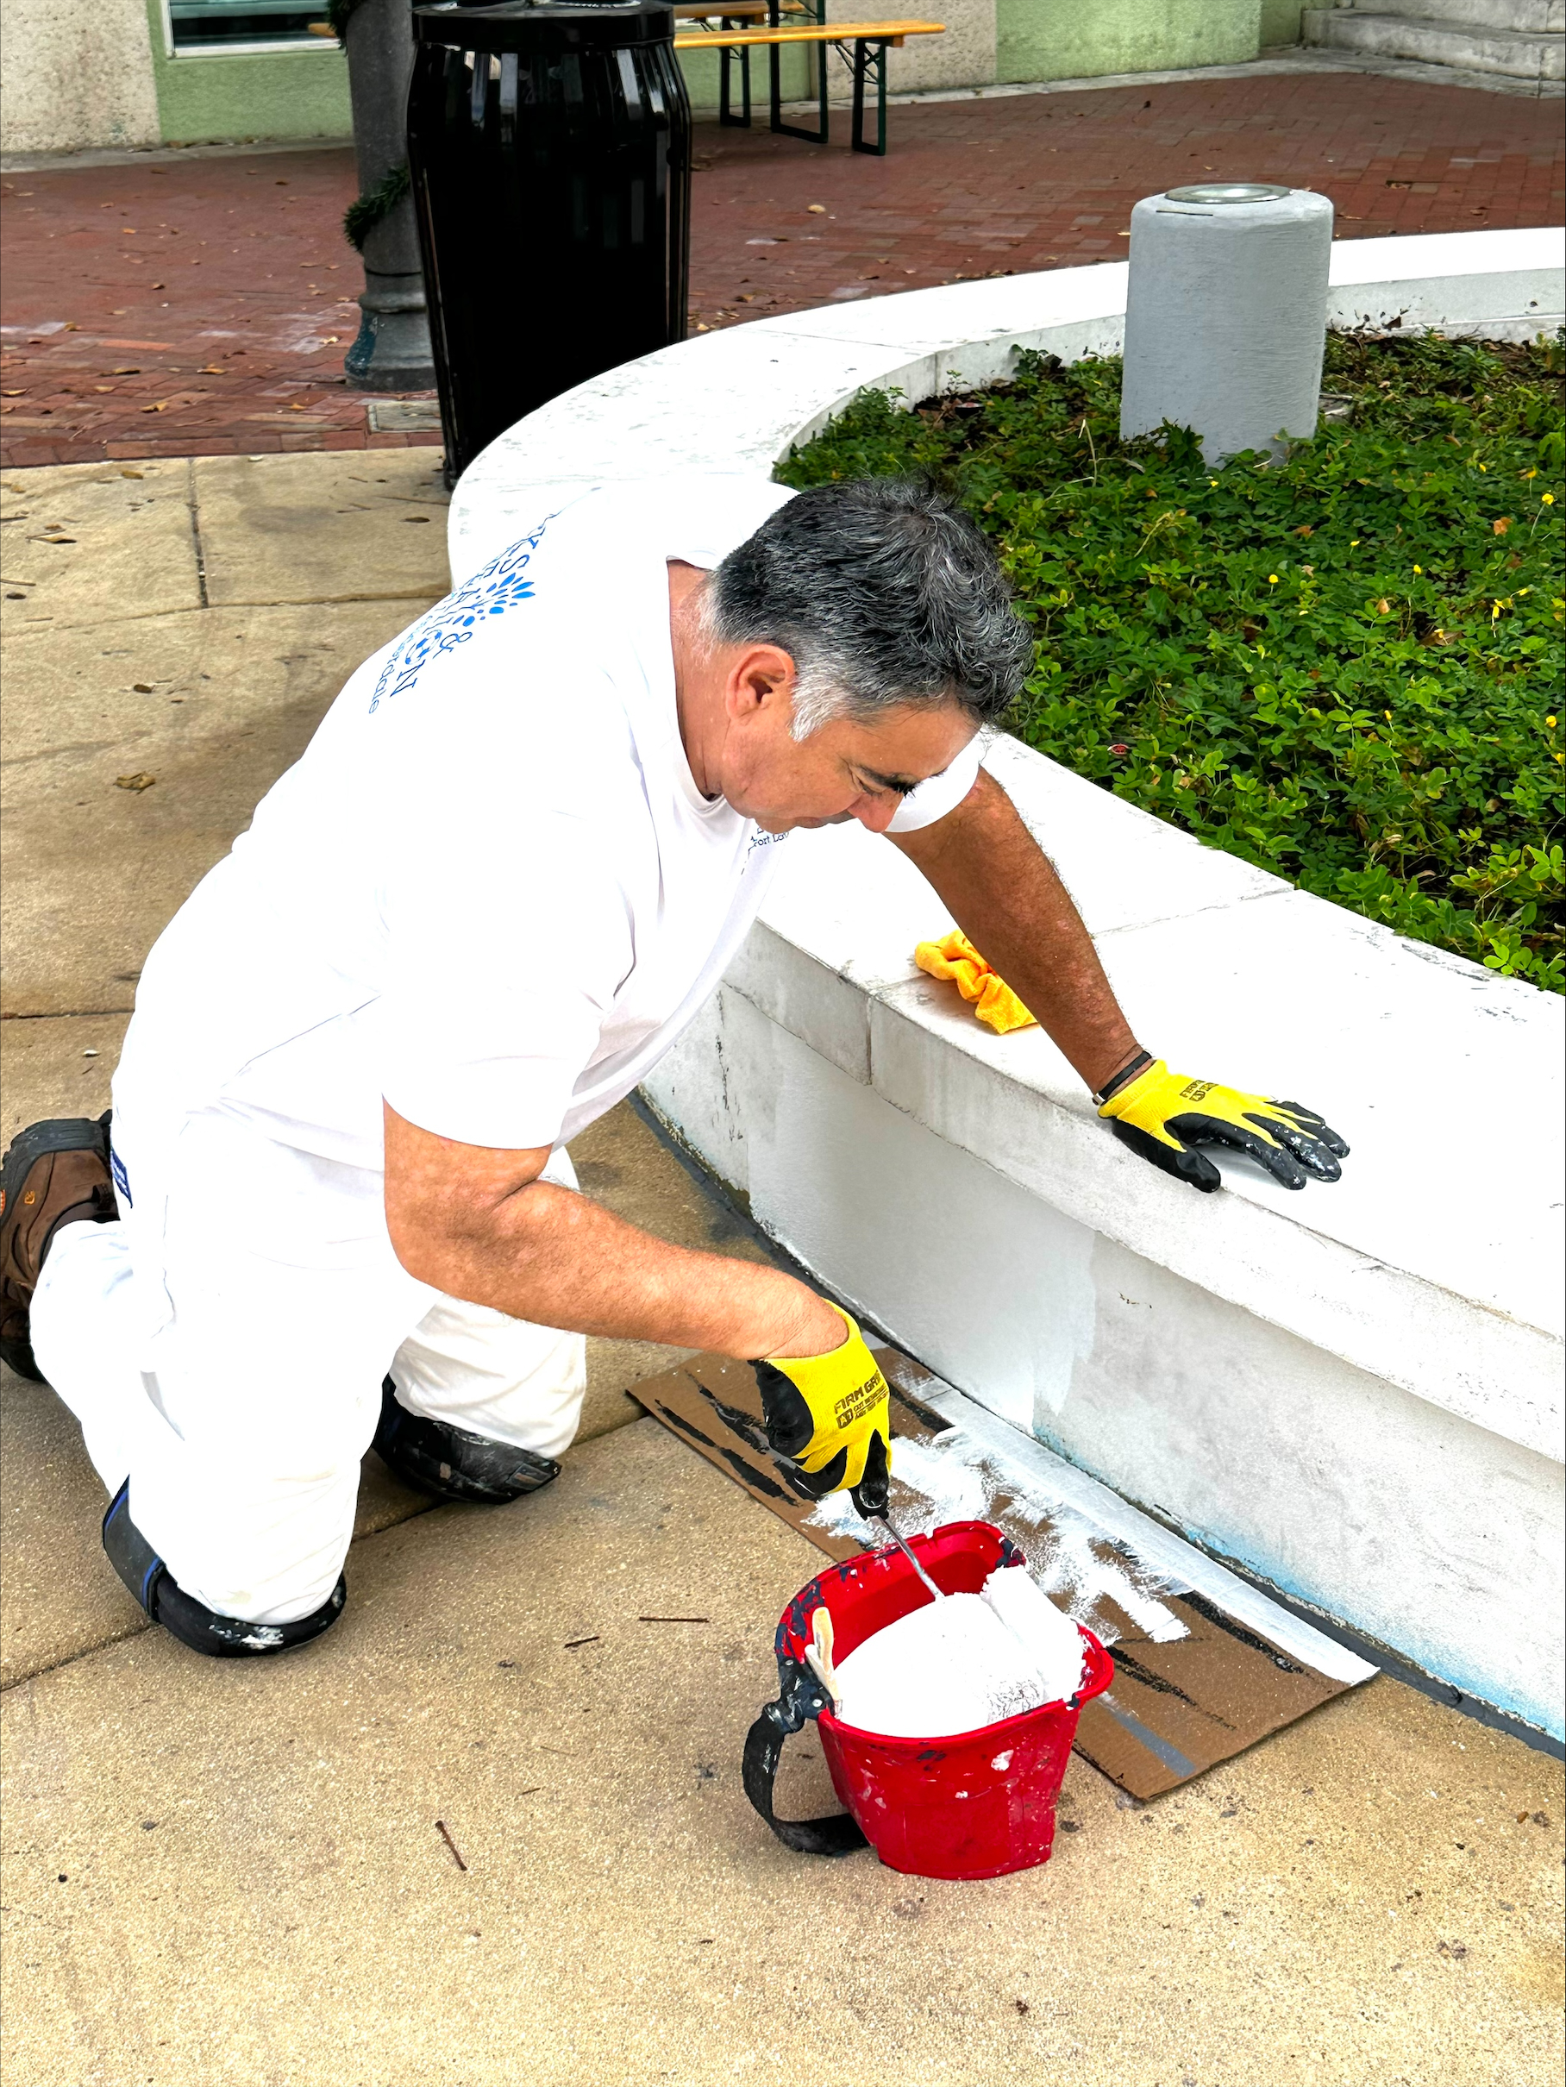
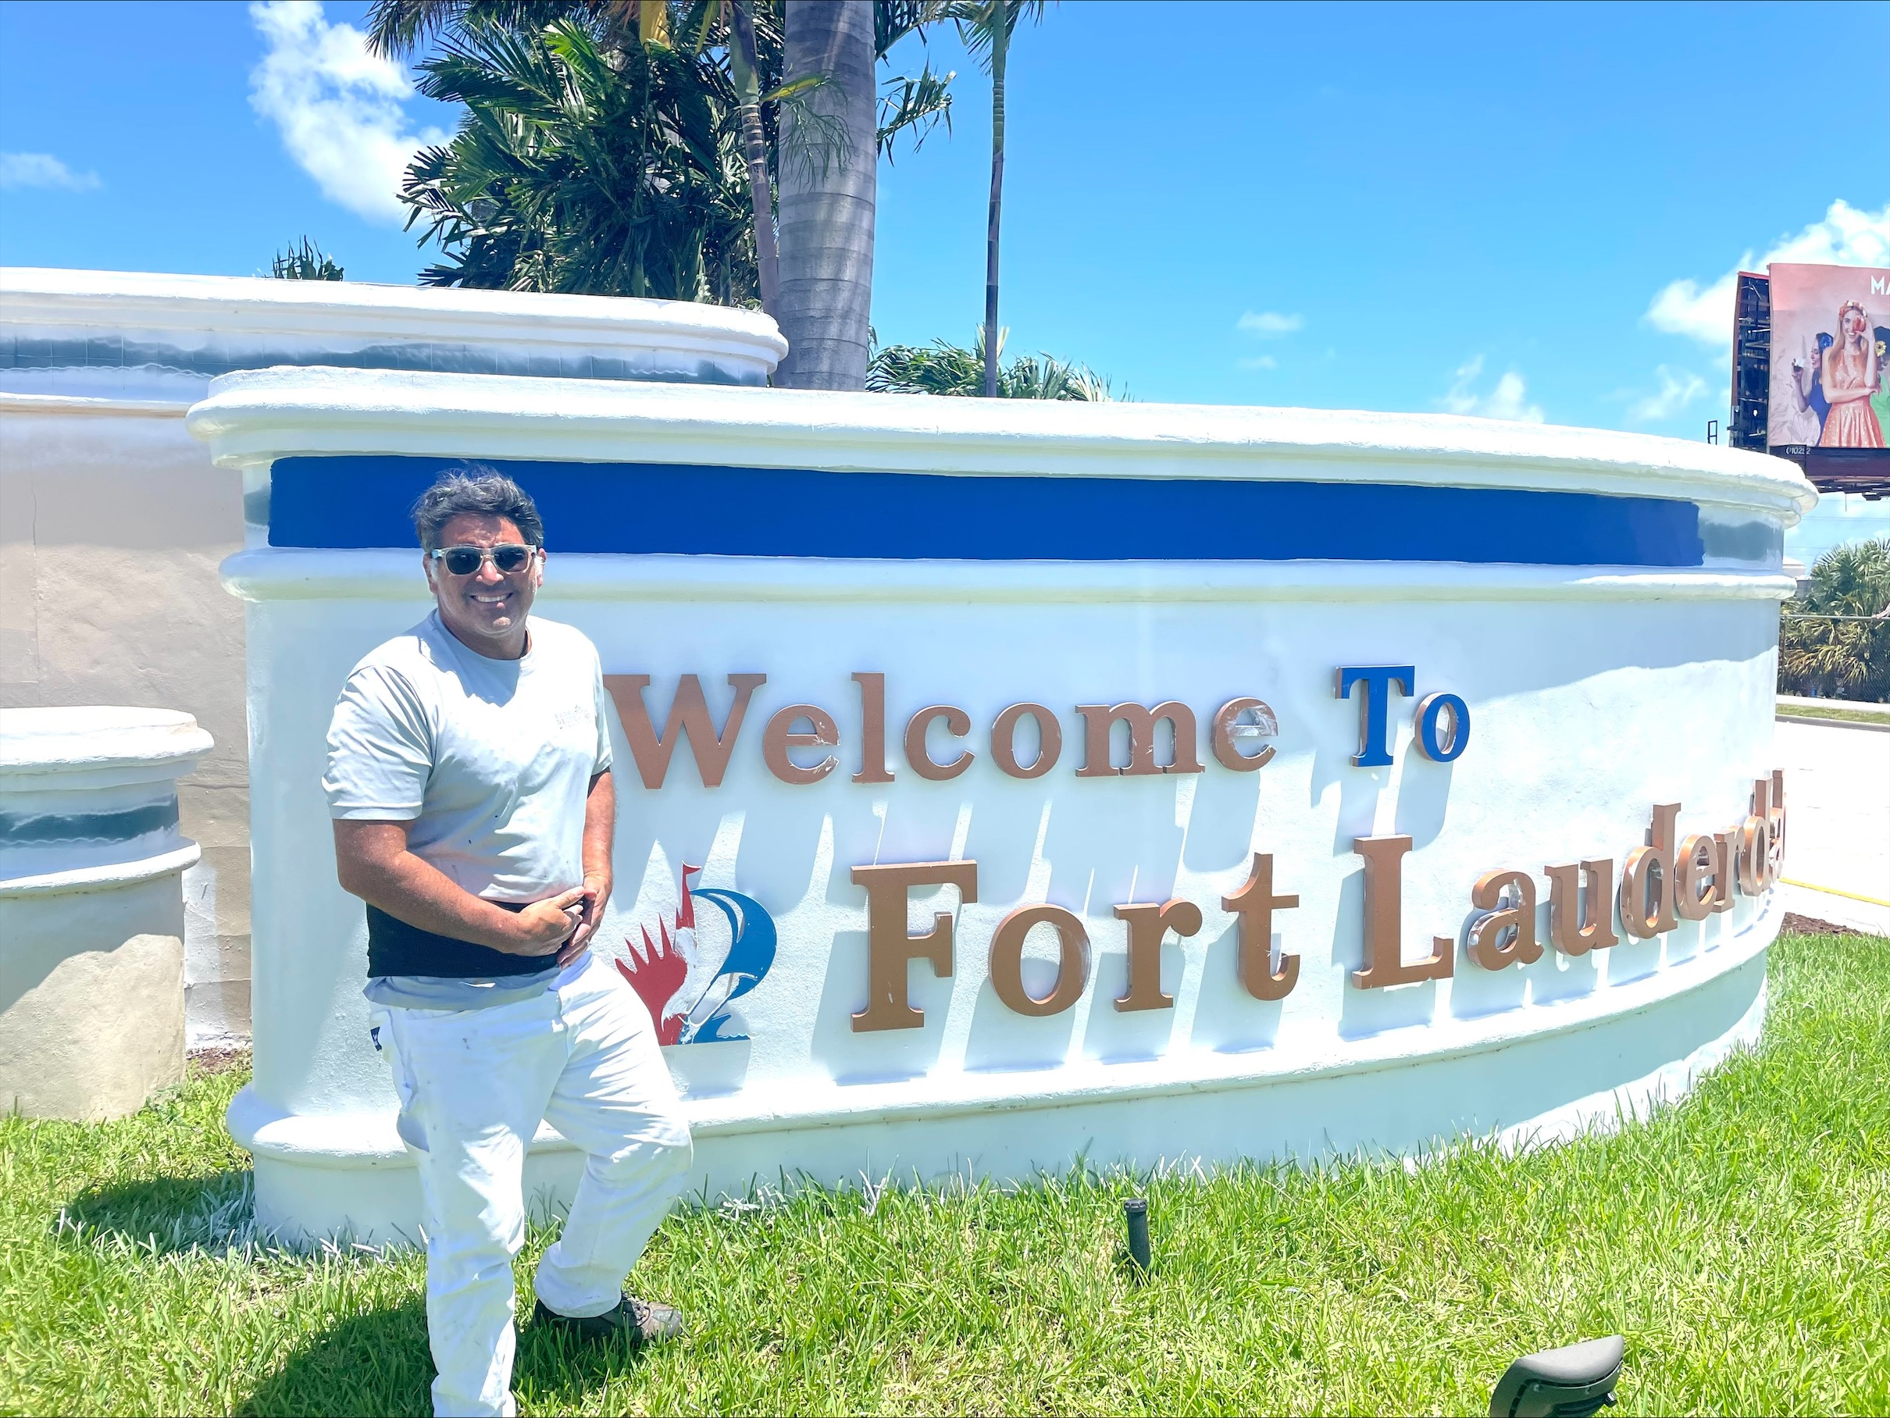
Painting Park Structures

Slide 6
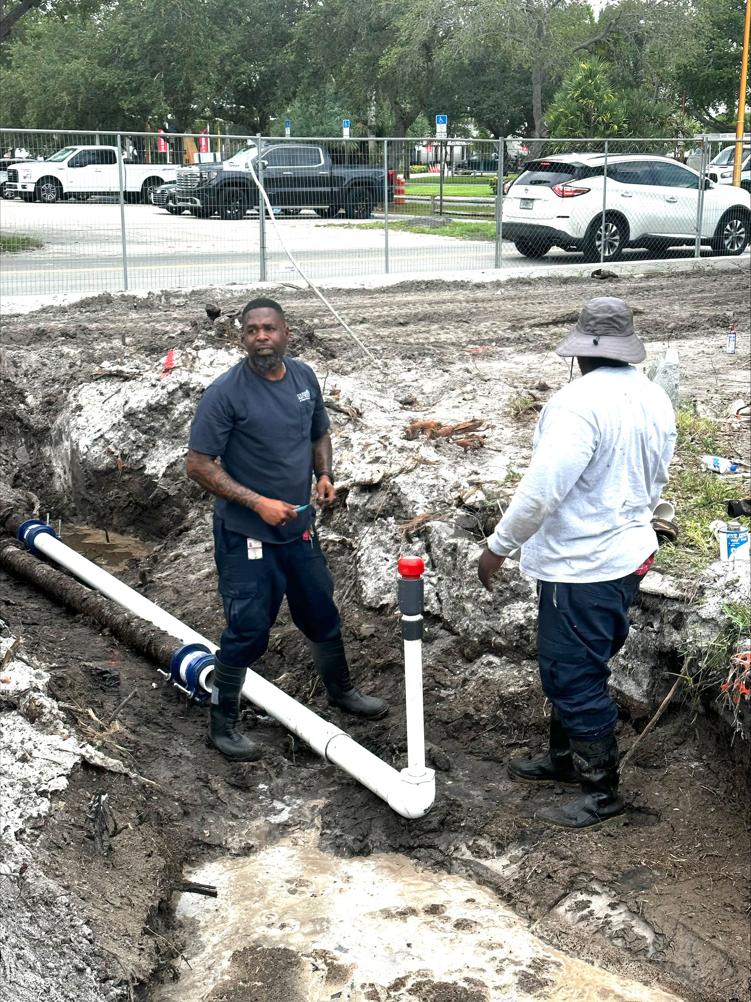
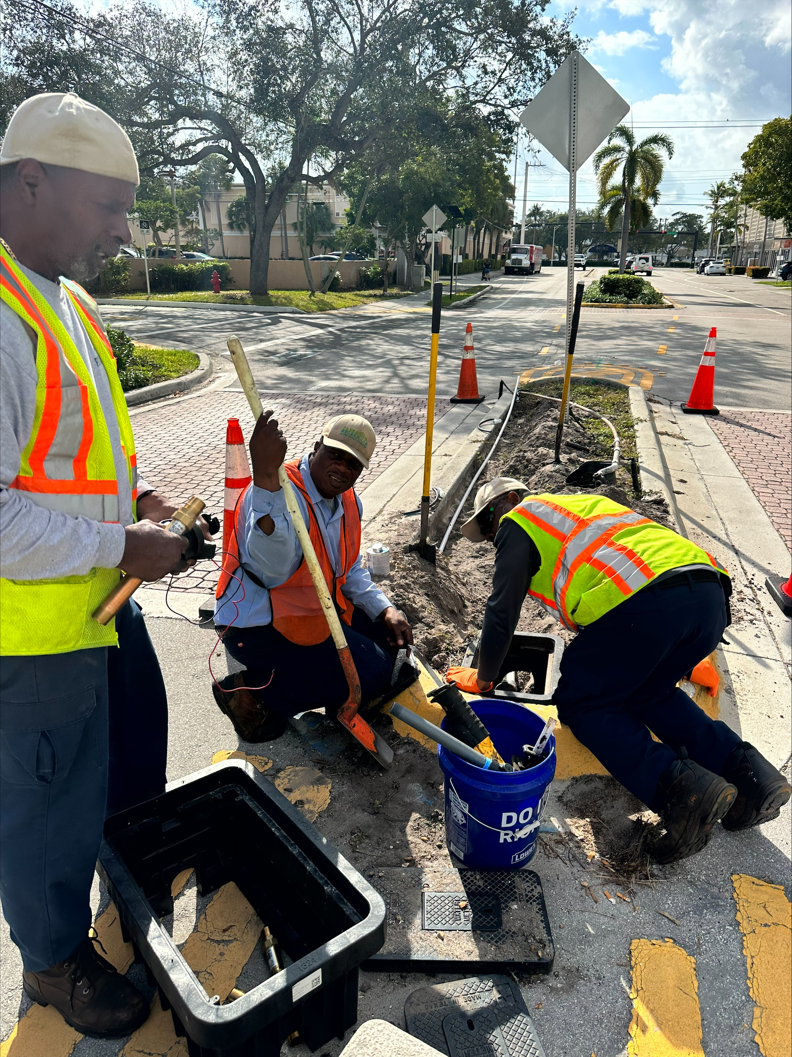
Irrigation Installation & Repair
Half of our Parks are Weather Trak Ready

Slide 7
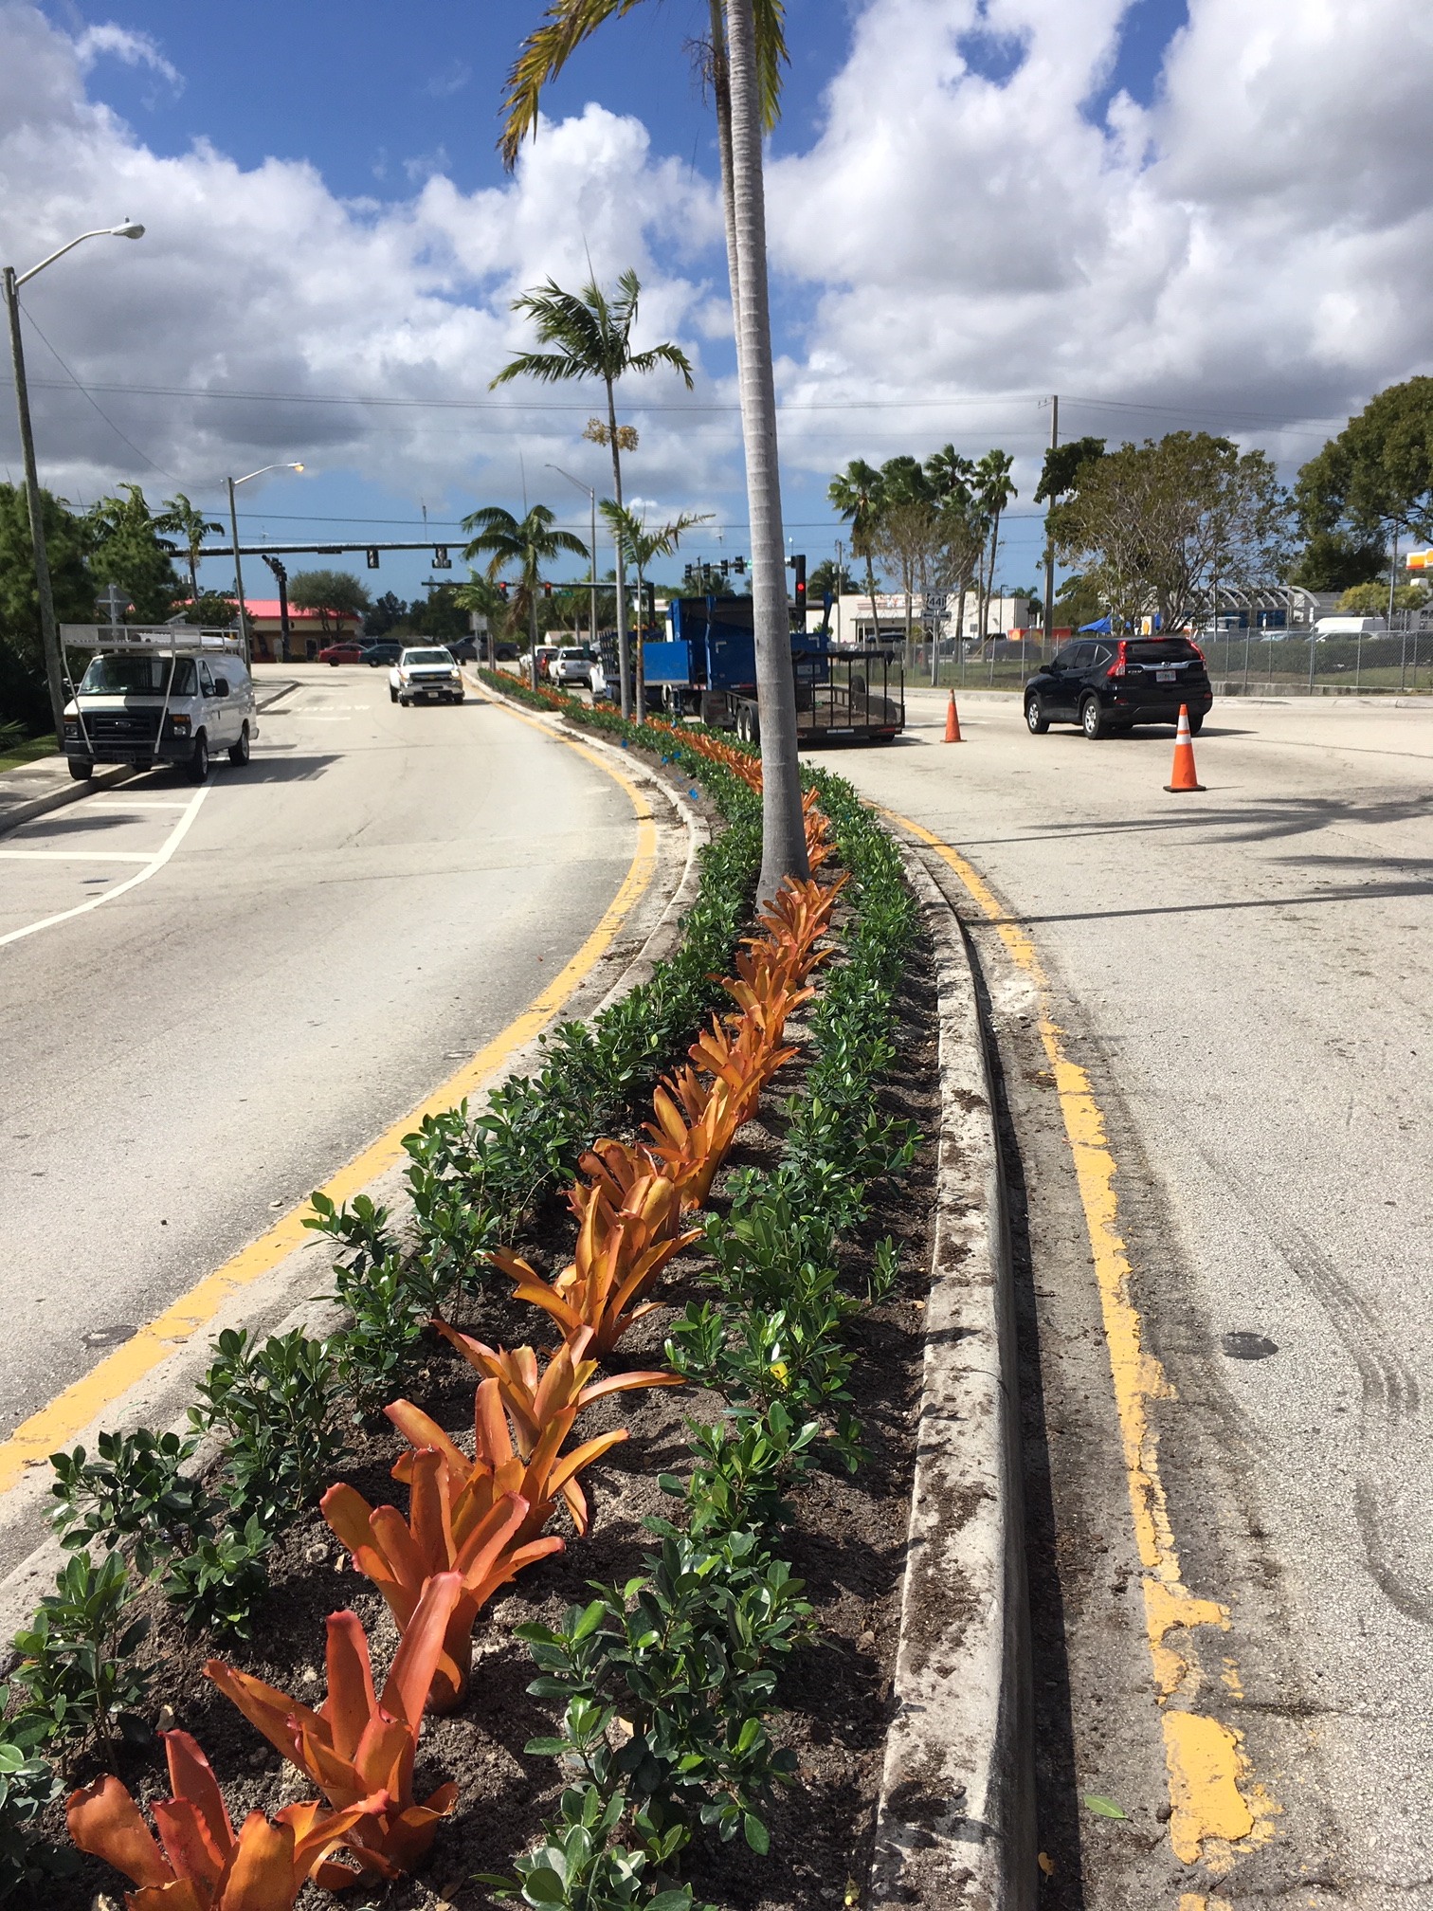
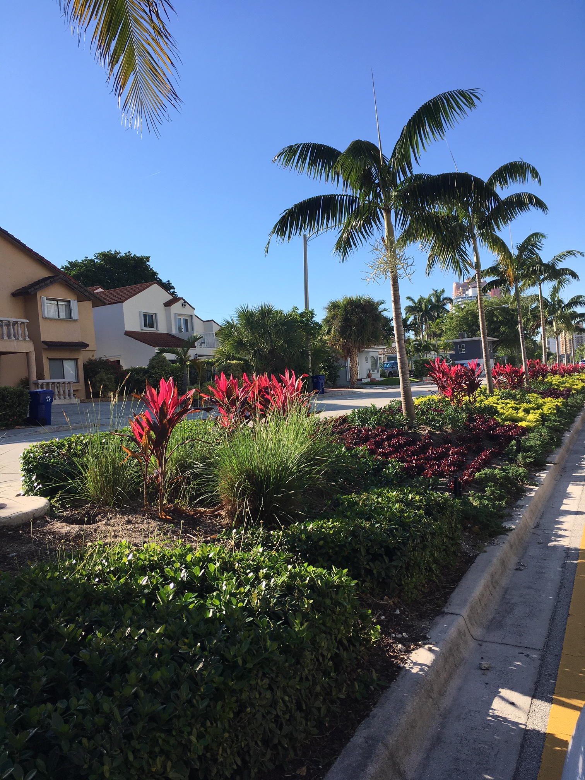
Median Renovation

Slide 8

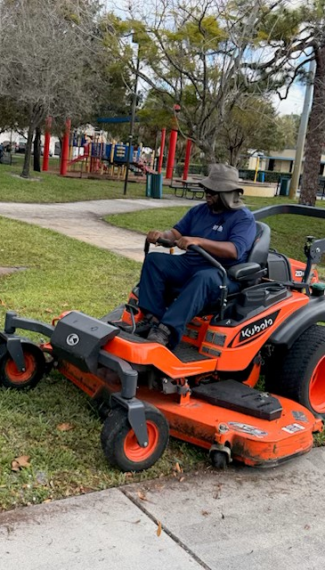
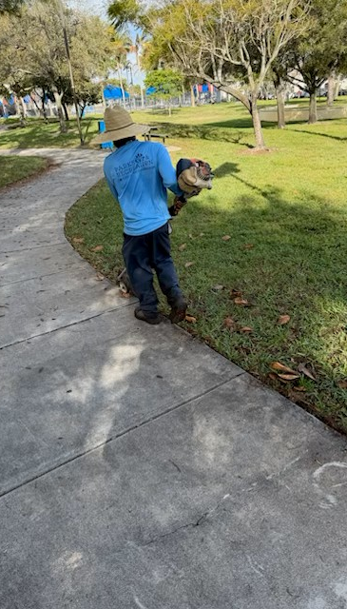
Mowing, edging and hedge trimming are done in-house

Slide 9
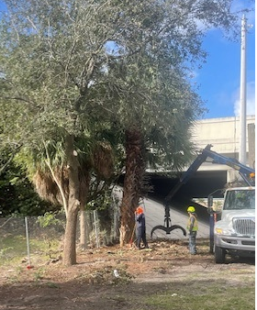
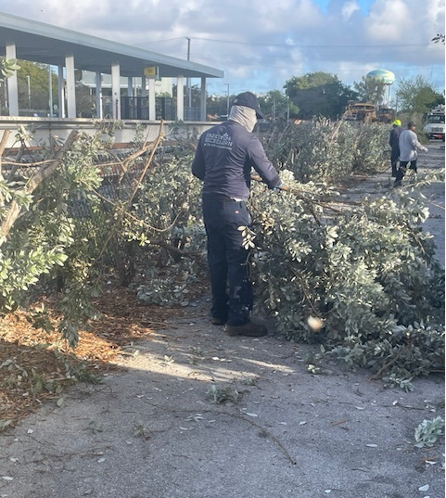
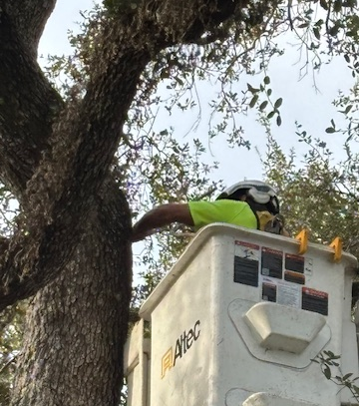
Tree Trimming Crew

Slide 10
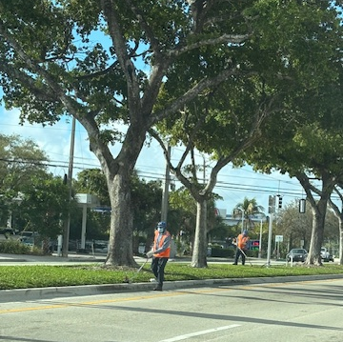
Median Maintenance- Contracted Service
1 Contract Administrator (City)
2 Administration Staff (City)
2 Inspectors (City)

Slide 11
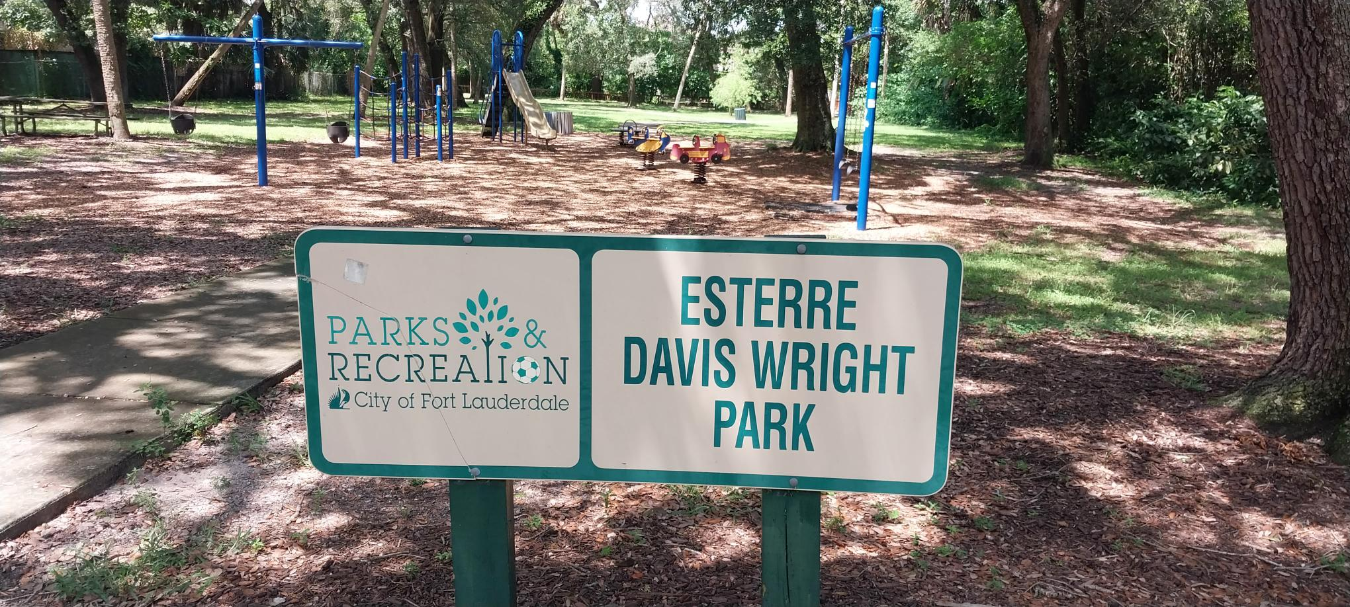
Park Inspections and Park Audits

Slide 12
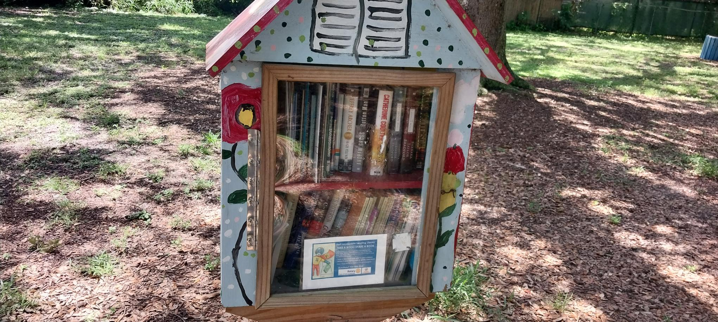
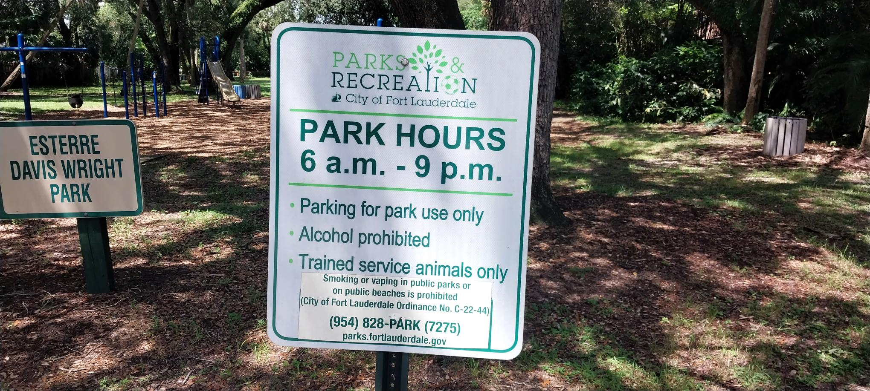
Little Library must be clean, dry and full
Park signs must be clean and legible

Slide 13
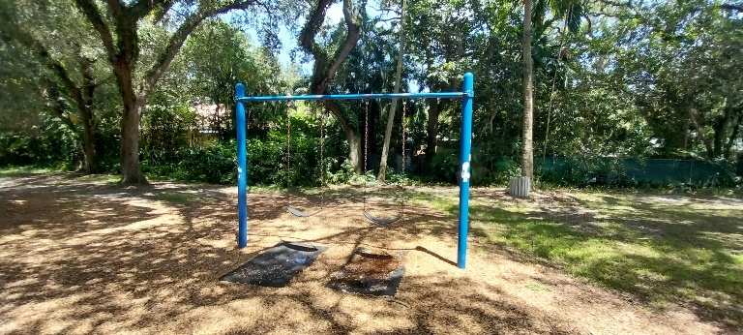
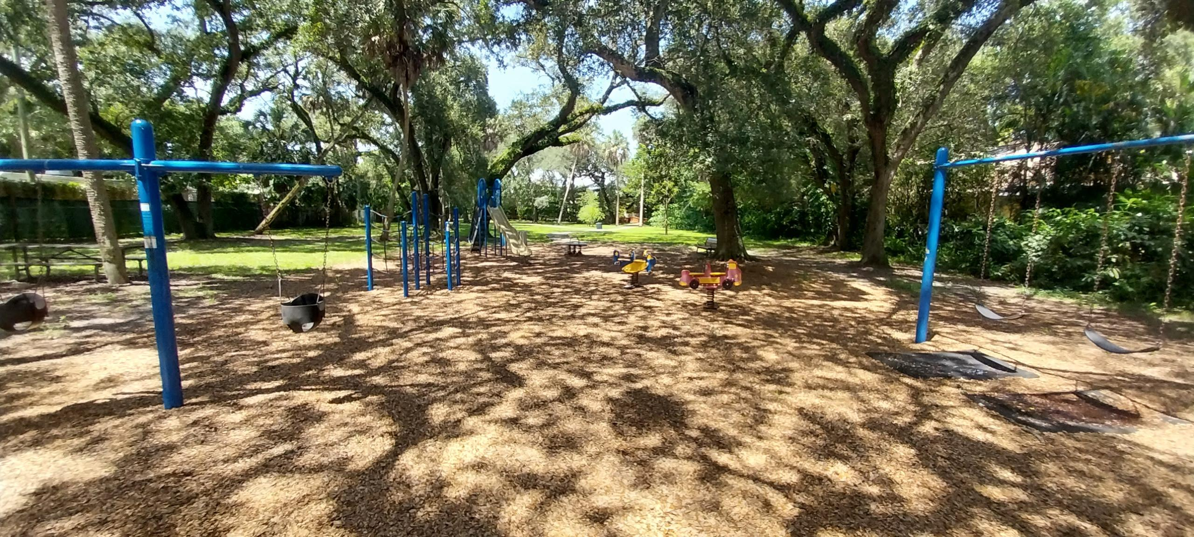
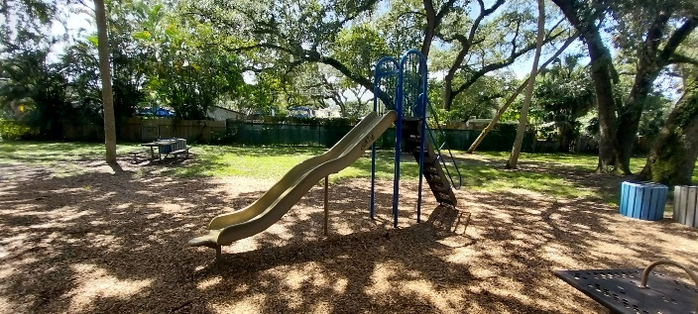
Playground Area
Proper amount of mulch
Clean and very well maintained

Slide 14
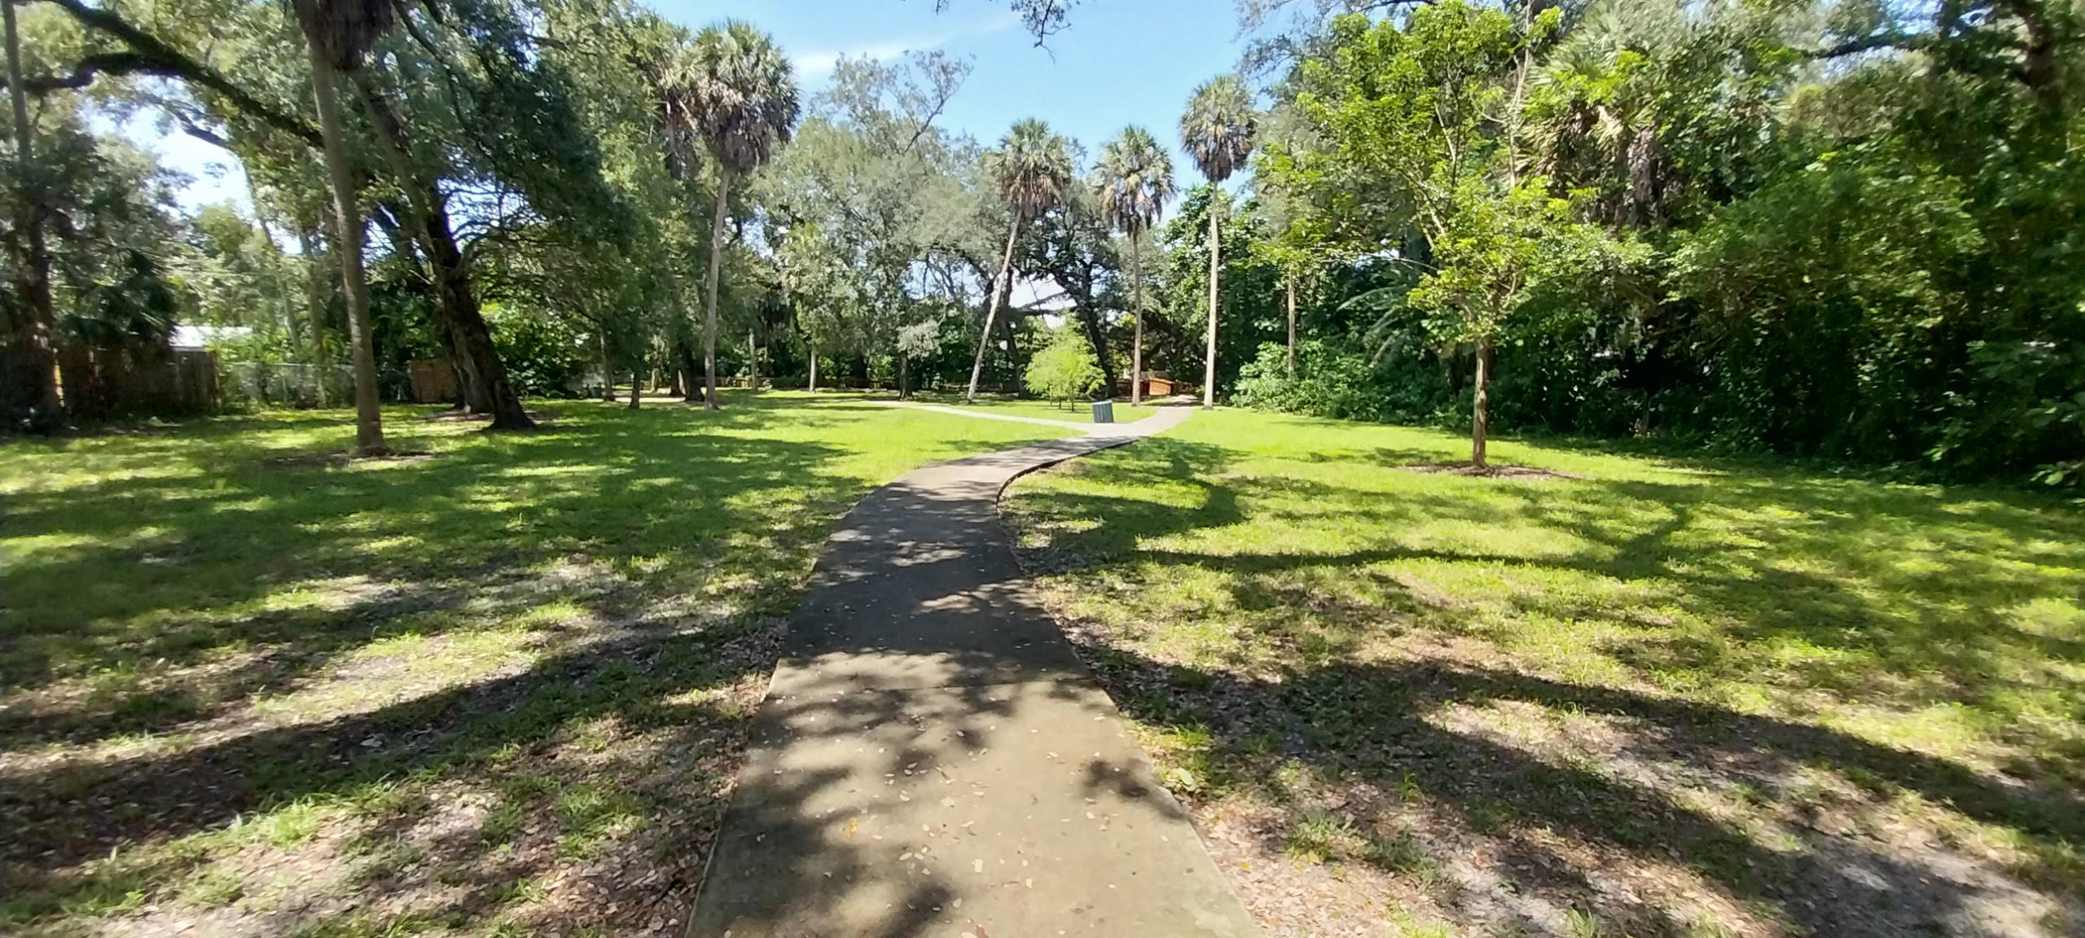
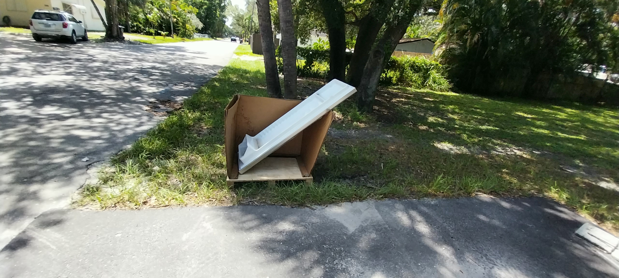
Ensure open spaces are well-maintained, clean and inviting.
Parks staff also remove dumped trash from the swale.

Slide 15
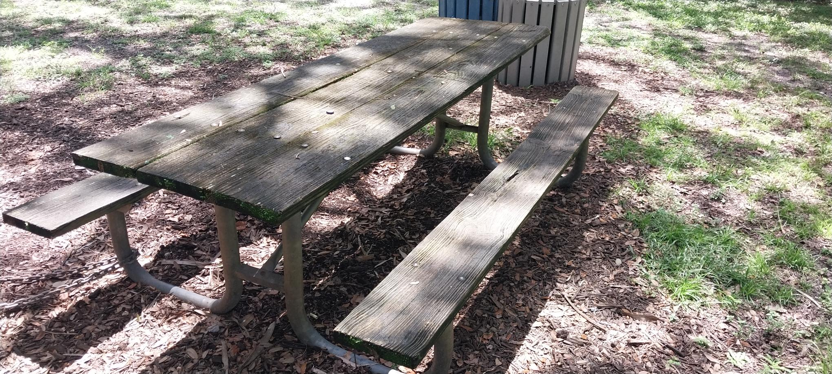
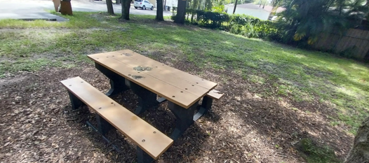
Maintain picnic tables clean and graffiti-free

Slide 16
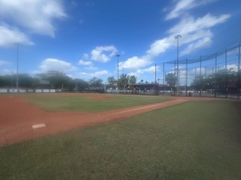
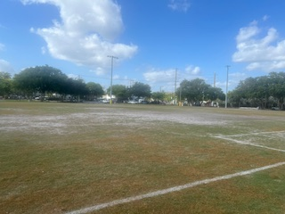
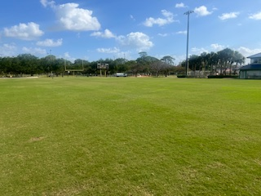
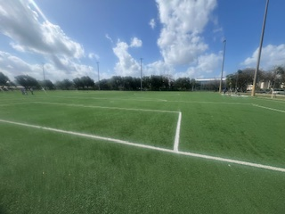
Ballfield Maintenance
Field with heavy open play
With staff expertise we can bring these field back
Synthetic fields are important possibility in the future

Slide 17
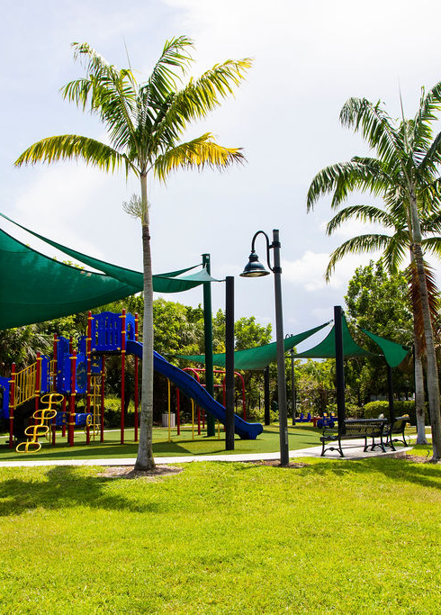
Questions
CITY OF
FORT
LAUDERDALE
Mark Almy, Parks Operations Superintendent, malmy@fortlauderdale.gov
Robert Dexter, Parks Manager, rdexter@fortlauderdale.gov
Kim Pearson, Parks Manager, kpearson@fortlauderdale.gov
Martin Zidtowecki, Urban Landscape Designer, mzidtowecki@fortlauderdale.gov

