Slide 1
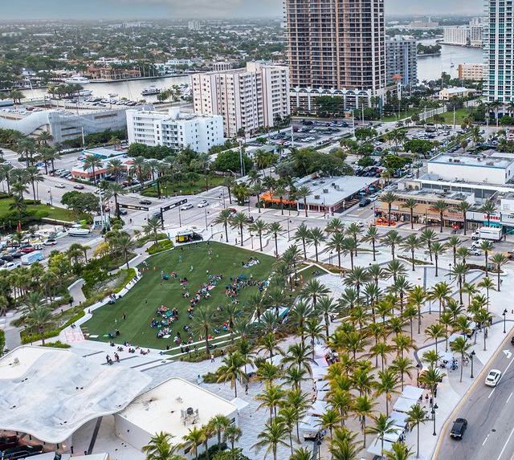

Park Rangers at the LOOP

Slide 2
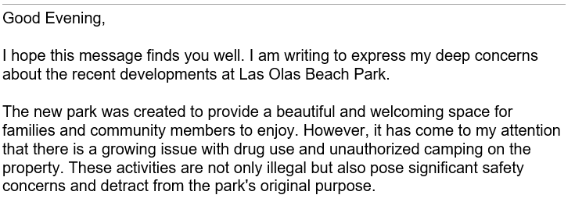
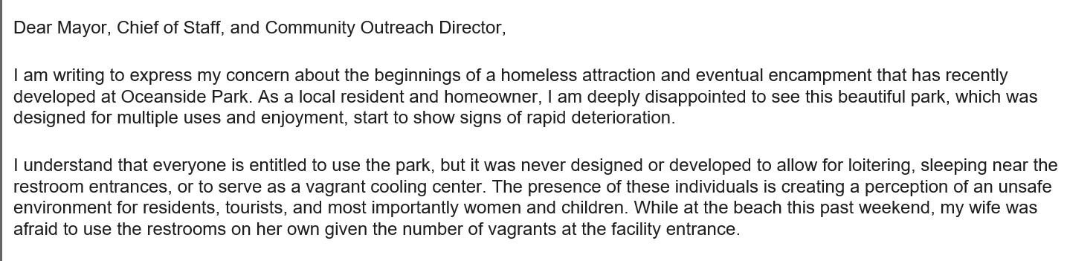

Neighbors and Visitors Concerns

Slide 3



Level of Service
Police
Police presence with beach/park sweeps starts early AM
Homeless Outreach Officers perform daily checks
Homeless Outreach Team (HOT) offices located at the Loop
Homelessness
Park Rangers and HOT are enforcing park rules
(i.e., no laying around, no open containers, no tents)
Homeless individuals' visibility does not equate to crimes
Cleanliness
Private company starts cleaning by 5:00 AM
Three cleanings per day on weekdays and six cleanings per day on weekends

Slide 4

Request
Request: Funding for Park Rangers to be designated to the park for eight hours a day, five days a week, for a duration of three months.
Amount: $15,000
Benefits:
Enhance the experience of neighbors and visitors at the LOOP
Increase visibility of park rangers onsite
Mitigate disruptive behavior from park patrons who may be blocking entrances to bathrooms, public indecency, and/or not utilizing park space for its intended use

