Slide 1




joint use parks Initiative
Parks, Recreation & beaches advisory board
January 26, 2022
Proposal Review
Partnership between City of Fort Lauderdale & Broward County Public Schools

Slide 2
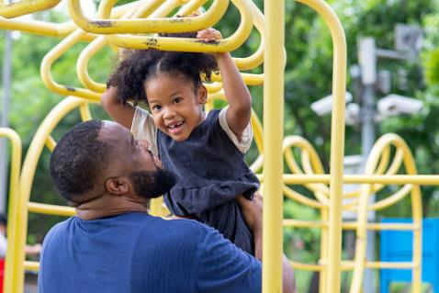

Maximize Return on Investment
of recreational improvements to School Board of Broward County (SBBC) properties.
Enhance Park System
Partner with SBBC to expand parks and recreational amenities, recognizing funding and land availability constraints.
Notes:
Image Source:-
https://pixabay.com/en/office-home-house-desk-chair-lamp-1078869/
https://pixabay.com/en/mountain-top-adventure-hiking-984083/

Slide 3
Revised Proposal
Bond List
Working Group
EAB Recommendation
Based on 2016 Master Plan
Based on Joint Use Criteria
With Working Group Input on Reductions
Cursory review of new school sites and limited coordination with SBBC.
Data-driven criteria following 18-month coordination with SBBC.
Maximize citywide recreational use and equitable investment in joint use parks.
Note: The School Board of Broward County is the landowner and must approve all projects.

Slide 4
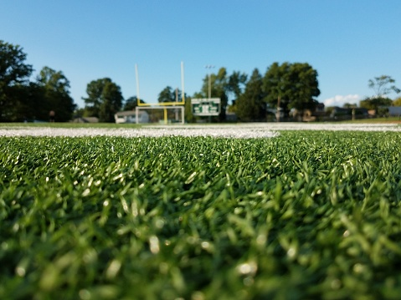
Bond List
1
Context
Based on 2016 Master Plan
Recreational needs have changed since 2016.
2
Planning
Limited coordination with SBBC on new joint use park possibilities.
3
Scope
Variability in types of amenities and insufficient funding for many newer projects.
List proposed in park bond referendum subject to change based on resident priorities and approval by SBBC as the landowner.
Notes:
https://unsplash.com/photos/RwvLuzb5EvE

Slide 5
Guiding Principles
Citywide plan
Geographic equity
Build community
Joint Use Working Group
Data-Driven Criteria
Asset inventory
Scoring Criteria
Re-evaluate joint use needs and opportunities
Citywide Impact
The Joint Use Working Group was formed at the recommendation of the Education Advisory Board and in consultation with the Parks, Recreation and Beaches Advisory Board.
Maximize recreational use
Add amenities
Reduce park deserts

Slide 6



Education Advisory Board
Recommendation
The EAB asked the Joint Use Working Group to review opportunities to accommodate additional amenities at select schools.
The Working Group proposed reductions with minimal impact on recreational use (i.e. fencing, signage, etc.).
The EAB recommended select reductions to extend the use of one school site in a park desert, but could not justify further reductions.
1
2
Recreational Use
Equity
Prioritize features aligned with community’s recreational interests.
Invest in park deserts and promote citywide benefit.
Notes:
https://unsplash.com/photos/6QvRVC-6_Vo

Slide 7
REVISED PROPOSAL
Park System Enhancements
Staff support the EAB’s recommendation based on the needs assessment and with the goal of maximizing citywide benefits. The proposal adds four new parks to the city’s network; increases recreational features in park deserts; and accounts for site viability and revised need since the 2016 master plan. The proposal stays within the joint use parks bond allocation and offers an economical way for the city to expand park amenities for the community at-large. The initiative also positively contributes to the city’s public schools by supporting expanded recreational and educational activities.
See appendix for the full budget.

Slide 8



Additional Considerations
Intent of joint use parks
Availability of joint use parks
Existing and new park considerations
Focus on recreational use vs. budget
Priority of neighbourhood enhancement
Benefit to schools and educational offerings for residents
Need for synthetic turf met
All projects contingent on SBBC approval as the landowner
Special acknowledgement and appreciation to SBBC, schools and neighbourhoods for the ongoing partnership and support.
15
Joint use parks
Use
Expanded recreational amenities citywide
$10.9k
Investment in park enhancements
Notes:
https://unsplash.com/photos/ZbiY0gwErbA

Slide 9
THANK YOU

