Slide 1
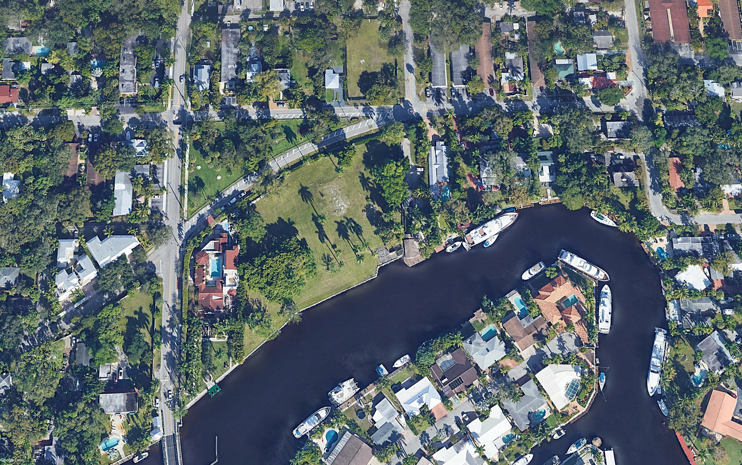
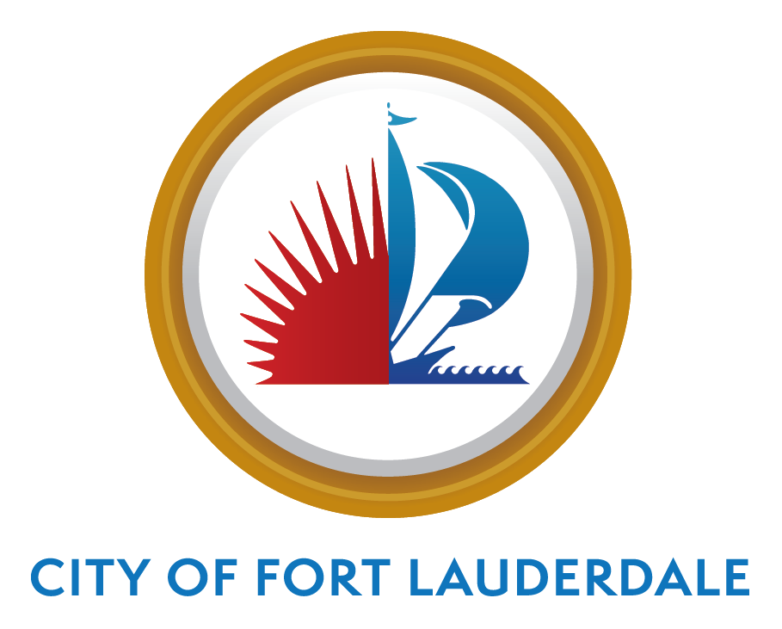

CITY OF FORT LAUDERDALE
PARKS ADVISORY BOARD
BOND UPDATE
January 2022

Slide 2
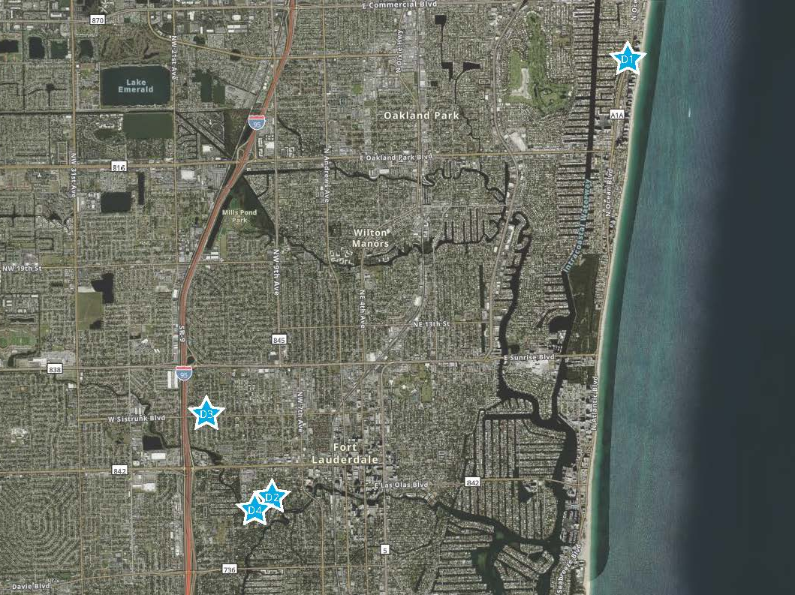

Slide 3
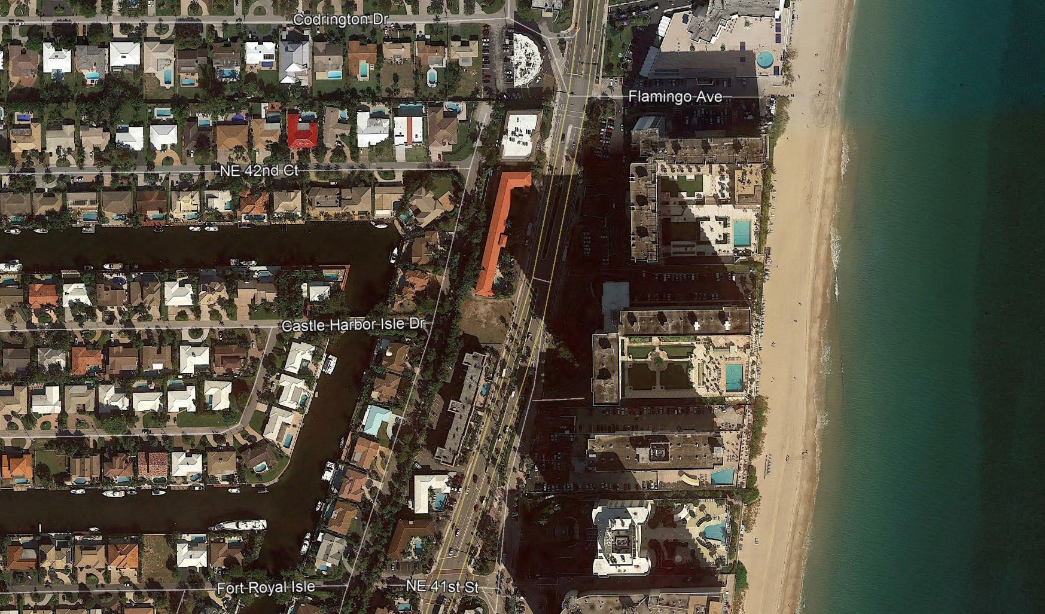
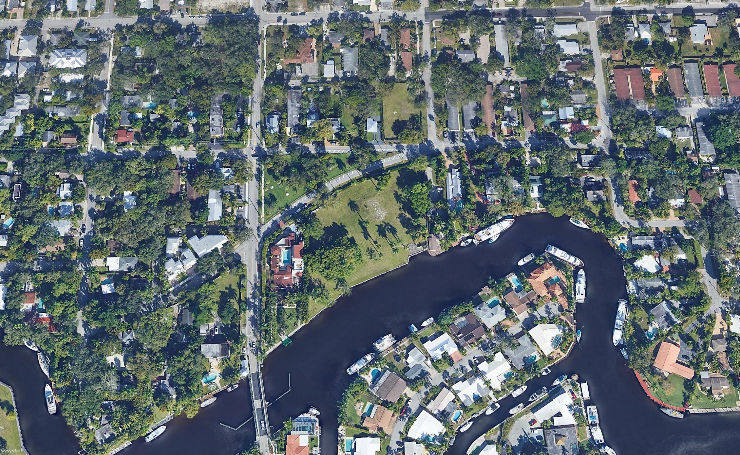
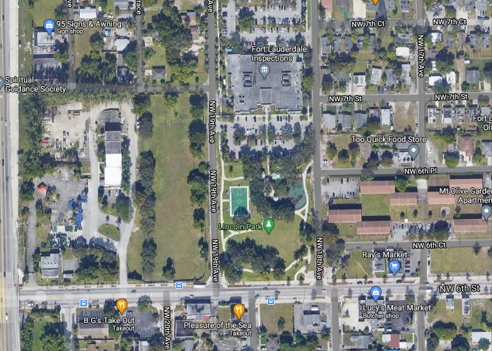
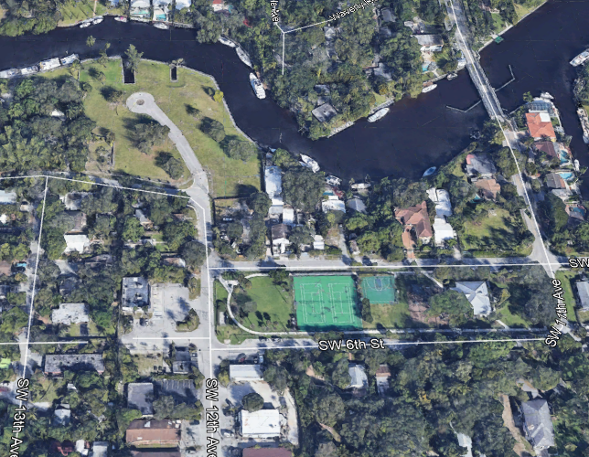
Park Acquisition- District 1
Park Acquisition- District 2
4201 N Ocean Blvd
Negotiated Price: $1.09M
Size 13,356 SF
1016 Waverly Road - District 2
Negotiated Price $2.54M
Size 2.01 Acres
Park Acquisition-District 3
NW 6th Street– Lincoln Park
Negotiated Price $125,000
Size: 4,482 SF
Park Acquisition- District 4
SW 5th Court and SW 12th Avenue- Riverside Park
Negotiated Price: $4.050M
Size: 2.16 Acres
Expand Riverside Park/Waterfront
Riverside Park

Slide 4
PROGRESS/GOALS
Acquired 4.5+ acres total for new greenspace
Spent a total of $7,805,000 to date
$22,195,000 still available for acquisitions

Slide 5
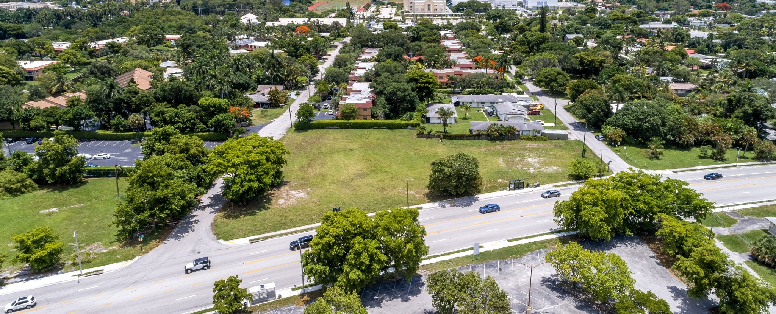
CHALLENGES
Current Real Estate Market
Environmental Issues- contamination of land
Sensitive to effects on surrounding neighbors
Any associated costs, i.e. demolition
Decreased property taxes
Timeline

Slide 6
NEXT STEPS
Focus:
  Kayak Launch
  Pickle Ball (Indoor/Outdoor)
  Dog Parks
  Downtown Parks – based on growth projections
  Skate Park
  Neighborhood Pocket Parks
  A1A area
  Coral Ridge
  Palm Aire
  Middle River Terrace
  Sail Boat Bend
  Riverside Park
Priorities:
Identify properties within areas of need
Waterfront lots
Corner lots
Large tracts of land

