Slide 1
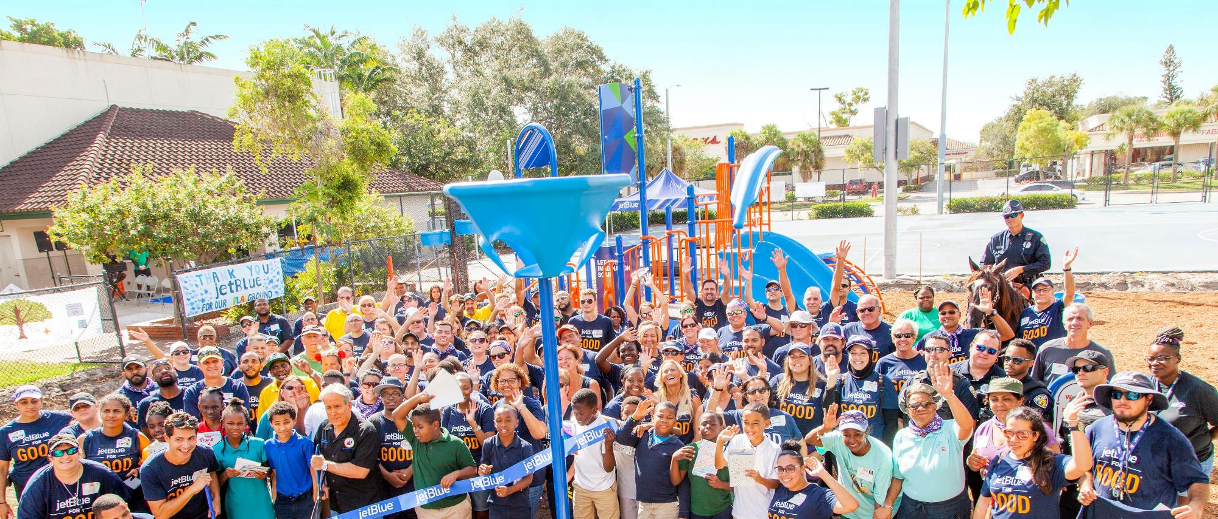

Fort Lauderdale Parks and Recreation Bond Master Plan design & Implementation program
Public engagement Summary and initial Project prioritization - PRAB Review - March 24, 2021

Slide 2
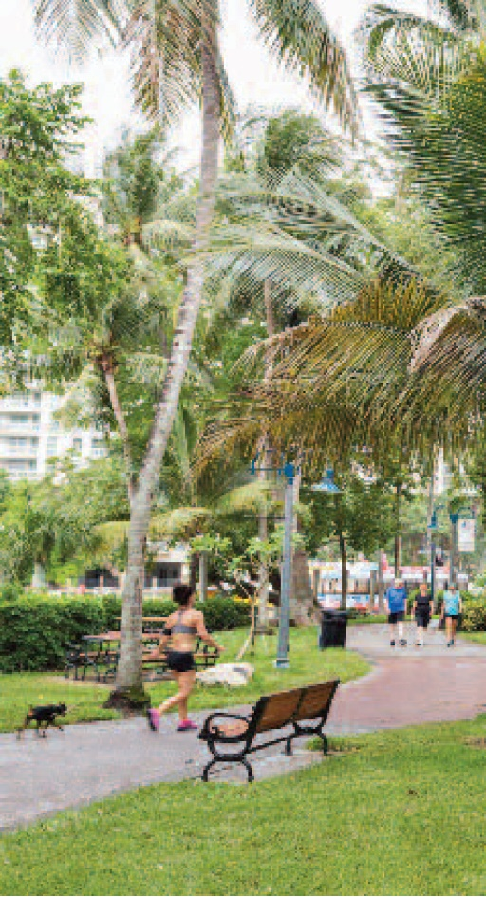
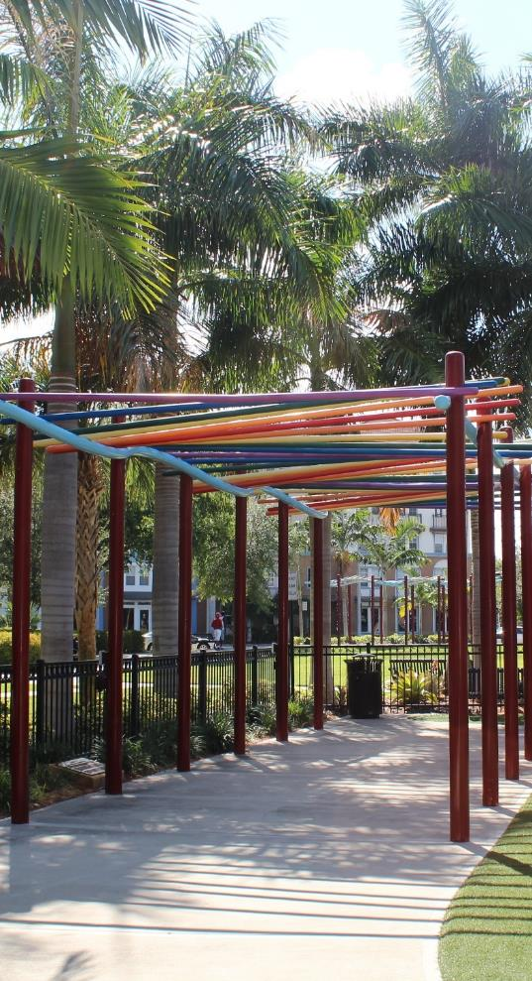
Agenda
Public Engagement Summary
Project Prioritization Recommendations
  Strategy
  Criteria
  Phase Recommendations
Next Steps

Slide 3
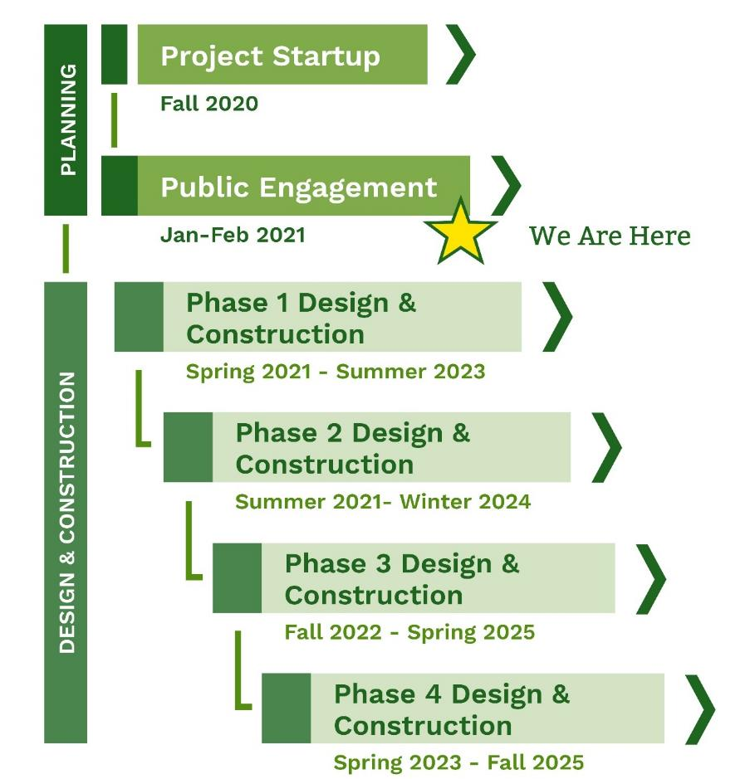
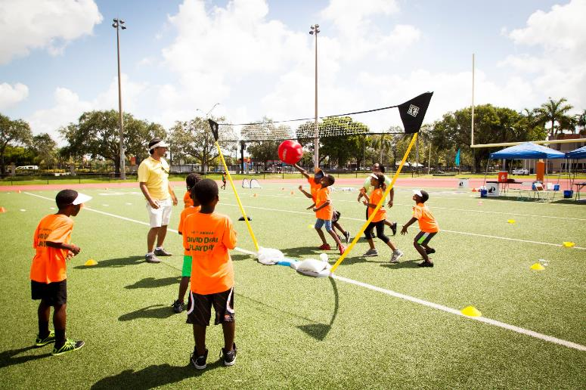
Where are we
A turning point in the program development
Notes:
Remind. The more we discuss the longer the timeline takes. A balance between thorough public input and the desire to move ahead.

Slide 4
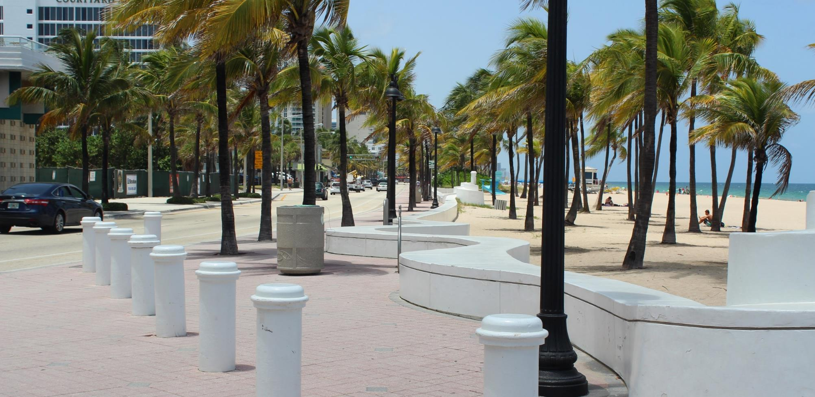
1. Public Engagement Summary

Slide 5
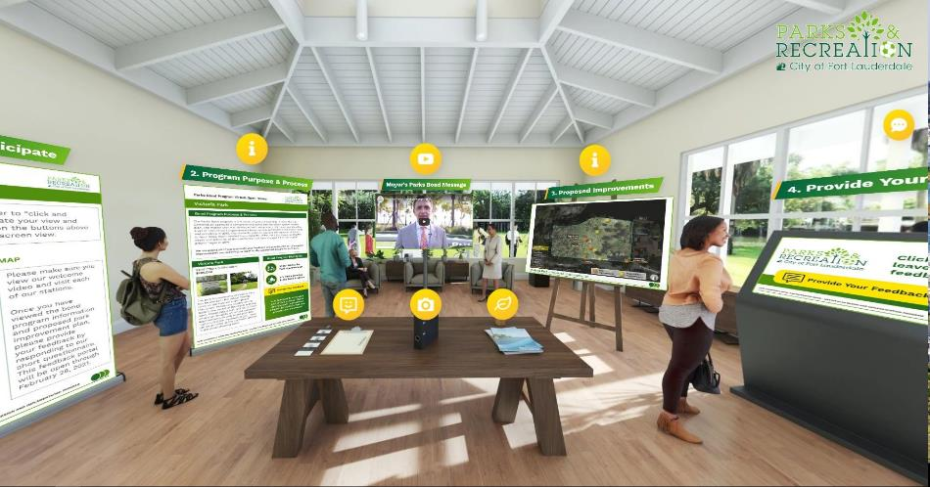
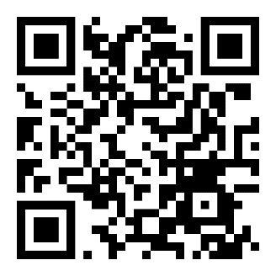
Public engagement summary
    Summary of participation
      6,452 Virtual Open House Visits
      4,700 Comment Portal Views
      1,164 participants provided 3,468 comments and responses
      534 participants left contact information
FTLparksprojects.com

Slide 6
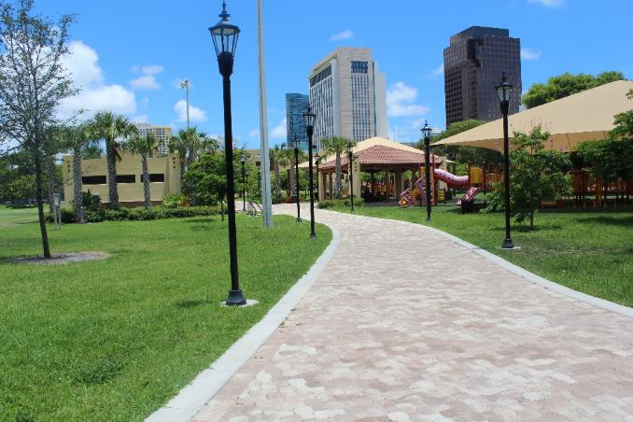
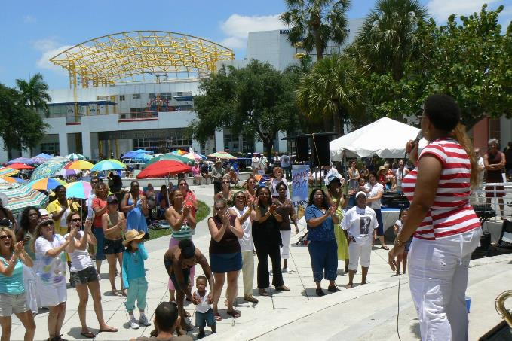
Public engagement summary
    Concurrence
      90 total parks
        55 have full concurrence
        13 minor corrections
        9 New Parks to be designed
        13 require follow up

Slide 7

Public engagement summary
    Summary of findings
      Access to parks
      Community facilities
      Canoe / Kayak Launches
      Dog parks
      More trees
      Natural areas and beautification
      Open spaces / passive areas
      Outdoor fitness equipment
      Pathways
      Pickleball
      Playgrounds / shade
      Sidewalk connections & crosswalks
      Skate Park
      Water access and shoreline improvements
      Lots of people happy to see improvements!

Slide 8
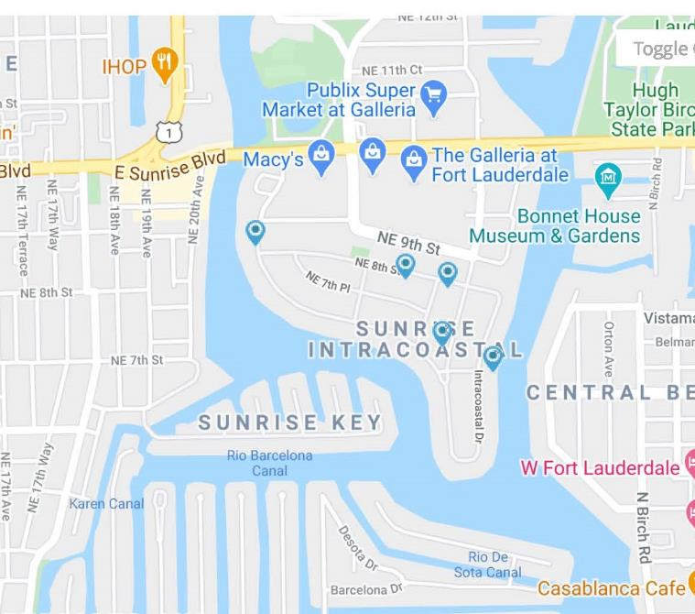
Public engagement summary
    Park Example – Greenfield Park
      245 Engagement Portal Views
      15 Participants
      41 Comments & Responses
    Common Themes:
      Playground Upgrades / Swings
      Shade
      Pavilion
      Happy with Improvements!
Greenfield Park

Slide 9
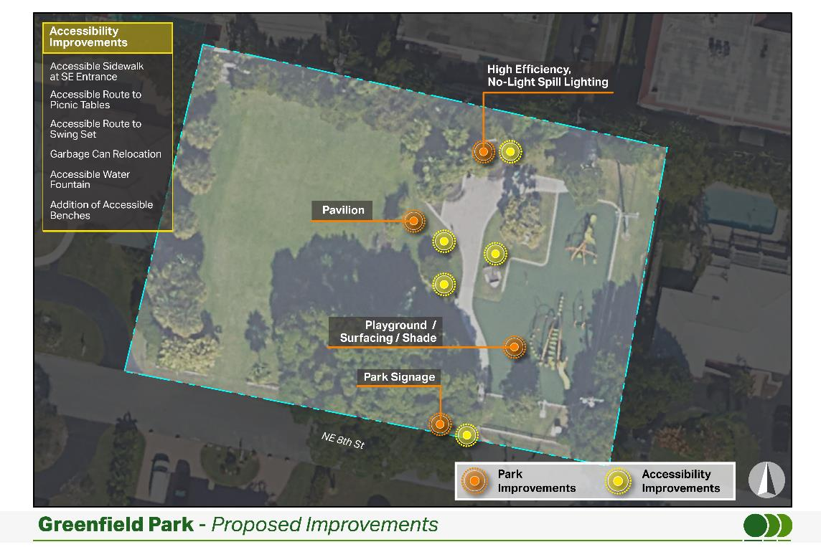
Public engagement summary
    Top Priorities:
      Playground – Shade and Surfacing
      Swings on Playground
      Pavilion
      High-efficiency, no-light spill lighting

Slide 10
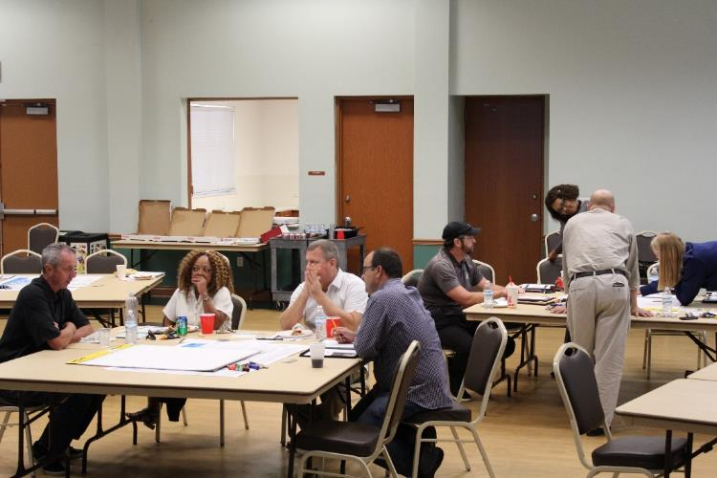
Public engagement summary
    Staff Input
      Fort Lauderdale Parks and Recreation Staff were provided with a separate portal to provide their input
      Intended to provide operational and maintenance insight for the proposed improvements
Add pic of staff

Slide 11
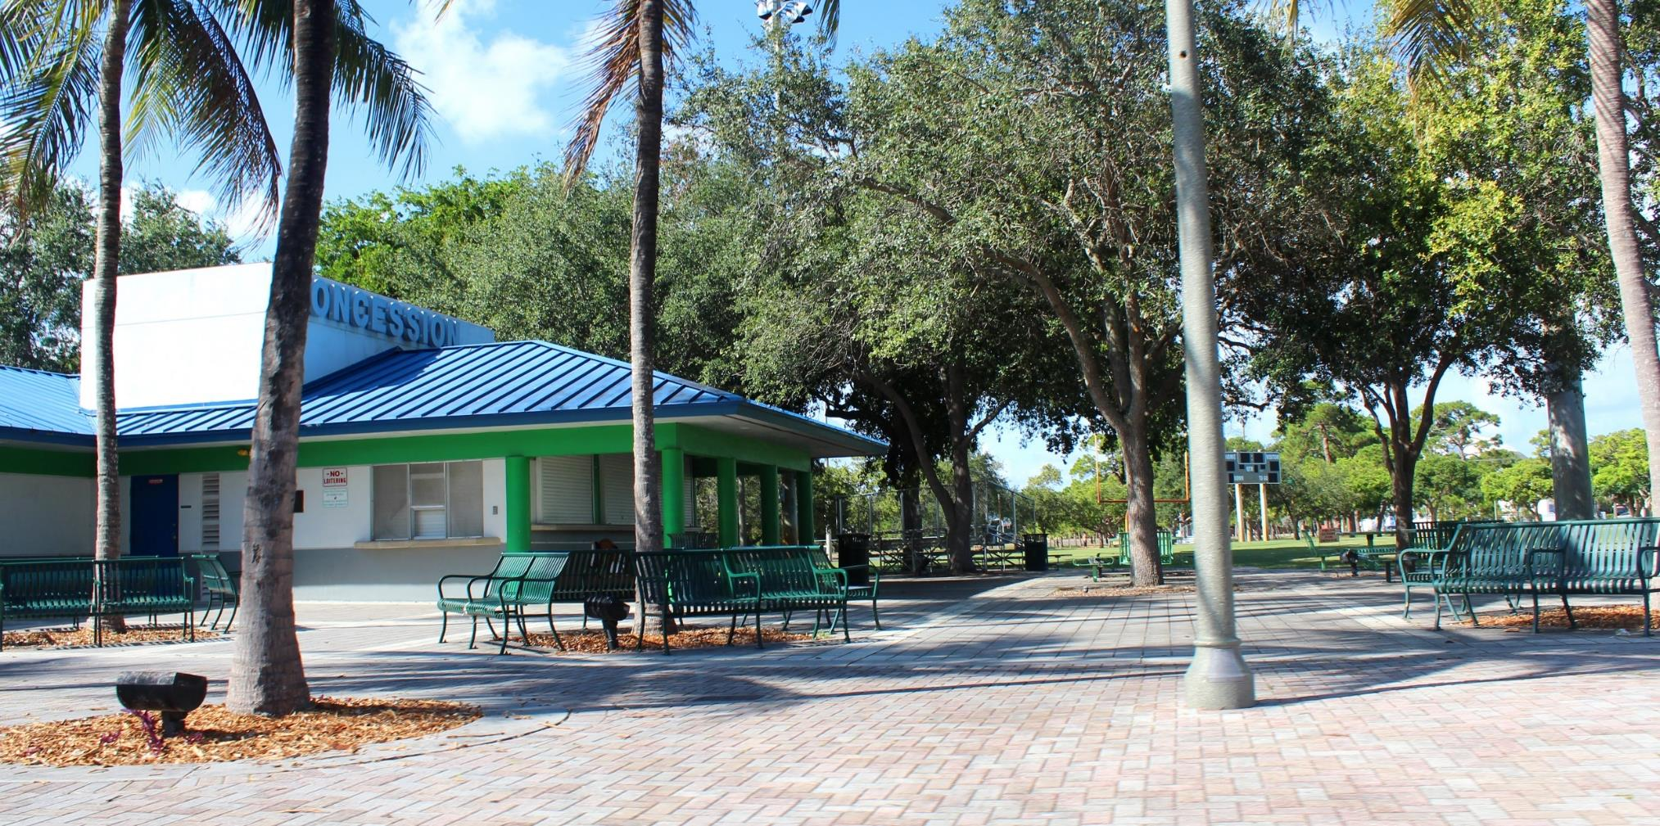
2. Project Prioritization

Slide 12
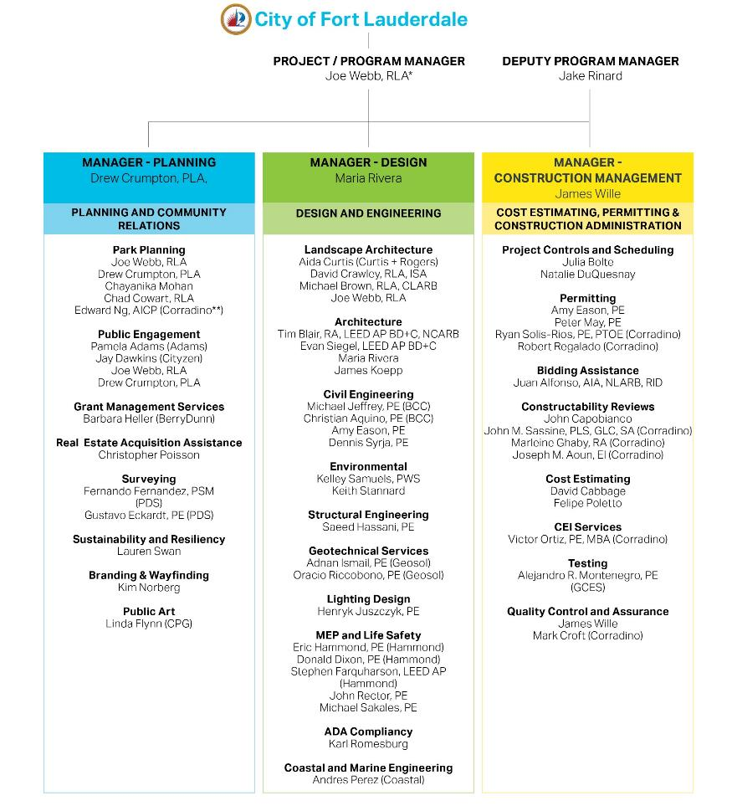
Prioritization strategy
    Balance the need for effective public input with the desire to move projects ahead
    A multi-team approach to advance as many projects as possible simultaneously

Slide 13
Criteria for Phases
Methodology is a Balance of Art and Science
1
Identified Signature Projects
2
Community consensus on the park development program
3
Equitable distribution of projects across the City
4
Potential for grants or leveraging bond funds
5
Efficiency of design, bidding and construction
6

Slide 14
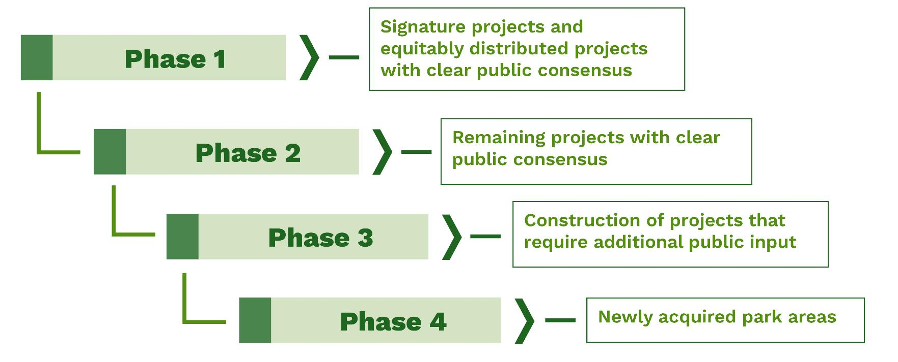
Phase recommendations
Notes:
This will be a fluid process…

Slide 15
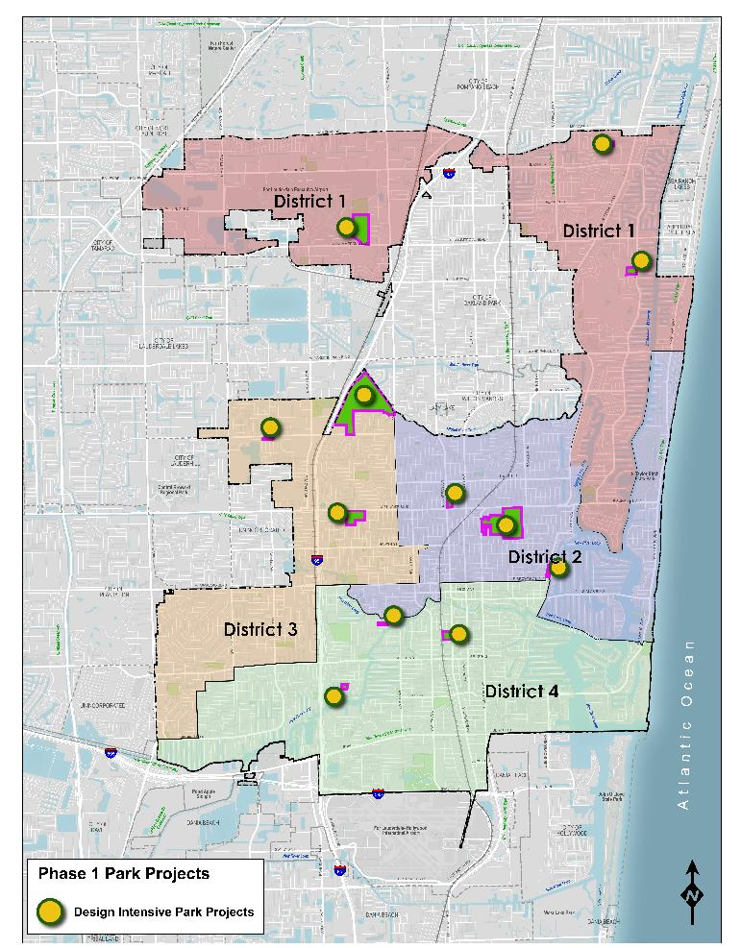
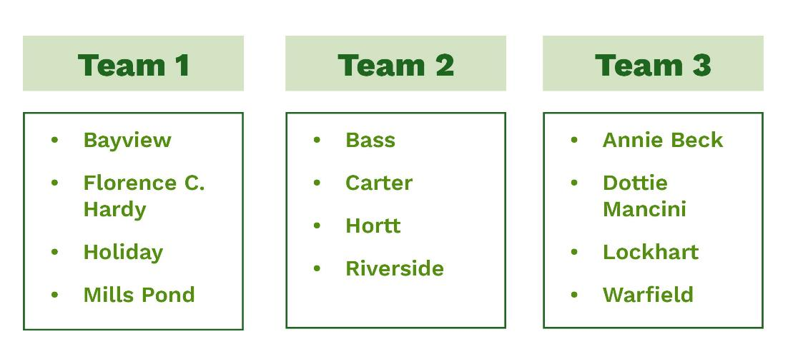
Phase 1 recommendations
    Design Intensive Park Projects
      Focus on true capital improvements versus deferred maintenance projects
      A multi-team approach

Slide 16
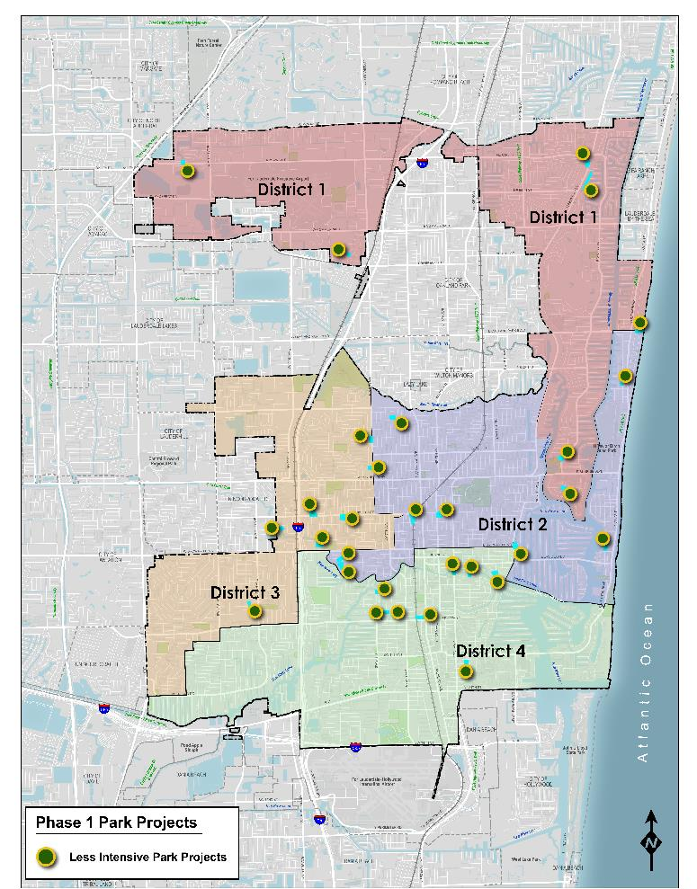
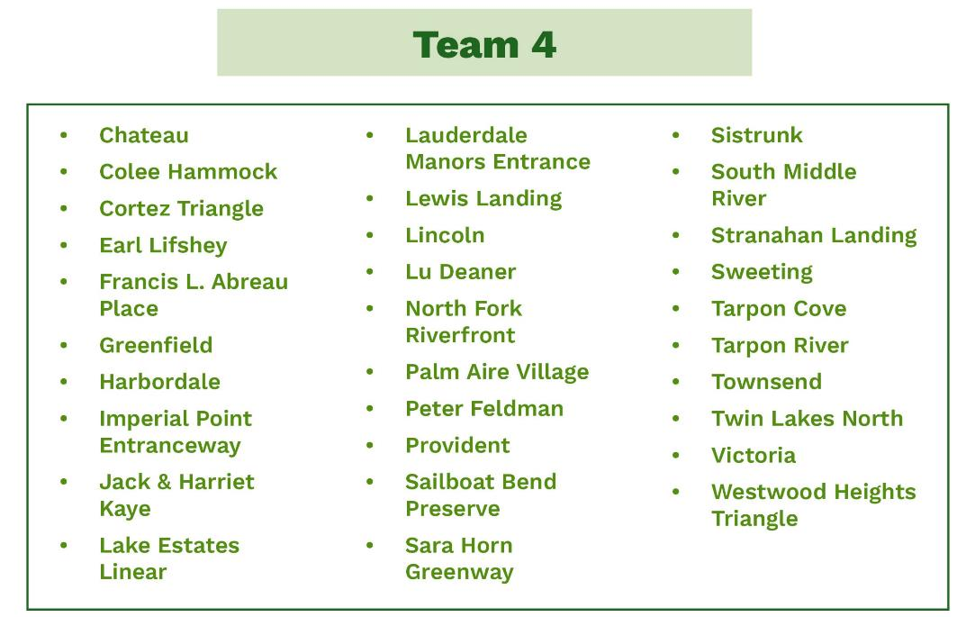
Phase 1 recommendations
    Phase 1 – Less Intensive Park Projects

Slide 17
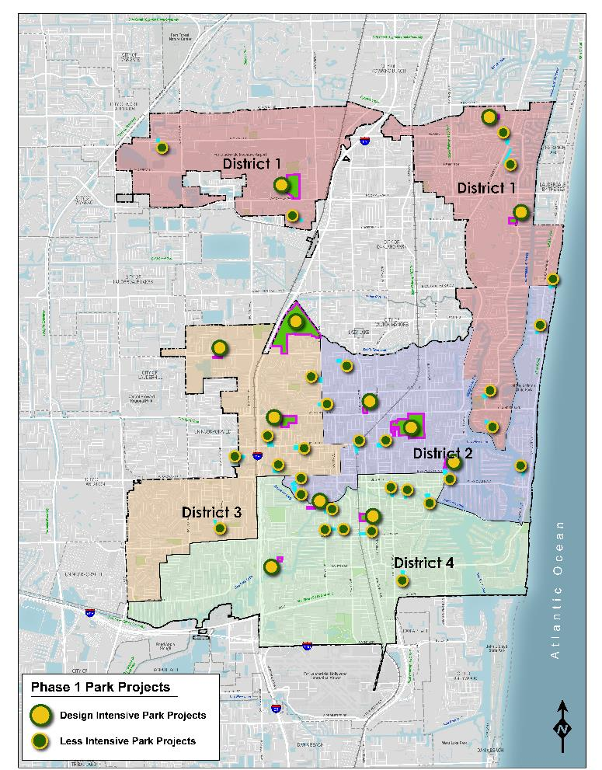
Phase 1 recommendations
    Phase 1 Projects
      Equitably distributed
      Show progress across the City
      Balance of design intensive projects and less intensive projects
    To view the individual park improvement diagrams please visit:
    https://publicinput.com/FTLParkProjectsPhase1

Slide 18
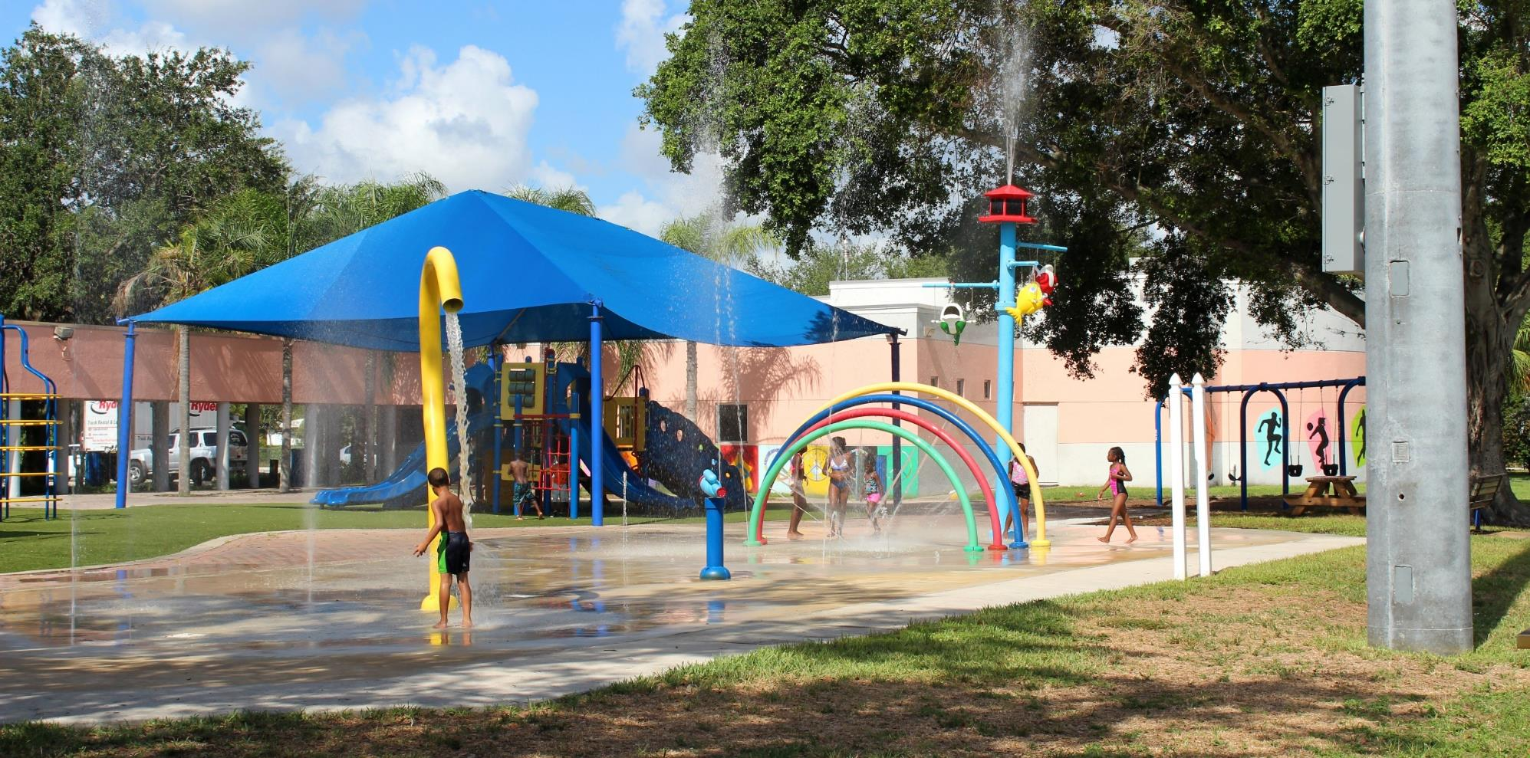
3. Next steps

Slide 19
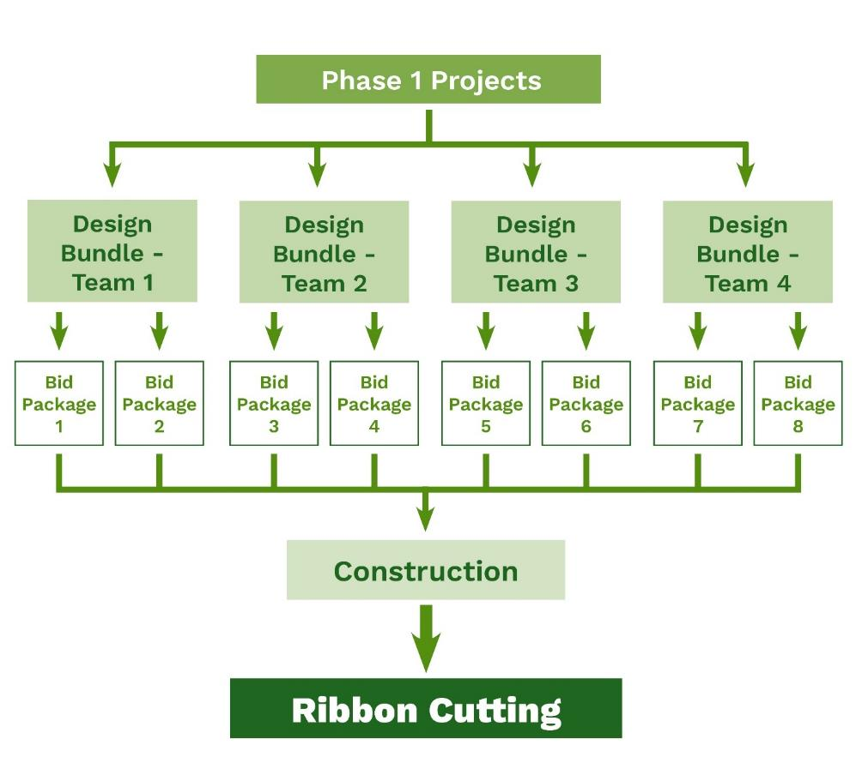
Next steps
    Design Bundles
    Bid Packages
    Construction
    Future presentation on refined list of phase 2 projects

Slide 20
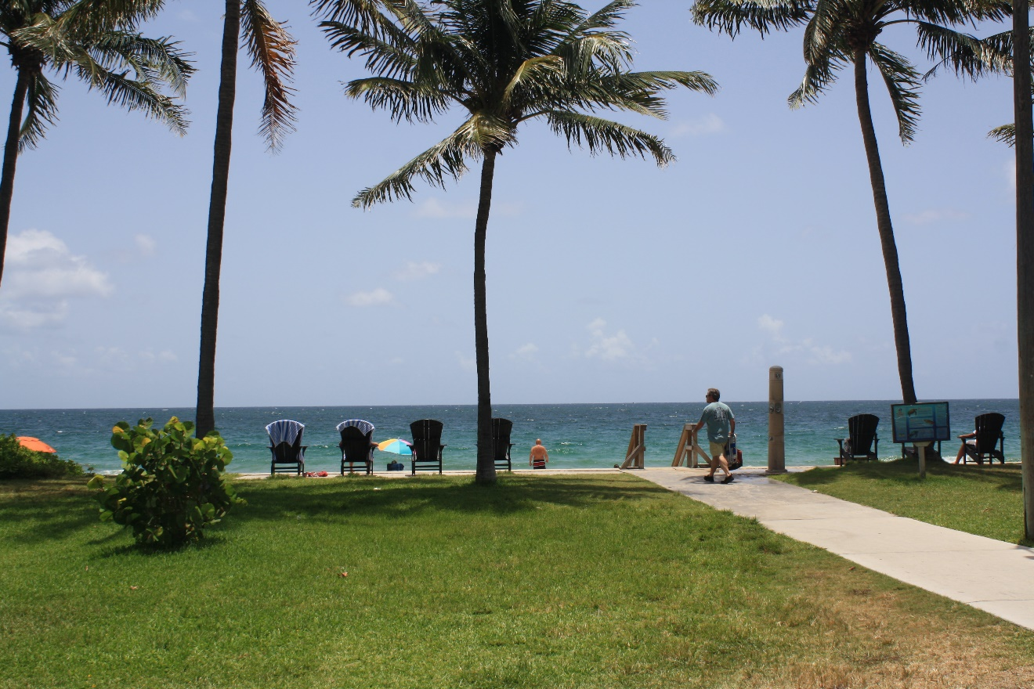
For your recommendation
We respectfully request the Parks, Recreation and Beaches Advisory Board’s recommendation to the City Commission to approve the Phase 1 list of projects and proposed park improvements

Slide 21
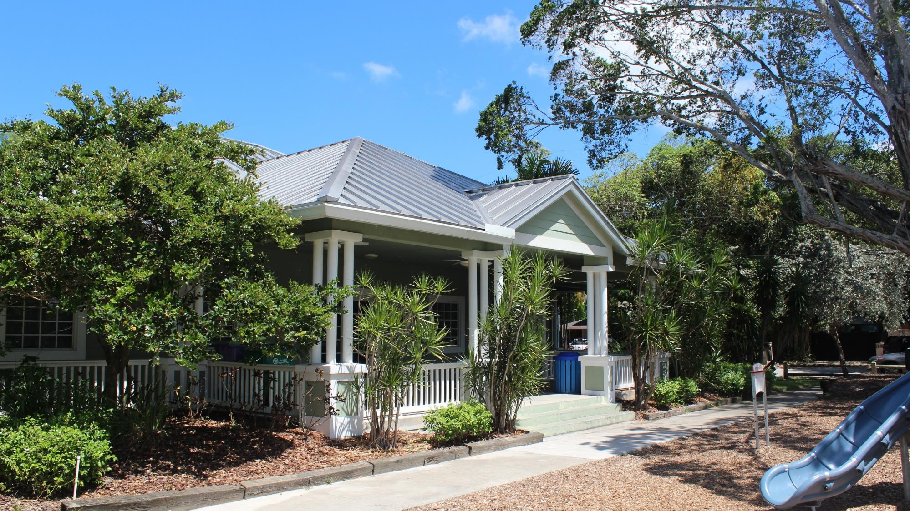
Thank you!

