Slide 1
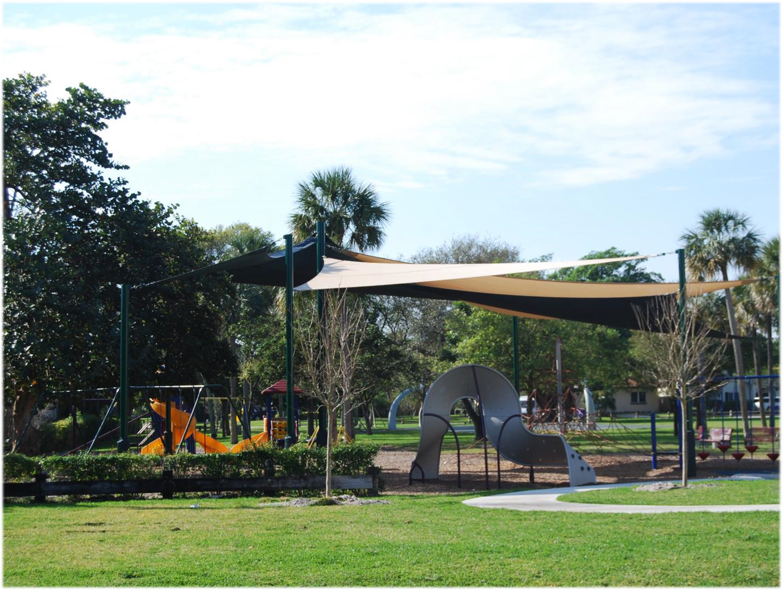
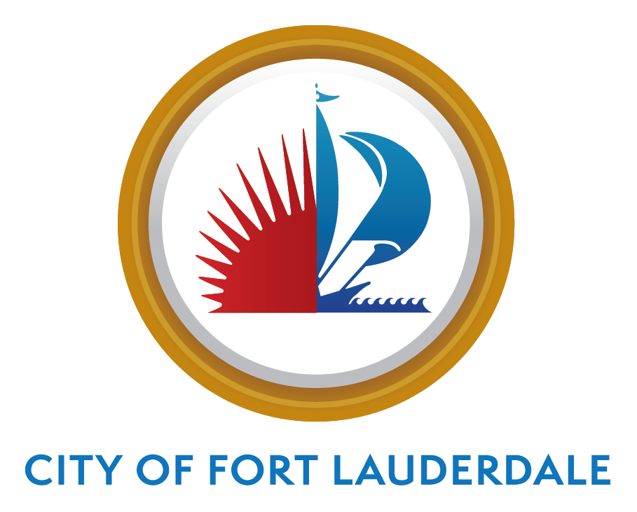


CITY OF FORT LAUDERDALE PARKS ADVISORY BOARD
BOND UPDATE
January 2021

Slide 2
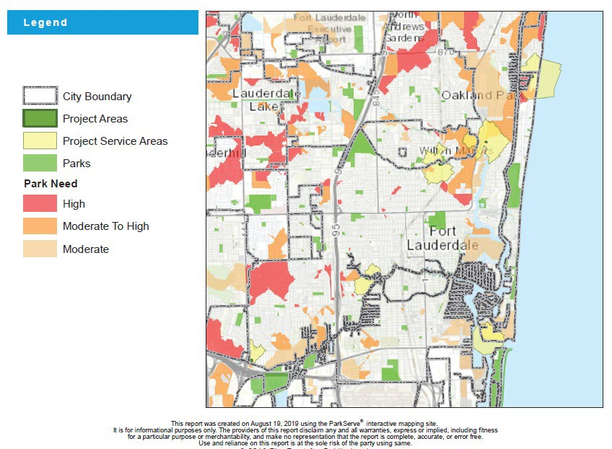
FORT LAUDERDALE AREAS OF NEED
TOP FIVE (5) AREAS
1- Oakland Park (N) and Commercial Blvd (S)
2- Melrose Park
3 - Sunrise Blvd (N) and Oakland Park (S)
4 - Commercial Blvd (N) and McNab Rd (S)
5 - Palm Aire

Slide 3
PARKS ACQUISITION PROCESS
Order Two Appraisals and Review
Create LOI
Option Contract
Parks Advisory Board
City Commission Approval
CM Memo

Slide 4
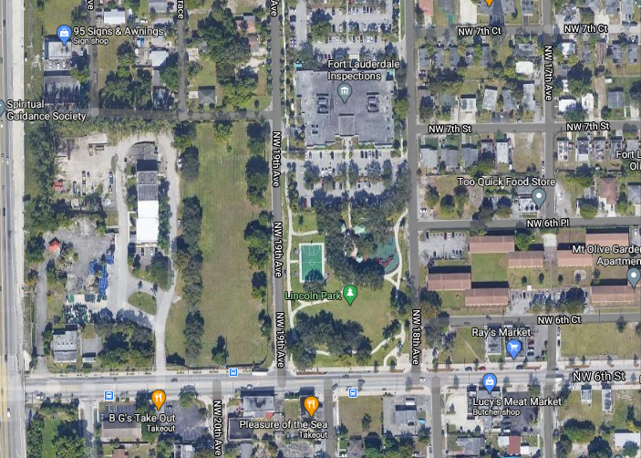

PROPOSED PARK ACQUISITION #4
NW 6th Street- District 3 – Lincoln Park
Size: 4,482 SF
Negotiated Price $125,000

Slide 5
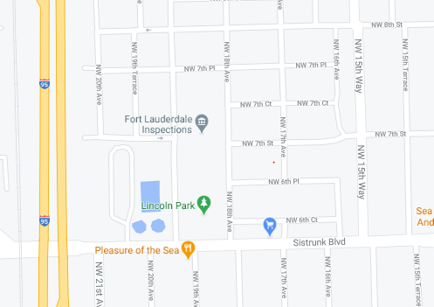
PROPOSED PARK ACQUISITION #4
NW 6th Street
Size:4,482 Sf Acres
Expand on Lincoln Park

Slide 6
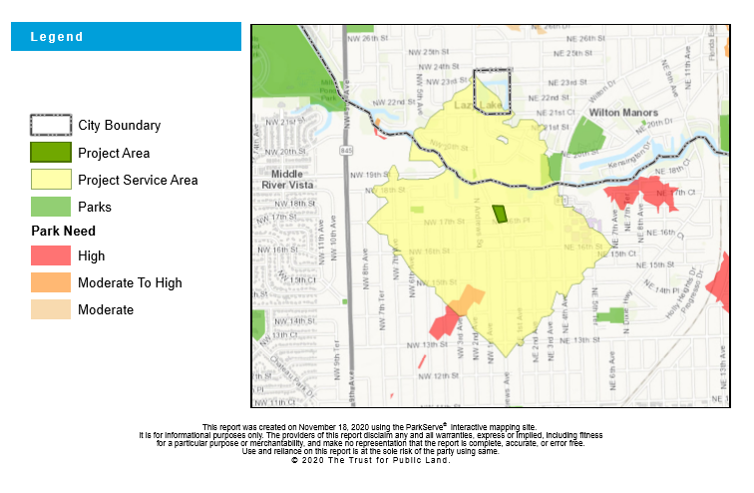
PROPOSED PARK ACQUISITION #5
1700 N Andrews Ave- District 2
Size: 1.2 Acres

Slide 7
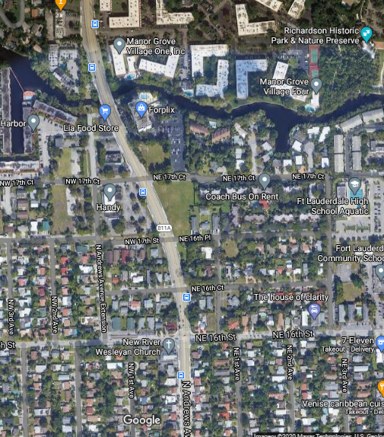
PROPOSED PARK ACQUISITION #5
1700 N Andrews Ave- District 2
Size: 1.2 Acres
Listed $1.075M
Negotiated Price $1,037,500
Located on Andrews Avenue, the property allows for easy access from surrounding neighborhoods, while providing ample size for sufficient parking and green space.
The surrounding area's residential density supports a park of +-1.2 Acre size at this location.

Slide 8

PROGRESS/GOALS
Closed on N Ocean Blvd, District 1- April 2020
Closed on 1016 Waverly Road, District 2- November 2020
Closed on SW 5/ SW 12, District 4- 12/20
Under Contract– 1700 N Andrews, District 2
Under Contract – NW 6th St, District 3
Focus/Priority: waterfront kayak/boat launch, Pickle Ball Court, Dog Parks
Continuing to gather input and review emails from the community
Ongoing meetings with City Staff, Parks Department, and Commissioners to discuss viability of potential locations for parks
Working list of properties that fall within the area of need
The City’s goal is for all residents to be within a 10-minute walk to a park. Using Trust for Public Land , ESRI, we can track how a new park improves the accessibility for residents to parks.

