Slide 1
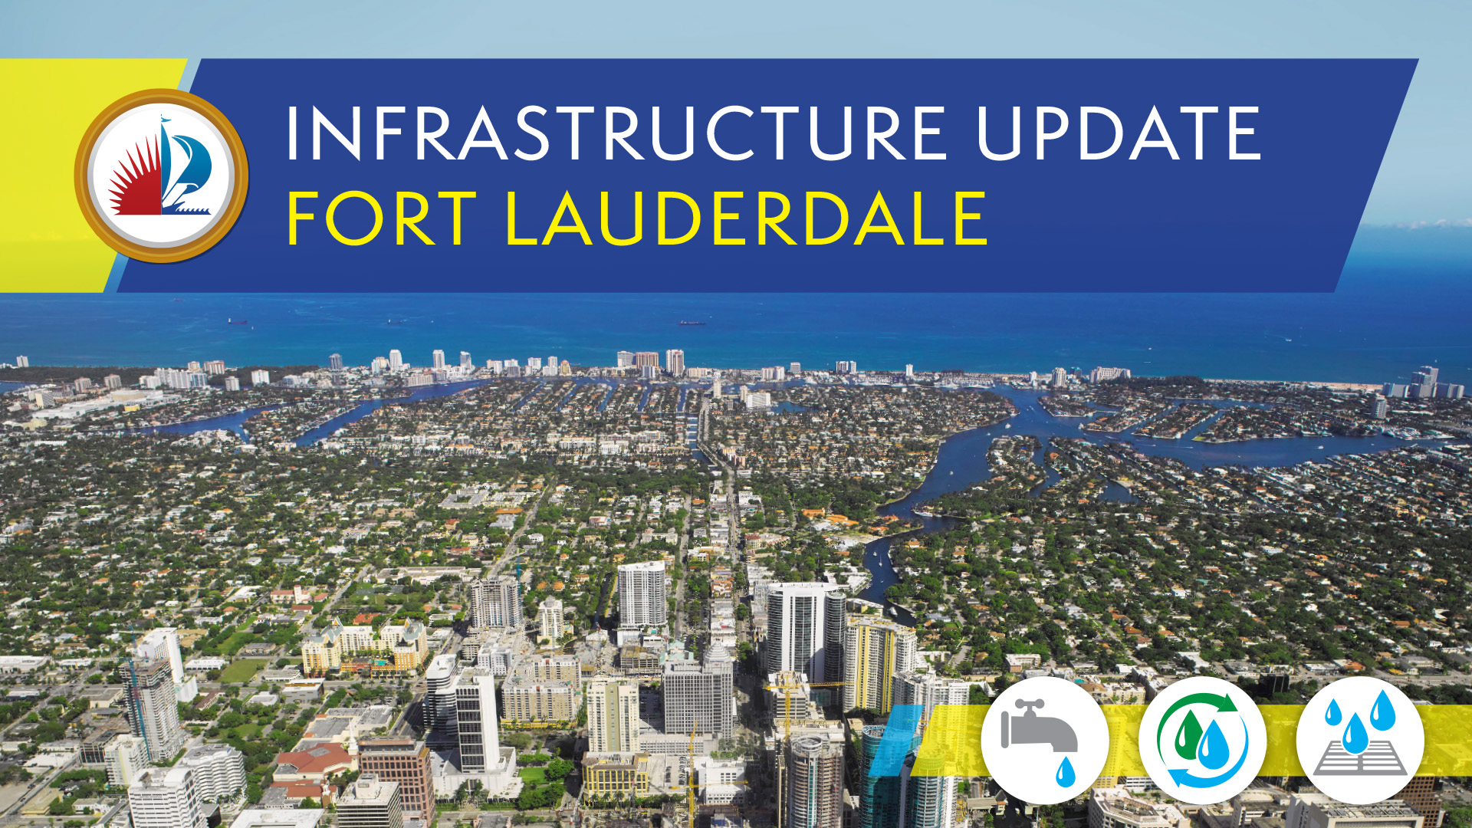

Slide 2
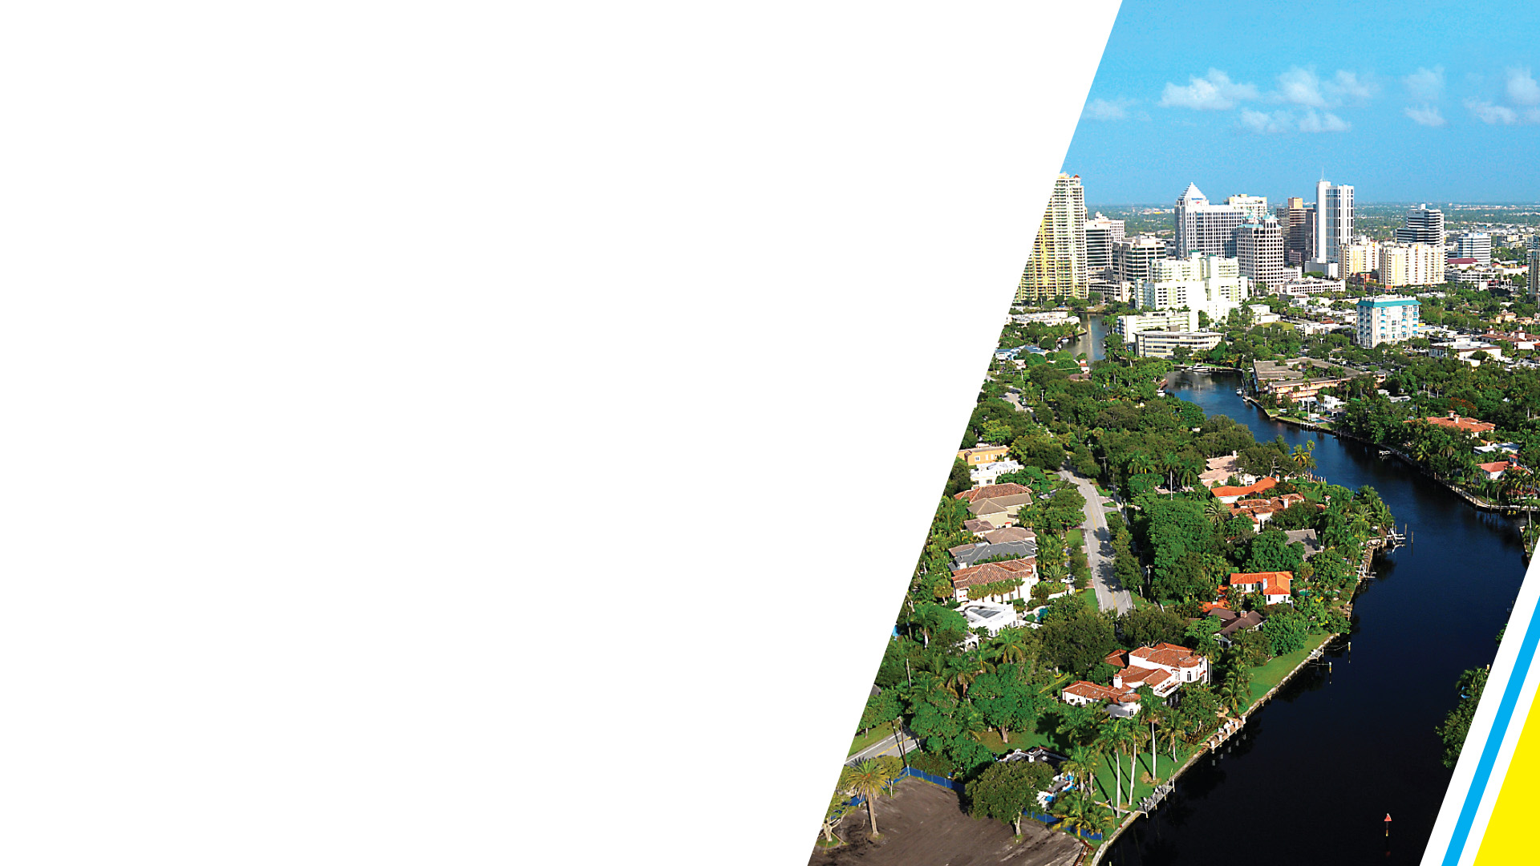
Welcome to the
City of Fort Lauderdale Infrastructure Update.
If you would like to submit a question, please complete
a card and return it to the registration table in the
rear of the Chambers.

Slide 3
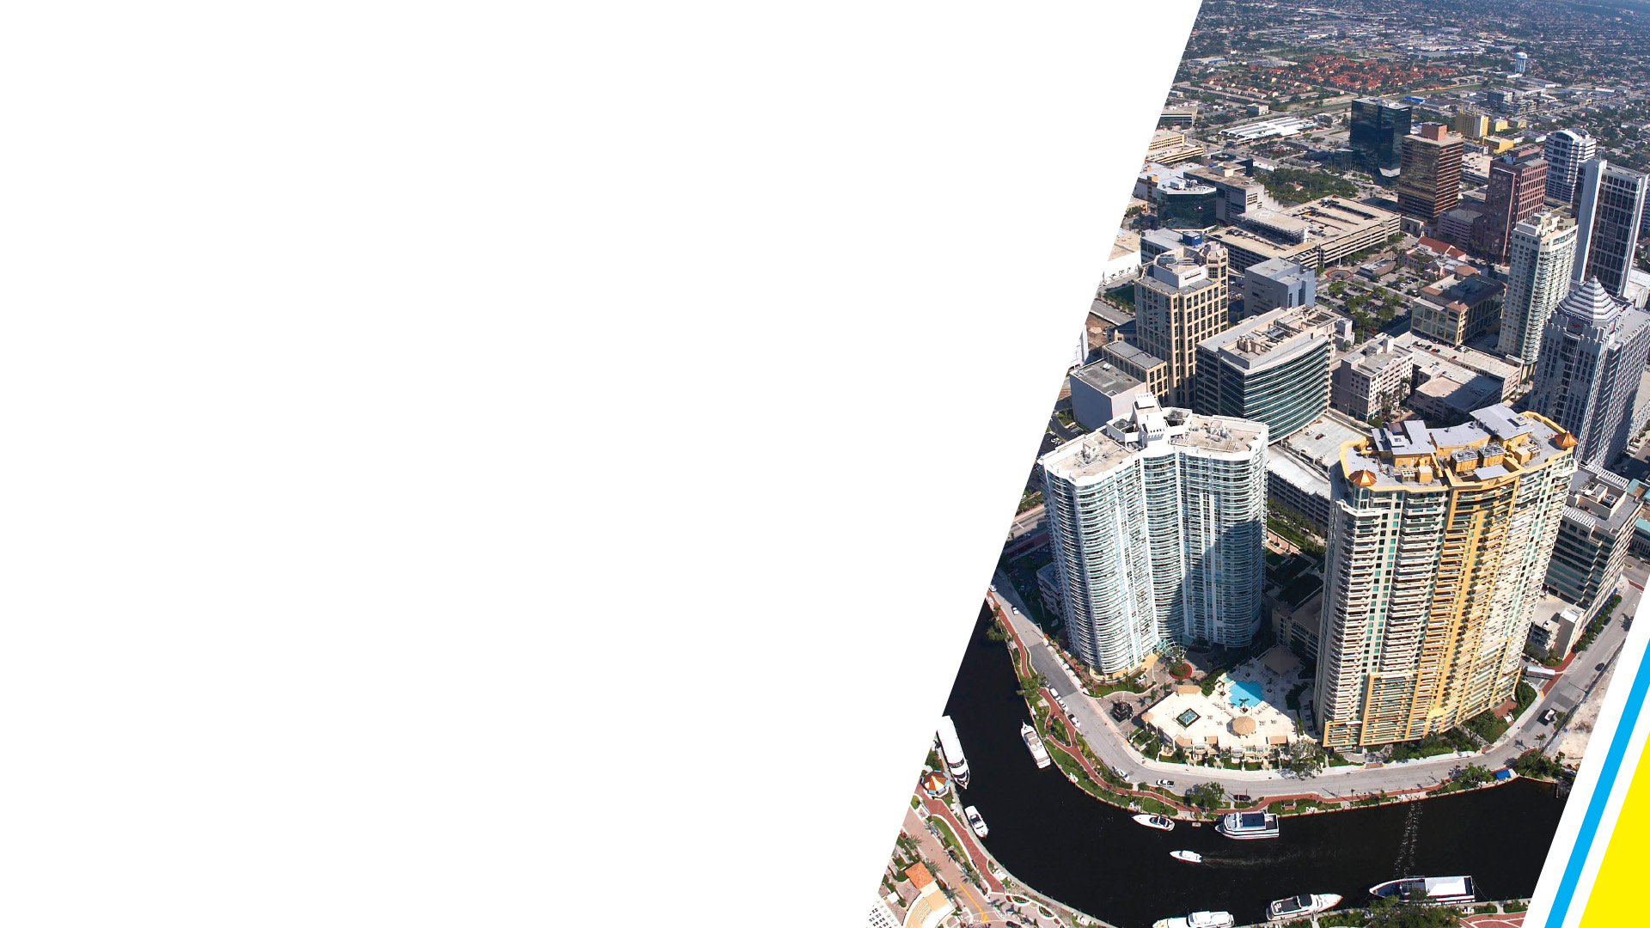
Agenda
Infrastructure Update from Mayor Dean J. Trantalis
Questions and Answers
Open House

Slide 5


COMMITMENT
Our commitment to bring this city’s aging infrastructure into the modern era
Invest as much as possible as fast possible in sewer system, water, and stormwater utilities
Plans are in place for major undertakings to address infrastructure needs over the next five years

Slide 6
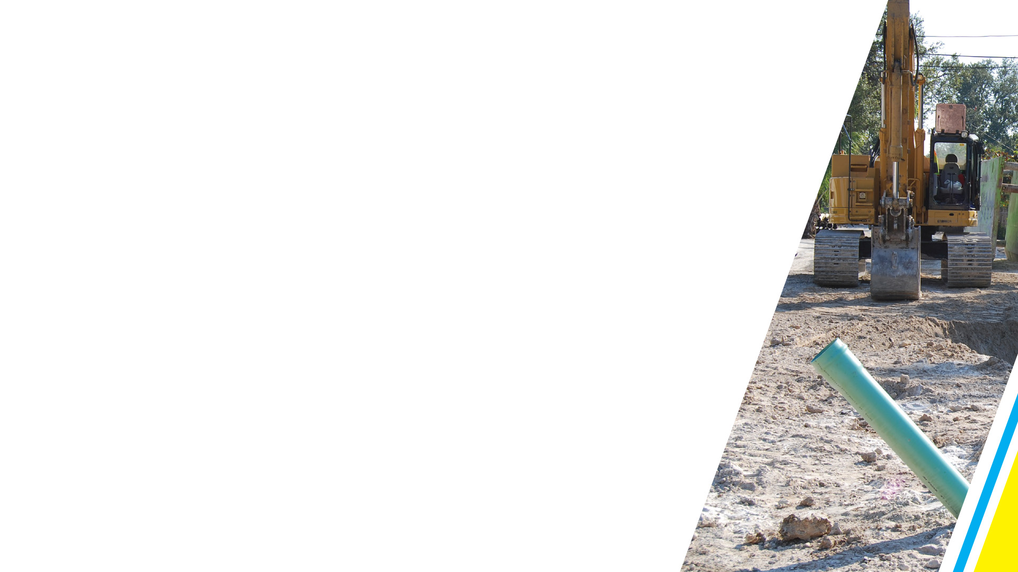

SEWER SYSTEM
$3.5 million emergency project underway
to replace section of failing sewer pipe in
Rio Vista
Once installed, the above ground bypass will be removed
Work expected to be completed in 90 days

Slide 7
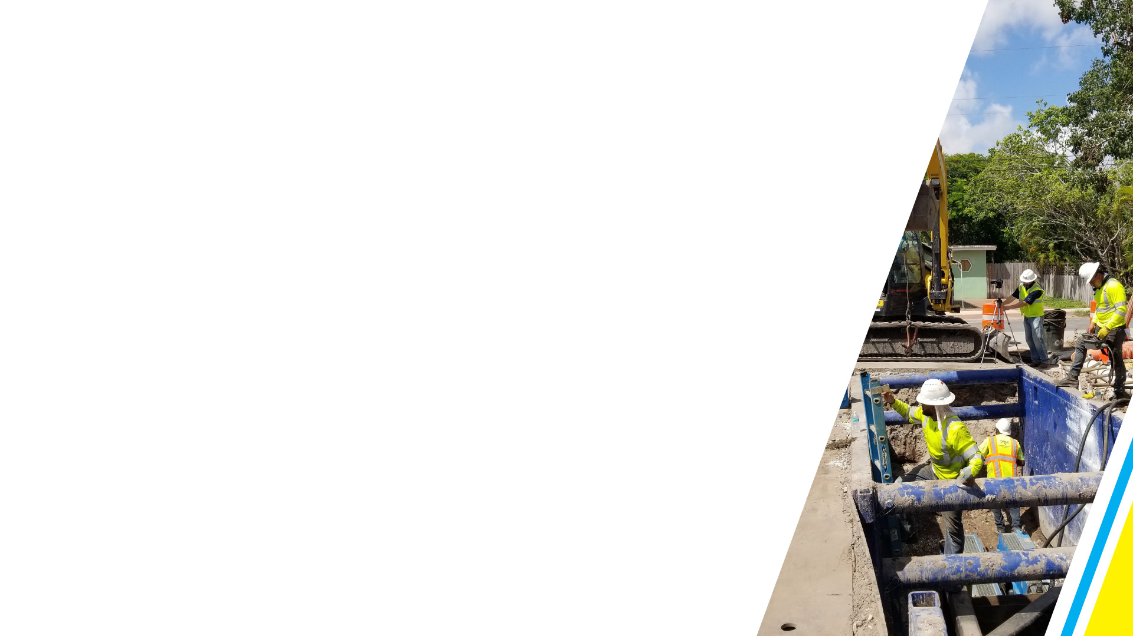
SEWER SYSTEM
Approved $65 million to replace the entire wastewater collection line from Coral Ridge Country Club to the treatment plant at Port Everglades
Innovative approach using two contractors to accomplish project in 18 months
Revitalize old pipe to serve as essential backup line

Slide 8
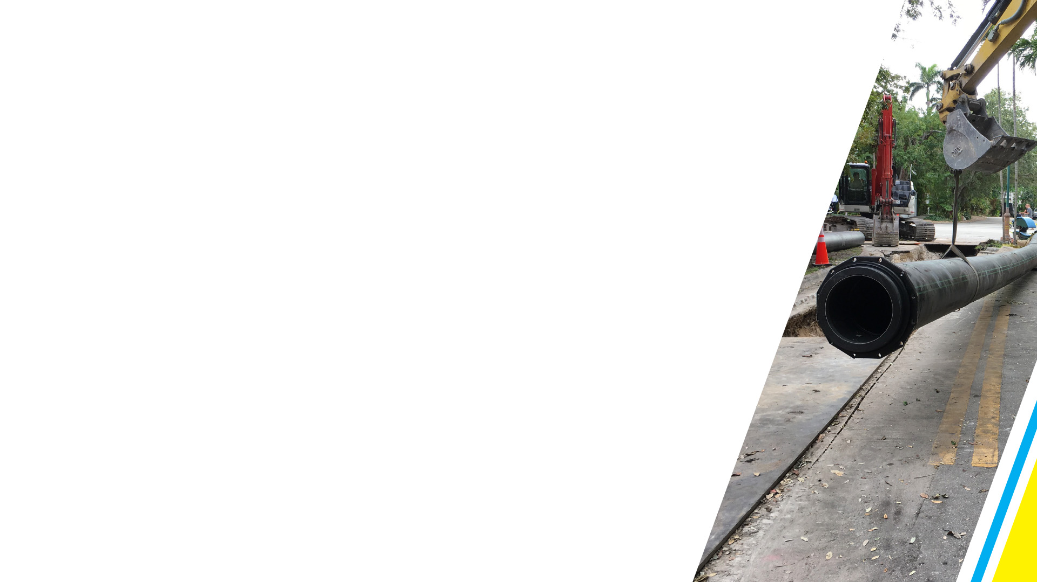
SEWER SYSTEM
Four major sewer projects underway
  Rio Vista emergency force main replacement
  Replacement of entire force main line
  Victoria Park 16-inch pipe replacement
  NE 36 Street 12-inch pipe replacement

Slide 9
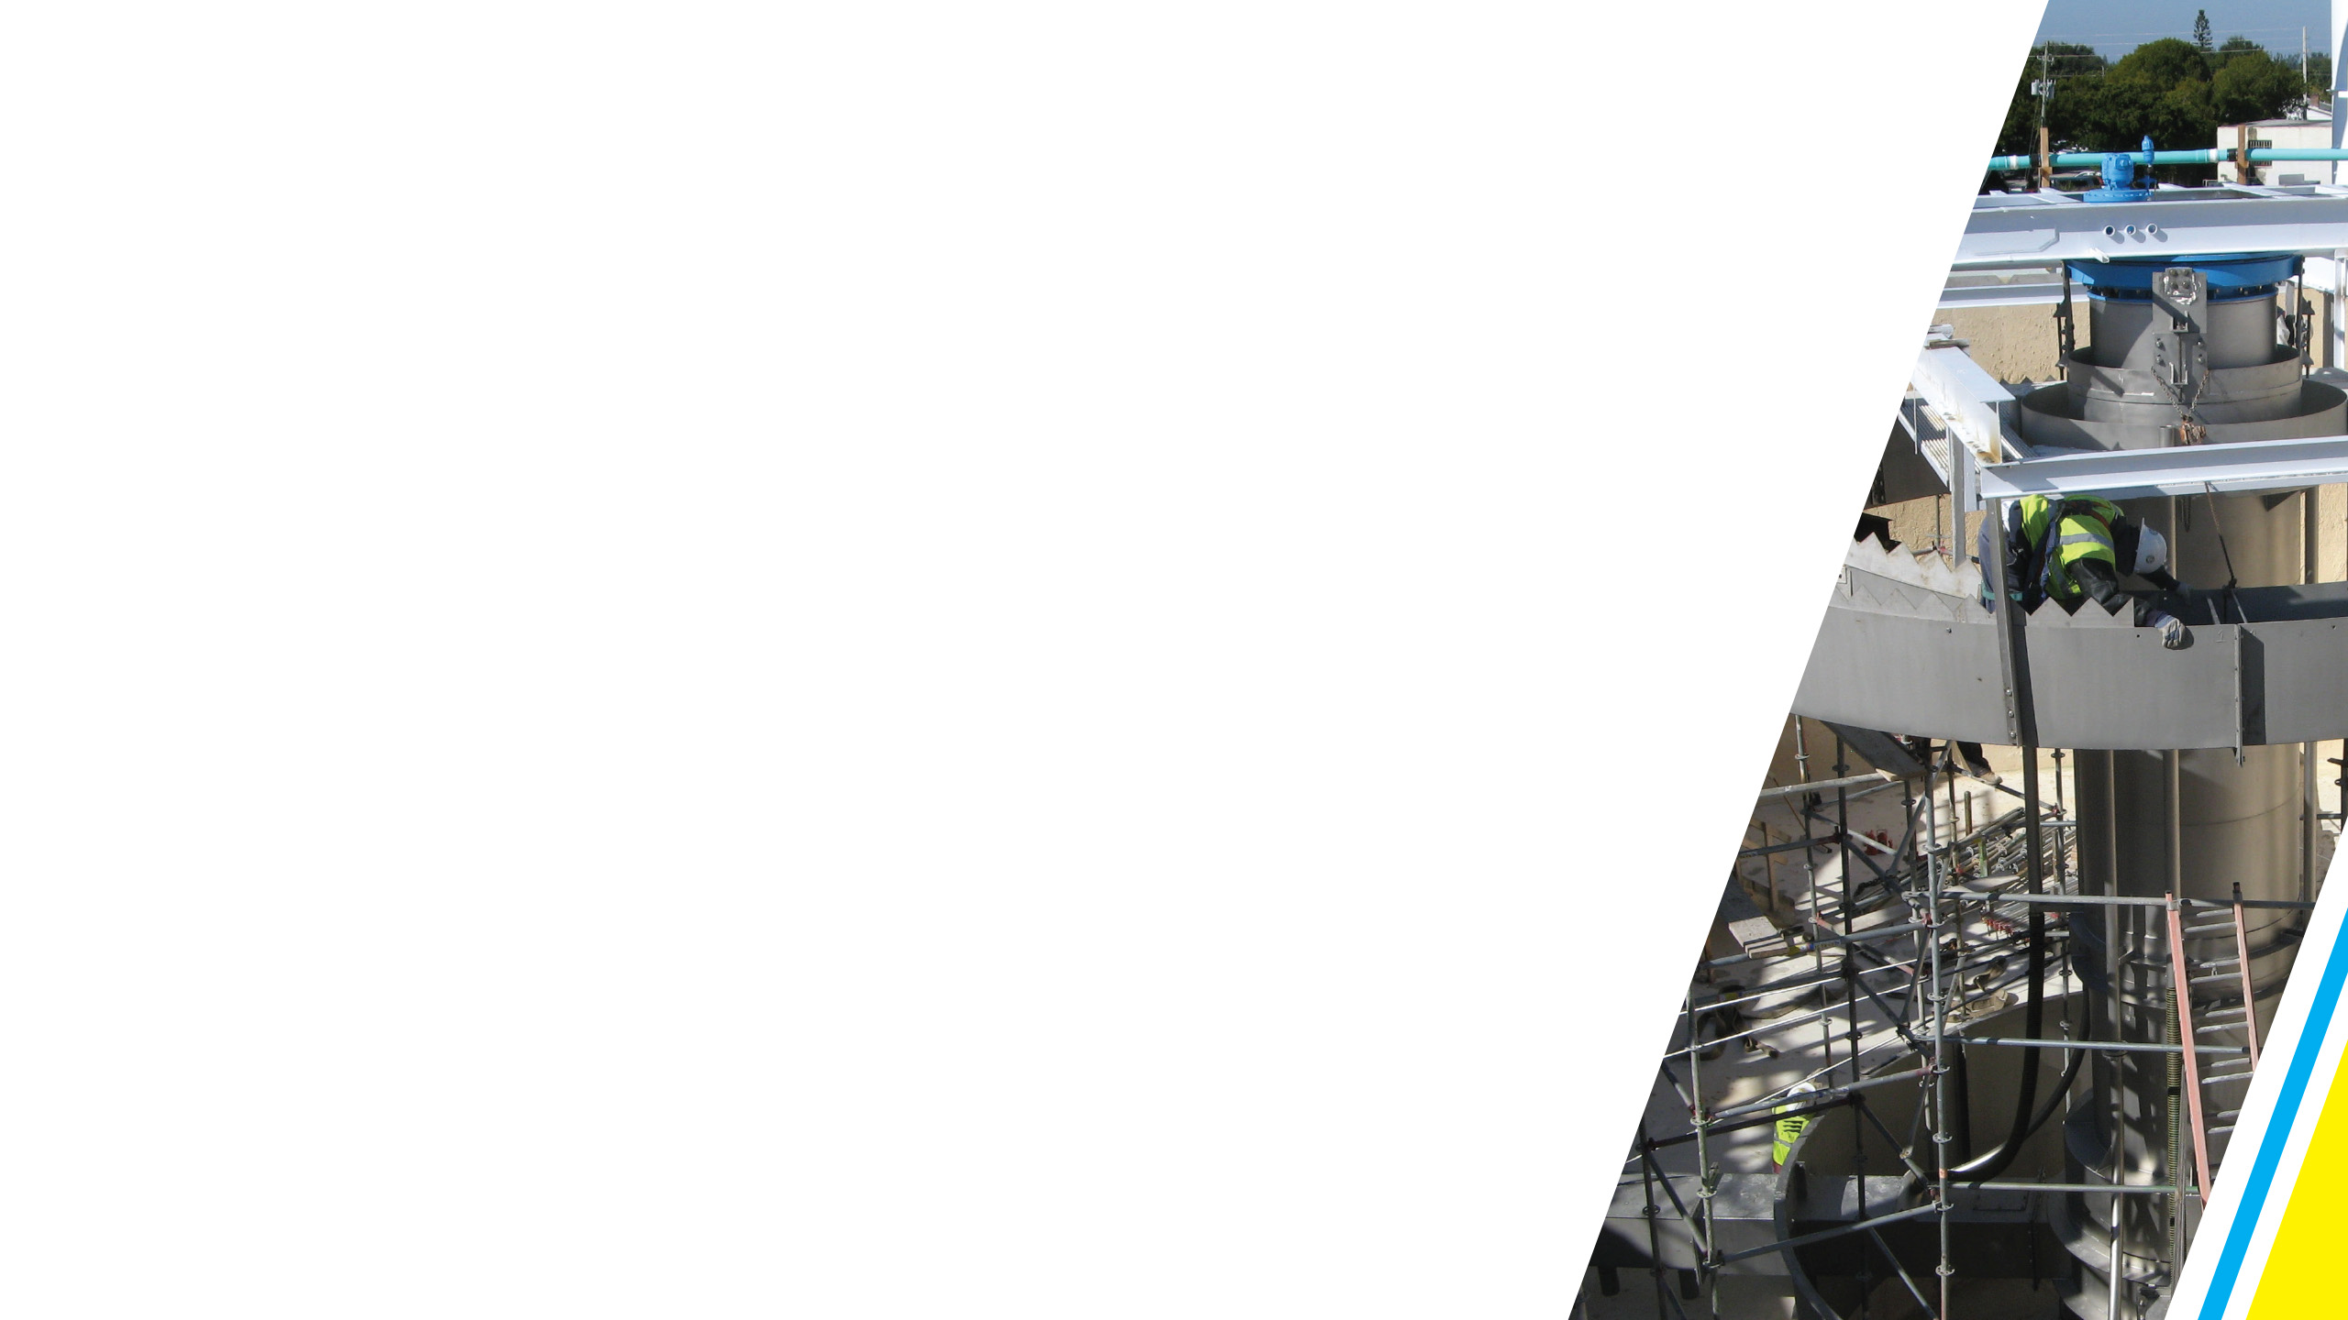
SEWER SYSTEM
Ahead of schedule with almost half of the 51 milestones completed in the Department of Environmental Protection’s (DEP) consent order
Four miles of new sewer mains completed in downtown and northwest neighborhoods
Pump stations completed in Central Beach, Harbor Beach, Imperial Point

Slide 10
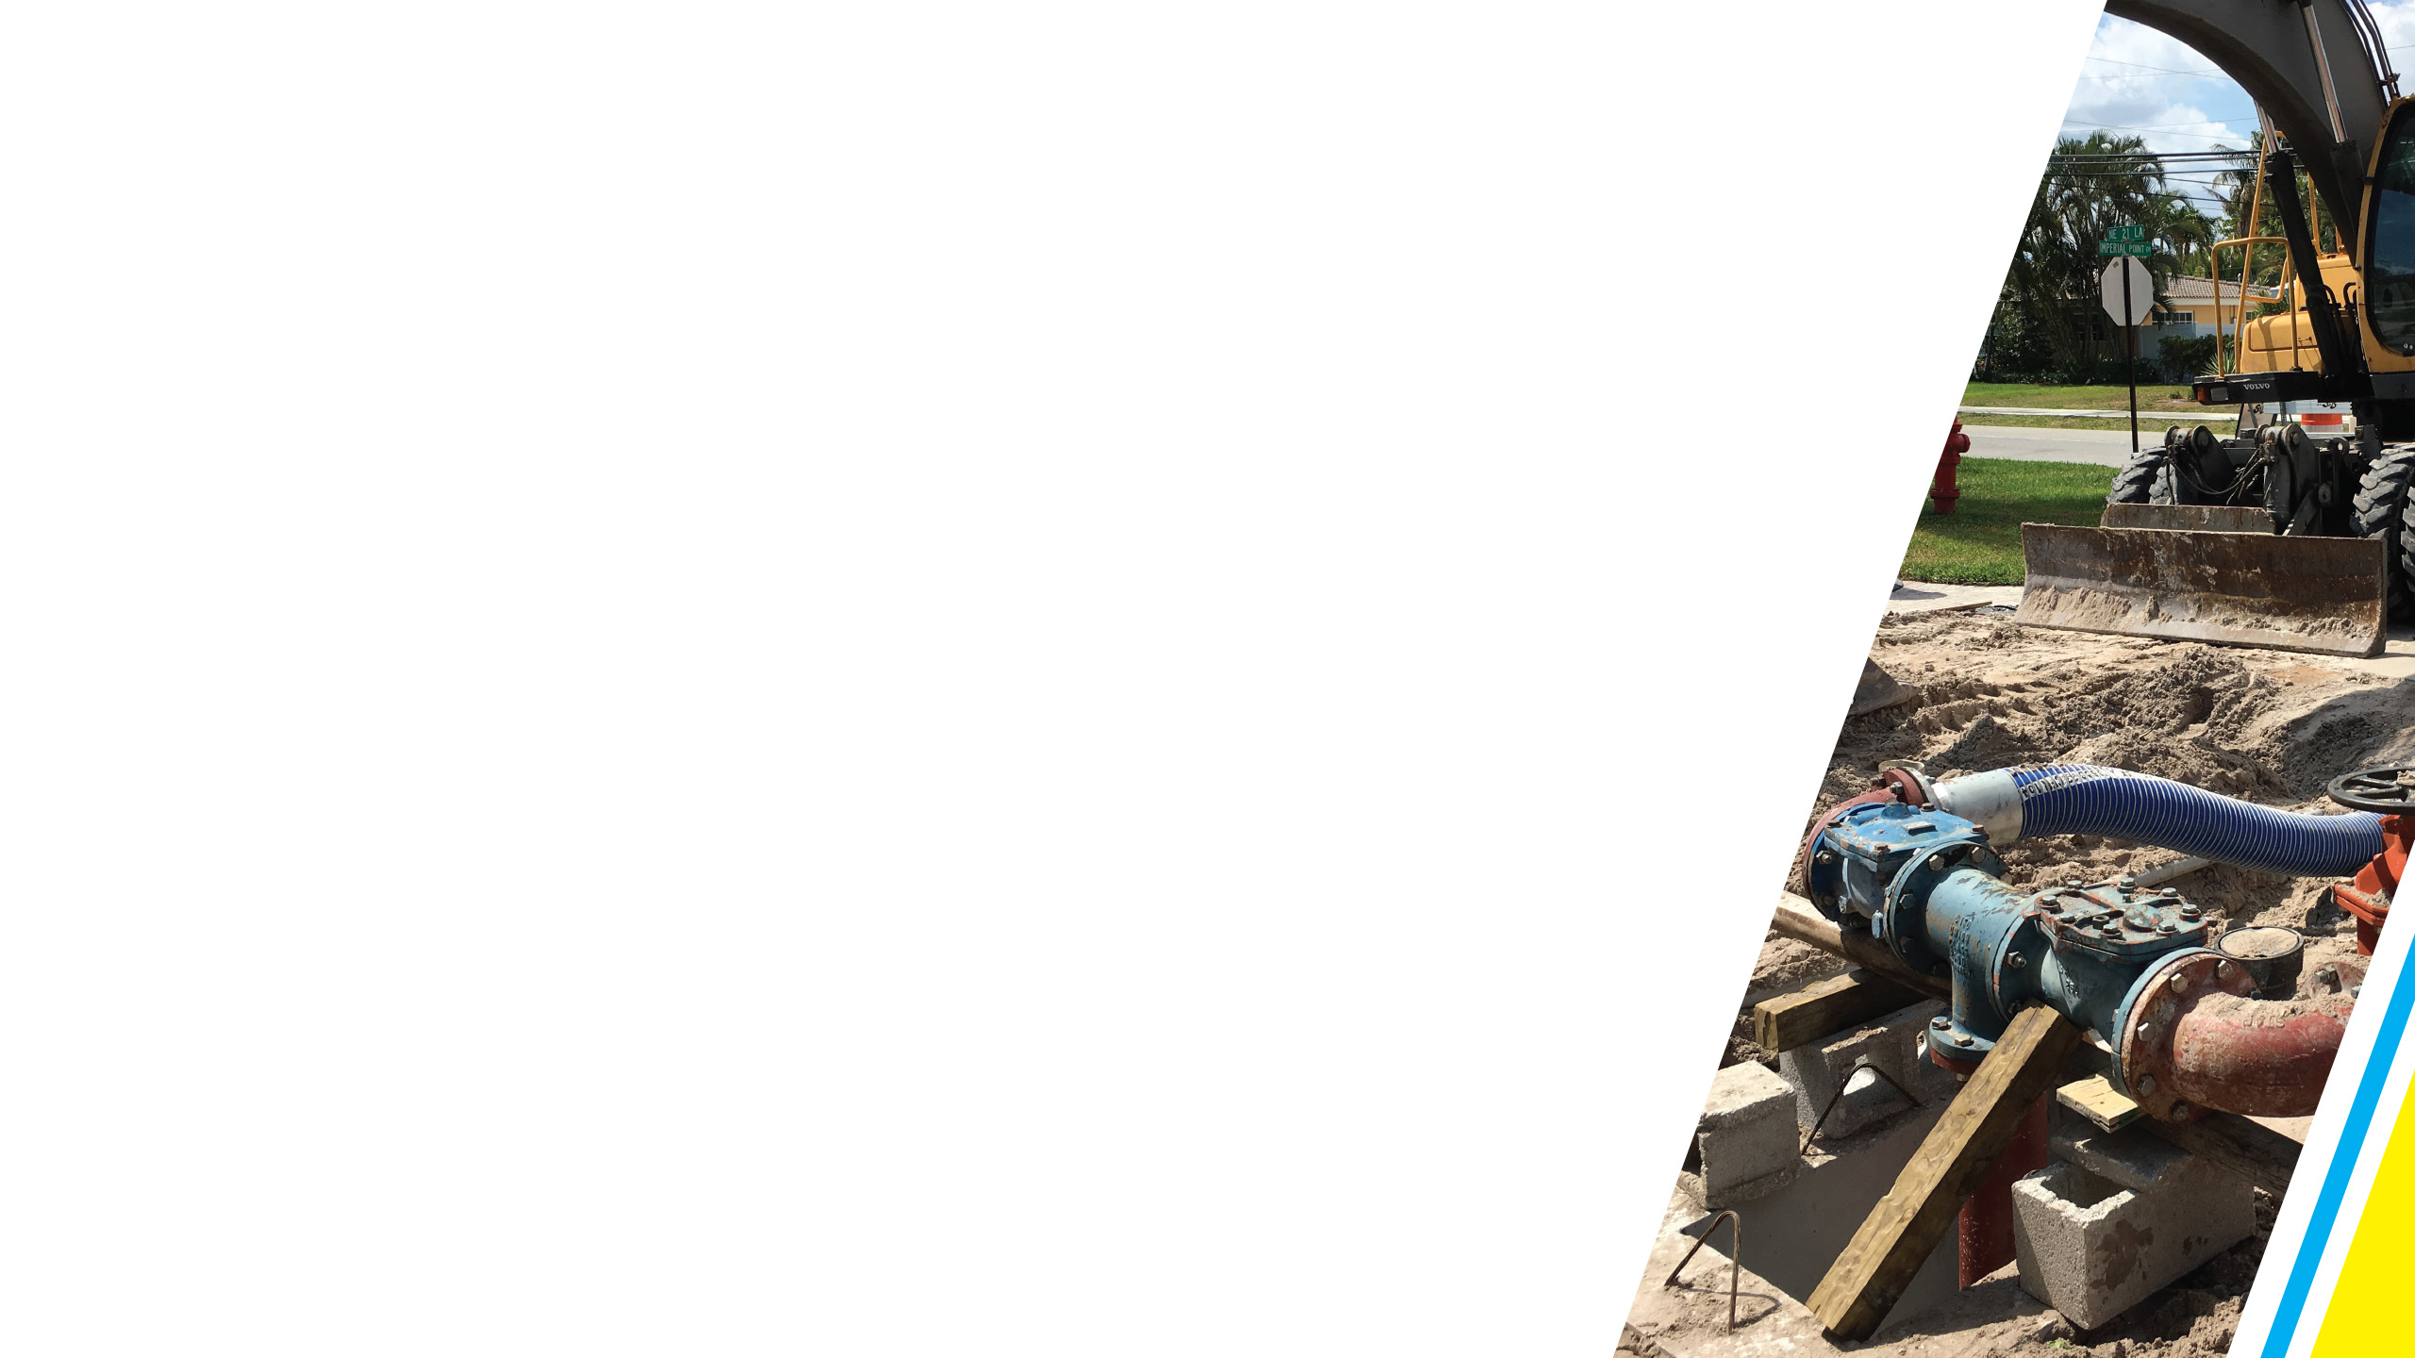
SEWER SYSTEM
43 miles of sewer mains assessed and 1,000 manholes evaluated for potential issues
36 miles of sewers have been lined to
prevent inflow and infiltration
Complete assessment of entire sewer force main system to be completed by March
Complete all work required under consent order well ahead of deadline

Slide 11
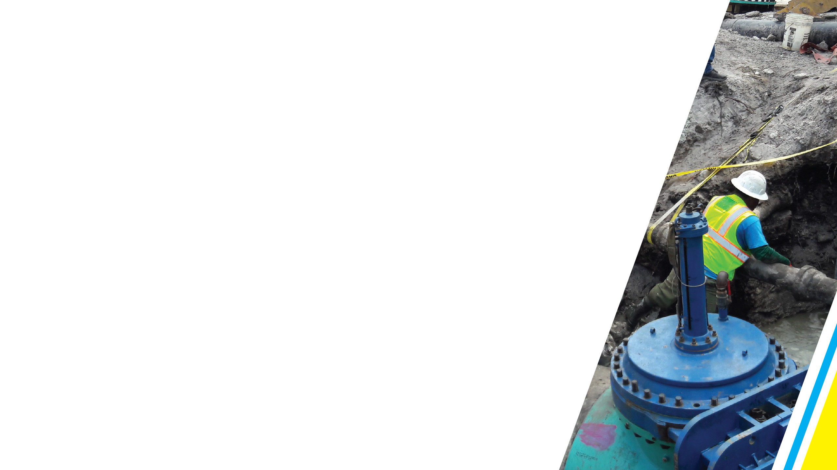
SEWER SYSTEM
$177 million committed for 118 miles of new pipe
$20 million committed to rehabilitate 29 pump stations
$52 million committed for upgrades at the wastewater treatment plant
Work on 3,000-foot deep injection wells to be completed in March

Slide 12

SEWER SYSTEM
Accelerate construction program
Water and sewer impact fees paid by developers were raised for first time since 2005
Sewer impact fee paid by developers tripled; water impact fee increased by 40 percent
Reinvest new revenue into system
Review other impact fees

Slide 13
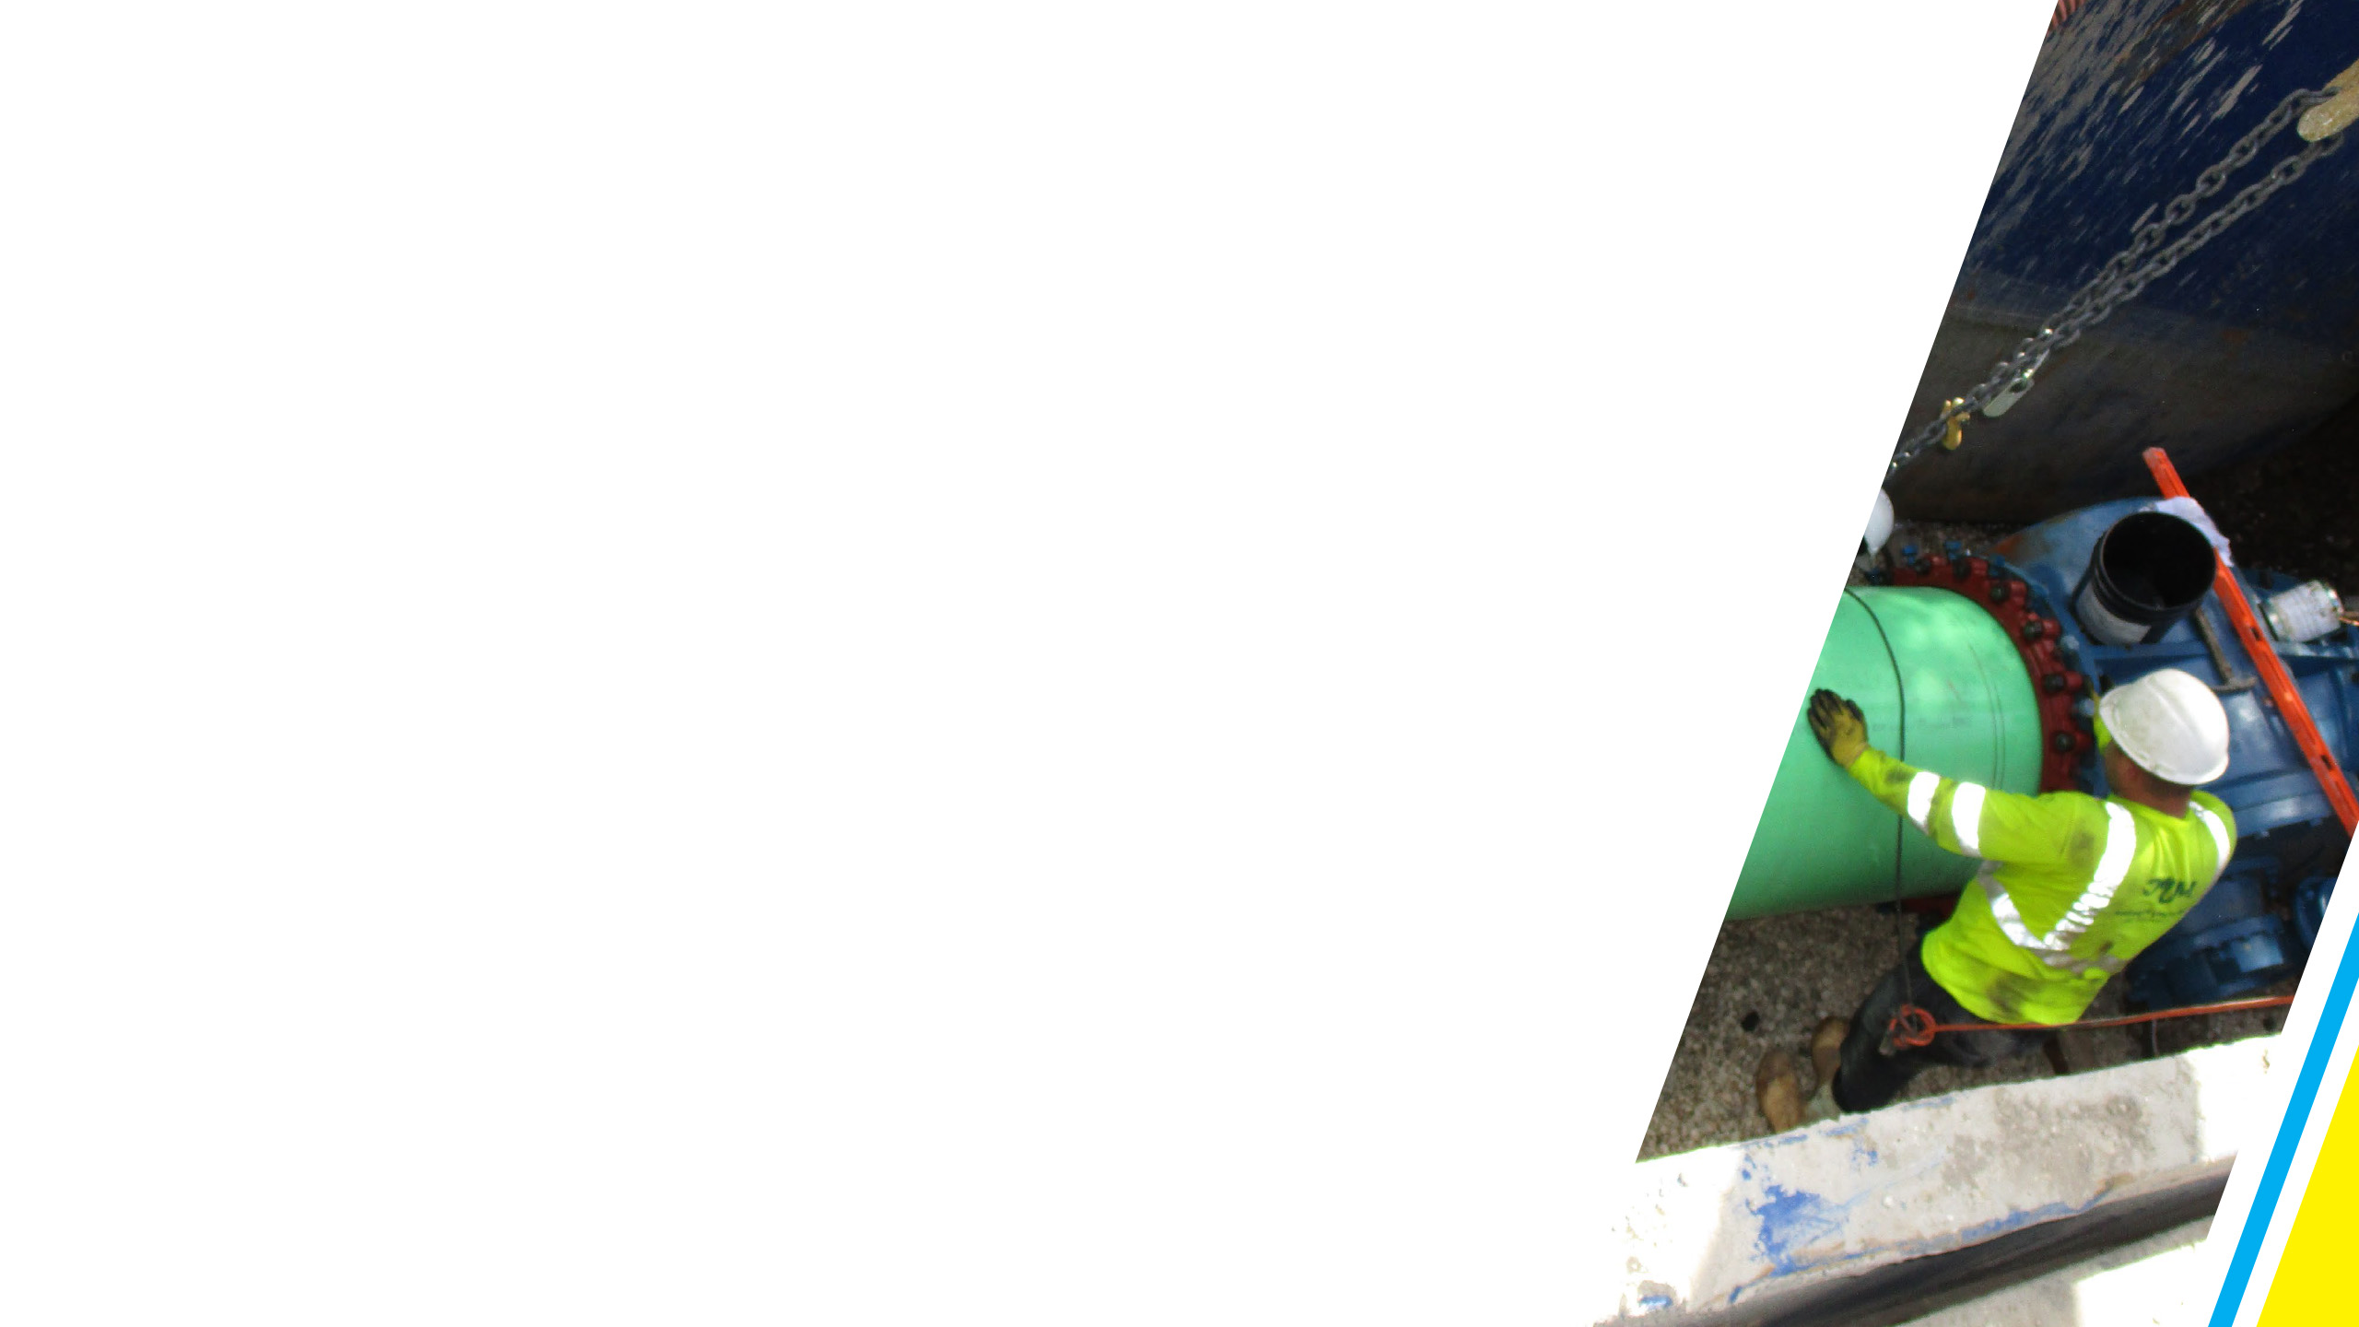
SEWER SYSTEM
Ensure downtown has the capacity to meet development trends
Adding pump stations and redistributing wastewater flow
New downtown pump station will add 1 million gallons of additional daily sewage capacity to downtown area

Slide 14
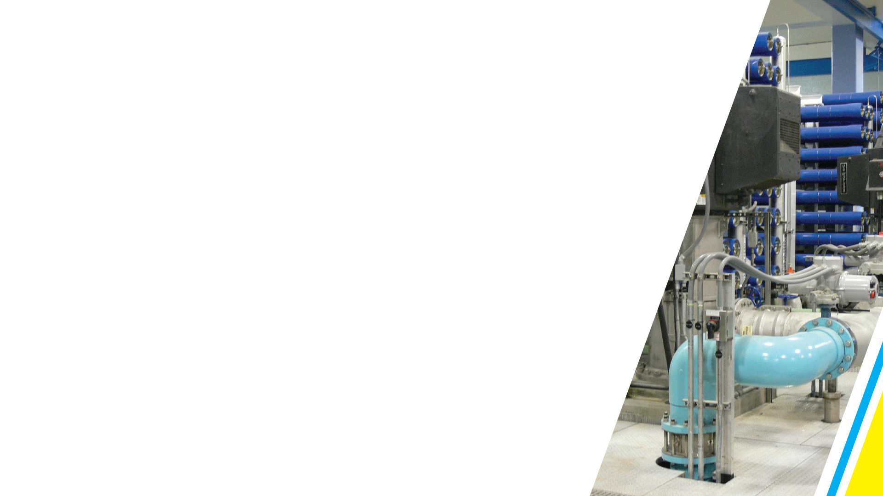

WATER SYSTEM
Replacement of 60-year-old Fiveash Water Treatment Plant is a top priority
Interest in public/private solution to bring efficiency, stable costs, guaranteed maintenance, and better water quality
City has shown cooperative arrangements can work

Slide 15
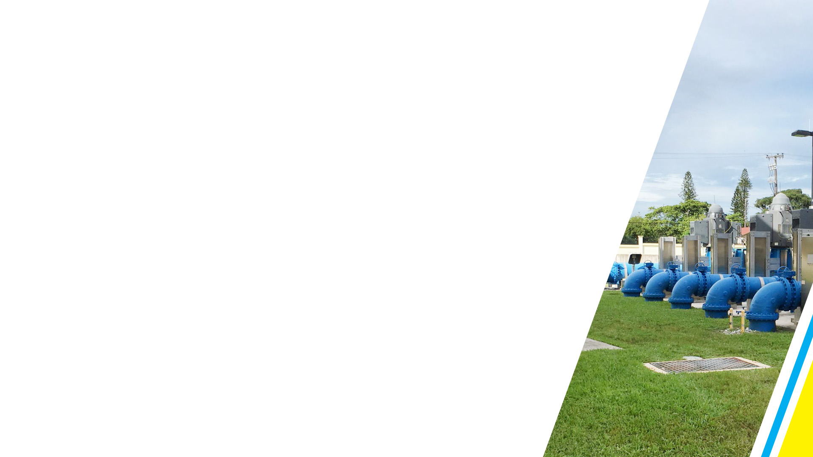
WATER SYSTEM
Four miles of new water mains completed in Croissant Park and Lake Estates
Five miles of new water mains being installed in Victoria Park and
Bermuda Riviera
$53 million committed for 60 miles of new water mains throughout the City

Slide 16
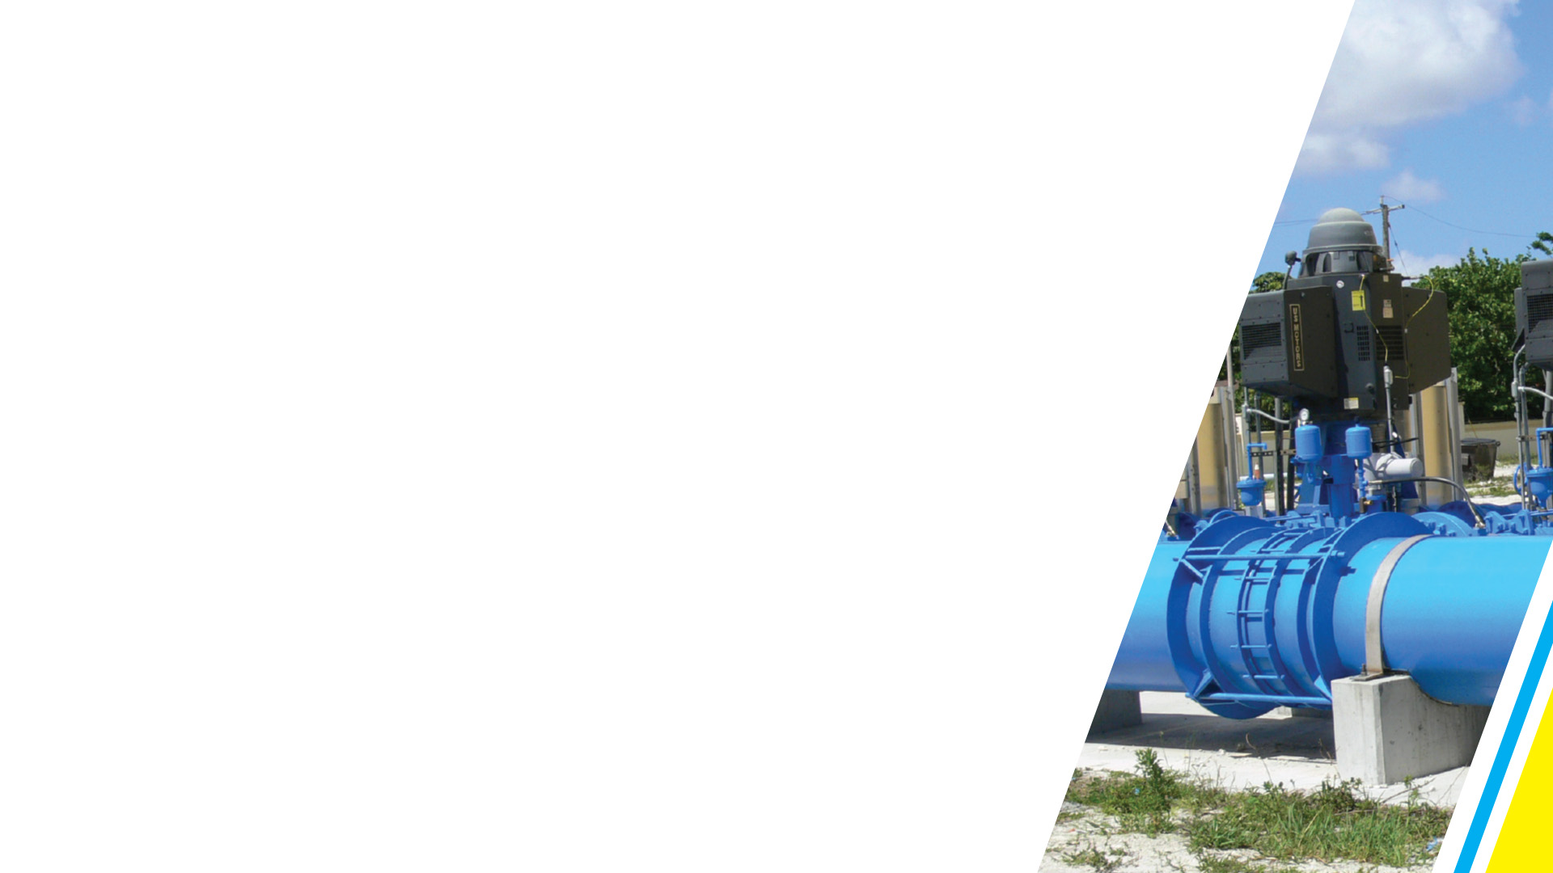
WATER SYSTEM
Mapped 11,224 water distribution valves
Commission approved funding to re-establish a public works crew dedicated to testing and maintaining valves
Computerized modeling of entire water system underway to identify improvements needed
Installed 22 auto-flushing devices; will add 50 more within the next year to remove sediment deposits from pipes

Slide 17

WATER SYSTEM
Upgrading interconnections with city of Pompano Beach for added redundancy
Joining with other local governments in the C-51 Reservoir alternative water supply project to help ensure an adequate water supply for the future
Purchased 3 million gallons of water a day with an option for another 3 million gallons
Upgrading water meter technology

Slide 18
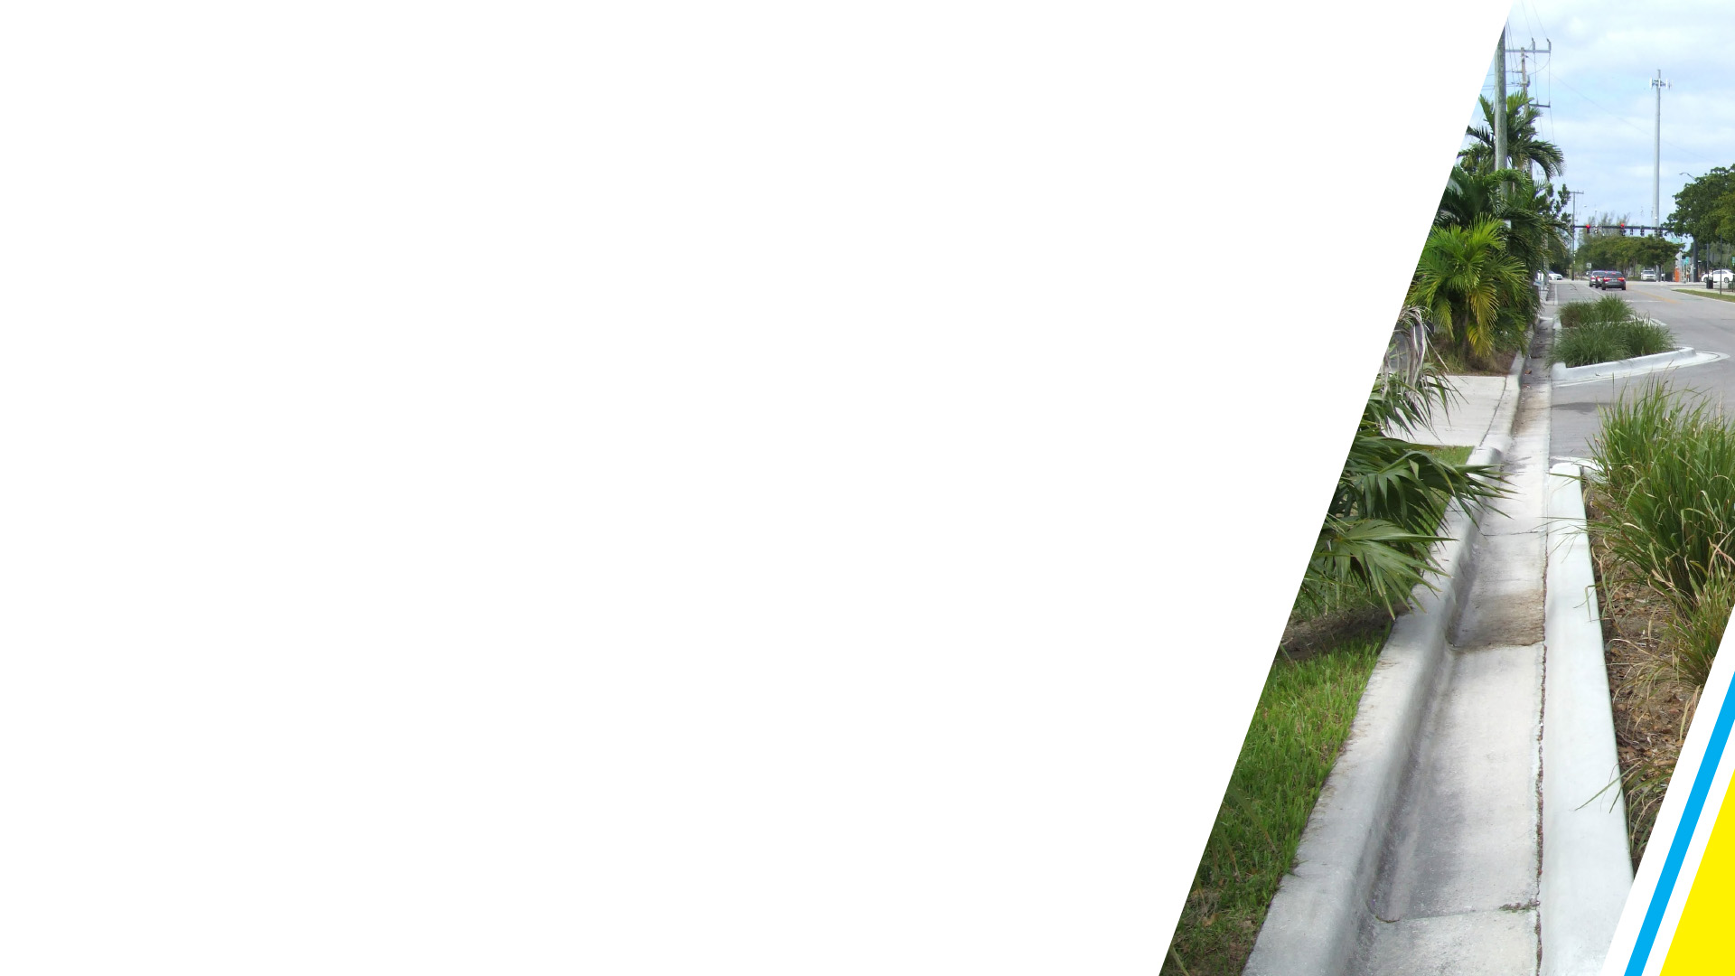
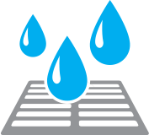
STORMWATER SYSTEM
Progress is being made on addressing the effects of climate change, high tides and sea level rise in low-lying areas
165 tidal valves have been installed in areas prone to tidal flooding
Installing catch basins and drainage pipes
Elevating public seawalls

Slide 19
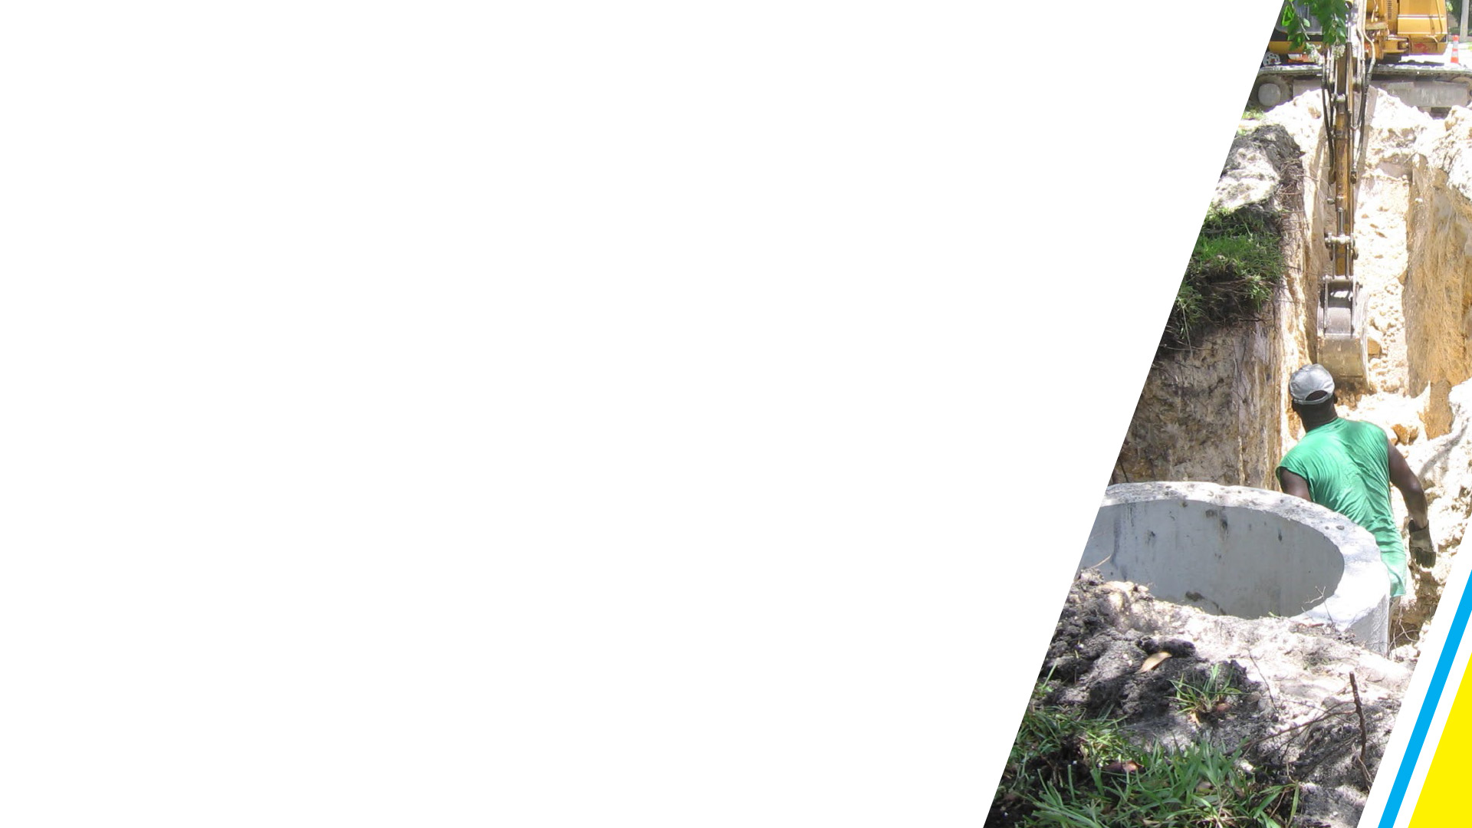
STORMWATER SYSTEM
Investing $200 million for stormwater pump stations, exfiltration trenches, catch basins, stormwater pipes, permeable pavement, swales, and force mains in seven key areas
Repairing or rehabilitating 22 miles of stormwater pipes
Installing another 129 tidal control valves
Building seven new pump stations

Slide 20
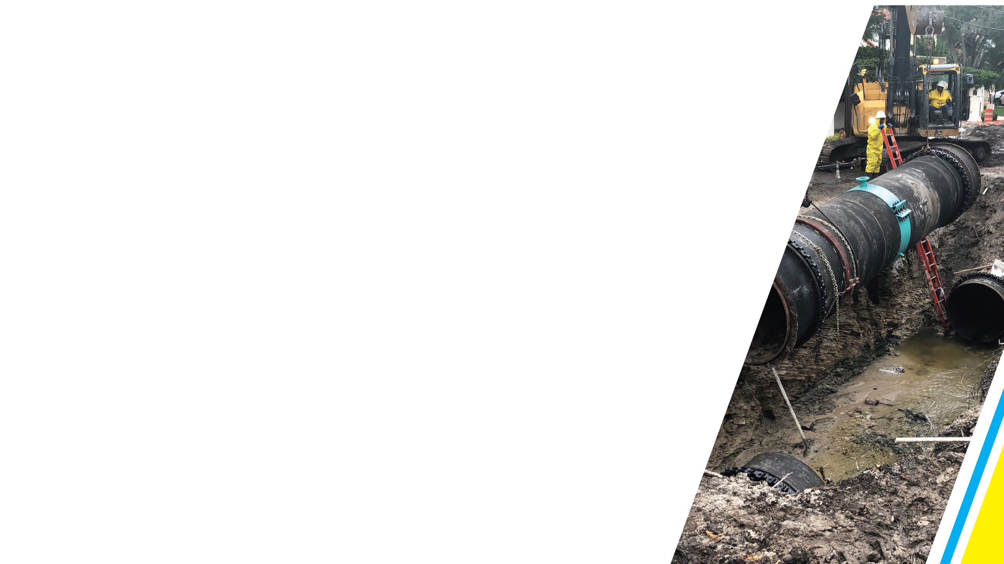

URGENCY
Investing more than $600 million in infrastructure improvements in less than five years
Taking a comprehensive, holistic approach to project management
Expediting work by bundling projects
Using a variety of procurement strategies

Slide 21
URGENCY
Moving forward with a sense of urgency; ensuring that no section of the city is
left behind
Fort Lauderdale will have the utility infrastructure that a modern metropolitan area expects and deserves

Slide 22
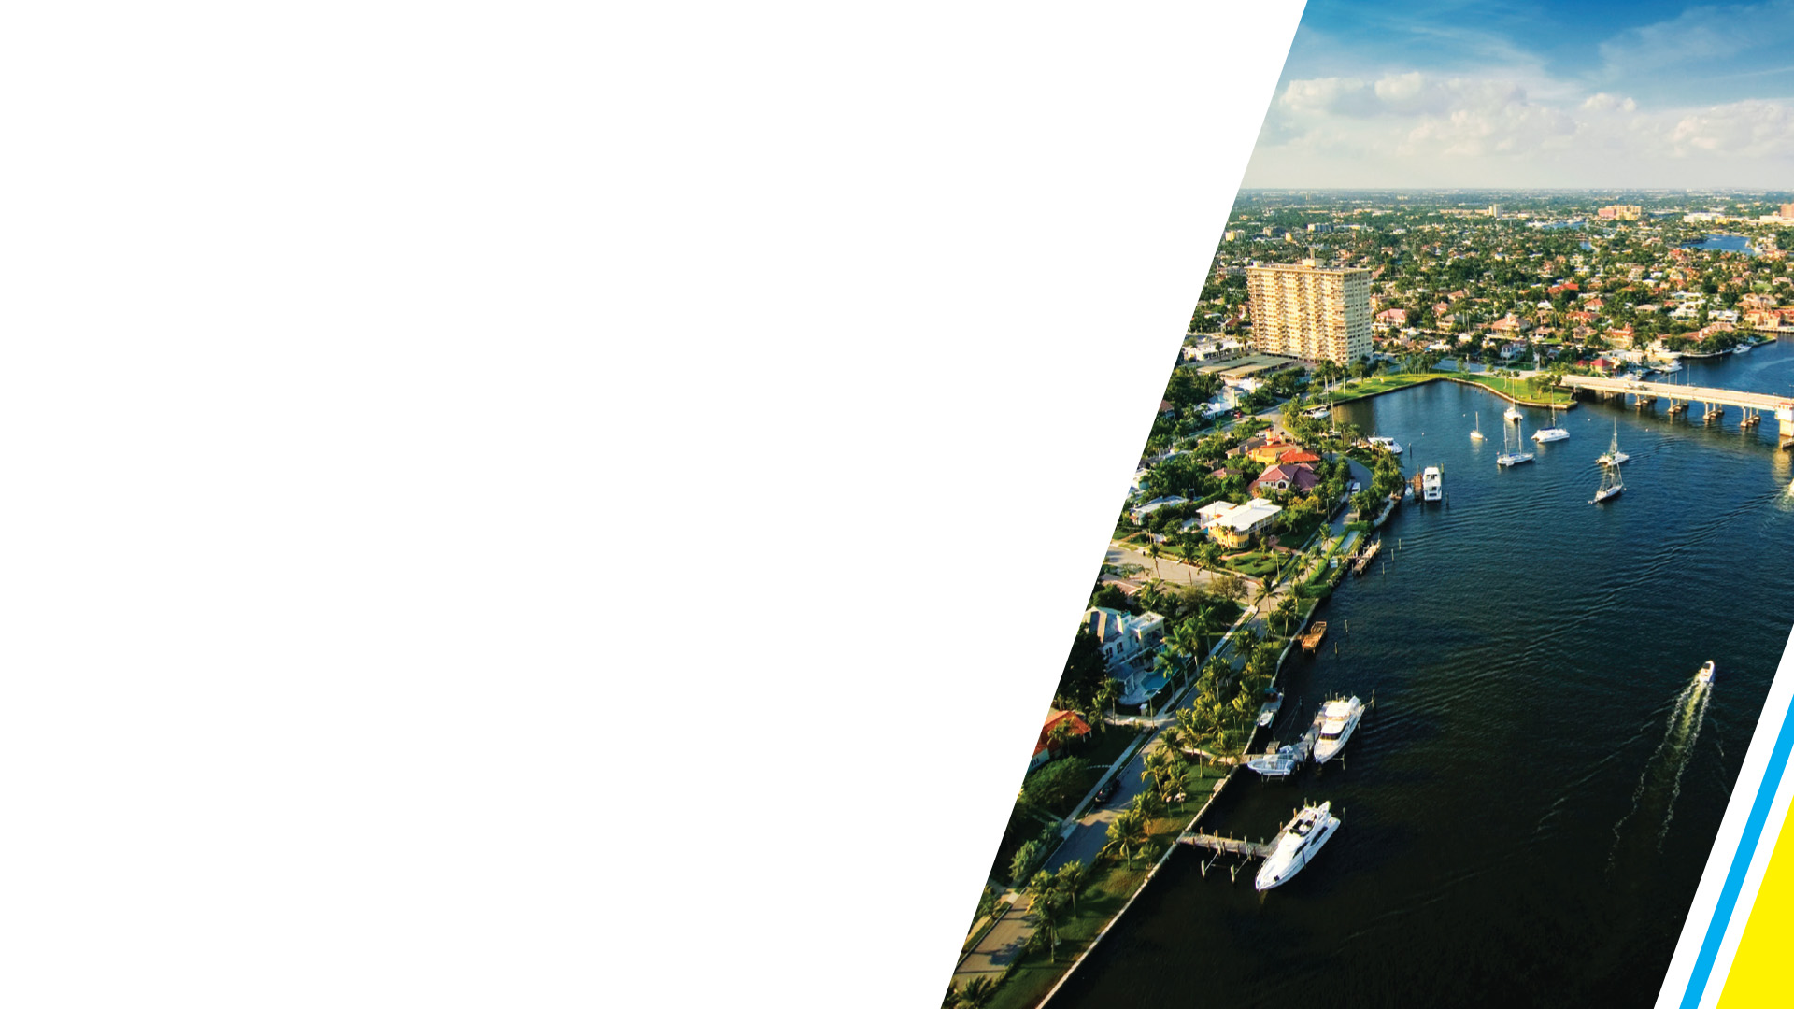
Questions
and Answers

Slide 23


